Slide 1
To Get Started
Paper sheet and online at: http://www.eecs.qmul.ac.uk/~william/CAS-London-2020.html
Download sample notebooks and data
Create directory (N:\session3\fullname)and unzip notebooks and data
Login to Google Colab: https://colab.research.google.com/
Create a new notebook
Use the file ‘upload’ menu to upload the ‘example’ notebook

Slide 2
Introduction to Data Analysis
William Marsh

Slide 3
How This Session Works
Introduce concepts
Practical work
Collaboration: practice teaching!
Repeat
Conclude
Probably Not Enough Time

Slide 4
Outline
Aims
Introducing the Python notebook using Google Colab
Part 1: the dataframe
Part 2: transforming data and the pivot table
Part 3: adding columns
Conclusion and discussion

Slide 5
Session Aims

Slide 6
Aims
Introduce Python Pandas
Popular library for data
Interactive notebook – Google’s Colab
Introduce key concepts
Dataframe
Filter and select
Pivot table
Visualisation
Pandas is very complex
Concepts common in other environments
Excel
RStudio
Help develop pedagogy

Slide 7
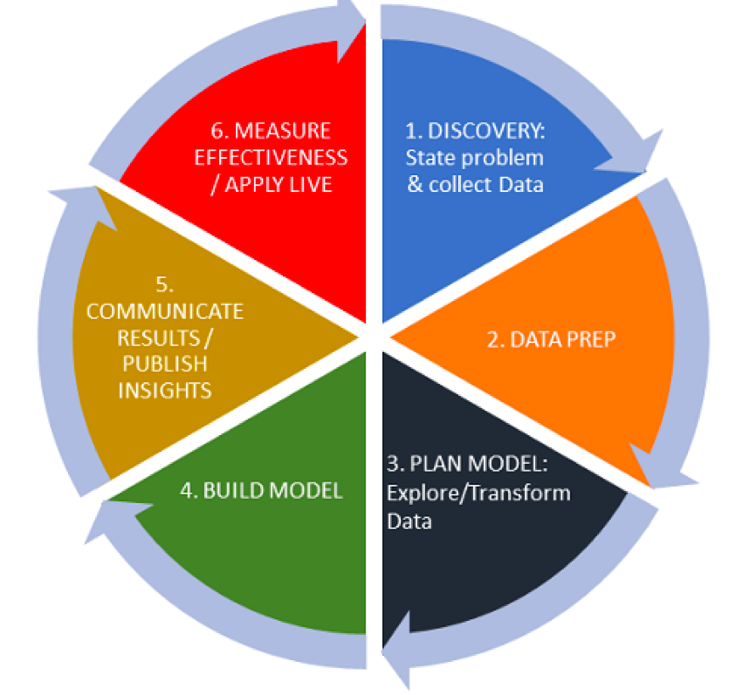
The Data Life Cycle
Using data to answer a question
What is the problem?
.. do we have the data?
Data analysis not just technical
We focus on the technical

Slide 8
Introducing the Interactive Notebook

Slide 9
IPython Notebook
IPython – interactive Python with graphics (2001)
Jupyter – web based interface for IPython (2014)
Also supports other languages
Google Colab
Hosted support for Jupyter on Google Drive
Better interface
Concept: program as an executable document

Slide 10
New, upload, save
Text: written in ‘markdown’
TOC: from ‘sections’
Code cell and output
Run button

Slide 11
Practical Break
Please try the ‘example’ notebook

Slide 12
Part 1: The Dataframe
Introducing the Python Pandas Library

Slide 13
The Data Frame
Header row
Shows the columns
Rows
Shows individuals
Tidy data
All columns have headings
All columns same ‘type’ (e.g. numbers)
No blanks
 | Name | Age | Team
0 | John | 24 | Arsenal
1 | Mary | 27 | Spurs
2 | Peter | 31 | Chelsea
,Name,Age,Team
0,John,24,Arsenal
1,Mary,27,Spurs
2,Peter,31,Chelsea
Loaded from CSV

Slide 14
The Data: Country of Birth
Taken from 2011 census
67,252 row
Example of ‘narrow’ or ‘tall’ data
Area | Age | Sex | Usual Residents | Birth Country | Birth Region
Tower Hamlets | Age 0 to 4 | Females | 3 | Ghana | Africa
Tower Hamlets | Age 5 to 9 | Females | 2 | Ghana | Africa
Tower Hamlets | Age 10 to 15 | Females | 4 | Ghana | Africa

Slide 15
Investigating the Data
Task 1.1: Load the data to a dataframe
Task 1.2: Look at values the unique values in each column
Answer some questions about the data
Column | Description
Area | Includes London Boroughs
Age | The ages in a number of bands
Sex | Males and Females
Usual Residents | An integer
BirthCountry | A country
BirthRegion | A region e.g. Africa or Europe

Slide 16
Getting Help
Pop up help
Pandas documentation - https://pandas.pydata.org/docs/
API – many optional arguments
User guides

Slide 17
Practical Break
Part 1: ‘Data analysis’ notebook

Slide 18
Part 2: Selecting, Transforming and visualising Data
Data transformation: Tall to Wide
The Pivot Table

Slide 19
What Questions Can this Dataset Answer?
How many people from the Americas live in Sutton?
Which Borough has the ‘most’ young people?
What age are people born outside the UK?
...
What additional information is missing?

Slide 20
Selecting and Transforming Data
Selecting some data
Data for one borough
... or one age group
... or one country or region
Use conditions
No loops
df[(df['Area']=='Tower Hamlets')]
df[(df['Area']=='Tower Hamlets’) & (df['Age'] =='Age 0 to 4')]

Slide 21
The Pivot Table
Person | Genre
 | Classic | Jazz | Folk
Andy | Like | Hate | Hate
Bill | Hate | Like | Like
Charlie | Like | Like | Hate
Transform data
Origin in spreadsheets
Person | Genre | Rating
Andy | Classic | Like
Andy | Jazz | Hate
Andy | Folk | Hate
Bill | Classic | Hate
Bill | Jazz | Like
Bill | Folk | Like
Charlie | Classic | Like
Charlie | Jazz | Like
Charlie | Folk | Hate
Genre | Person
 | Andy | Bill | Charlie
Classic | Like | Hate | Like
Jazz | Hate | Like | Like
Folk | Hate | Like | Hate

Slide 22
The Pivot Table
Aggregate over the places
Transform data
Purpose | Visits
 | Andy | Bill | Charlie
Hols | 4 | 0 | 3
Work | 5 | 7 | 0
Person | Place | Purpose | Visits
Andy | Berlin | Hols | 1
Andy | Berlin | Work | 2
Andy | Paris | Hols | 2
Andy | NY | Work | 3
Andy | Madrid | Hols | 1
Bill | Berlin | Work | 4
Bill | Paris | Work | 3
Charlie | Paris | Hols | 1
Charlie | Rome | Hols | 1
Charlie | Zurich | Hols | 1
Purpose | Visits
 | Berlin | Madrid | NY | Paris | Rome | Zurich
Hols | 1 | 0 | 3 | 3 | 1 | 1
Work | 6 | 1 | 0 | 3 | 0 | 0
Aggregate over the person

Slide 23
Practical Break
Part 2: ‘Data analysis’ notebook

Slide 24
Part 3: Adding Columns

Slide 25
The Problem of Comparing Boroughs
Boroughs vary in population
What does this question mean?
Need to transform the data into ‘proportion’
Where in London do most people born in Spain live?

Slide 26
Proportion of Borough Born in Each Region

Slide 27
Practical Break
Part 3: ‘Data analysis’ notebook

Slide 28
Summary and Discussion

Slide 29
Summary
Discussion Questions
What is emphasis of curriculum?
Should we use a large data file?
Is the complexity of Pandas manageable?
Balance of technical versus ‘interpretation’ of data
The environment
Web-based Interactive Python
Does not have to be hosted
The Pandas library
Comprehensive but complex
Key concepts
Dataframe and selecting data
Transforming: pivot table
Visualizing: plot

