Slide 1
Kodz: a brief look at coding theory. John R. Woodward
How can we transmit a signal from one point to another ensuring minimal error? What is more, if we detect an error, how can we potentially recover the original signal? In this talk, we will look at a branch of mathematics and computer science called coding theory. We will look at some of the basic concepts such as error checking and error correcting code. These ideas will be illustrated with some examples from everyday situations.
Note use presenter view.
Notes:
How would you write “codes”
With a z
A child would
Perhaps an american

Slide 2
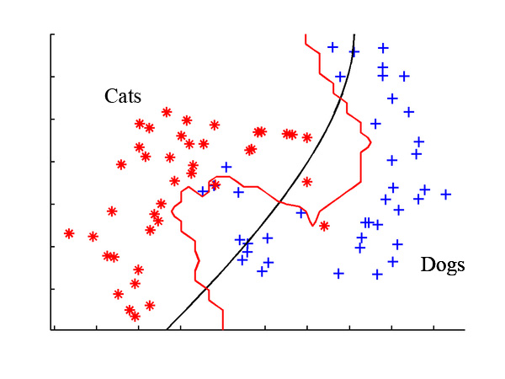
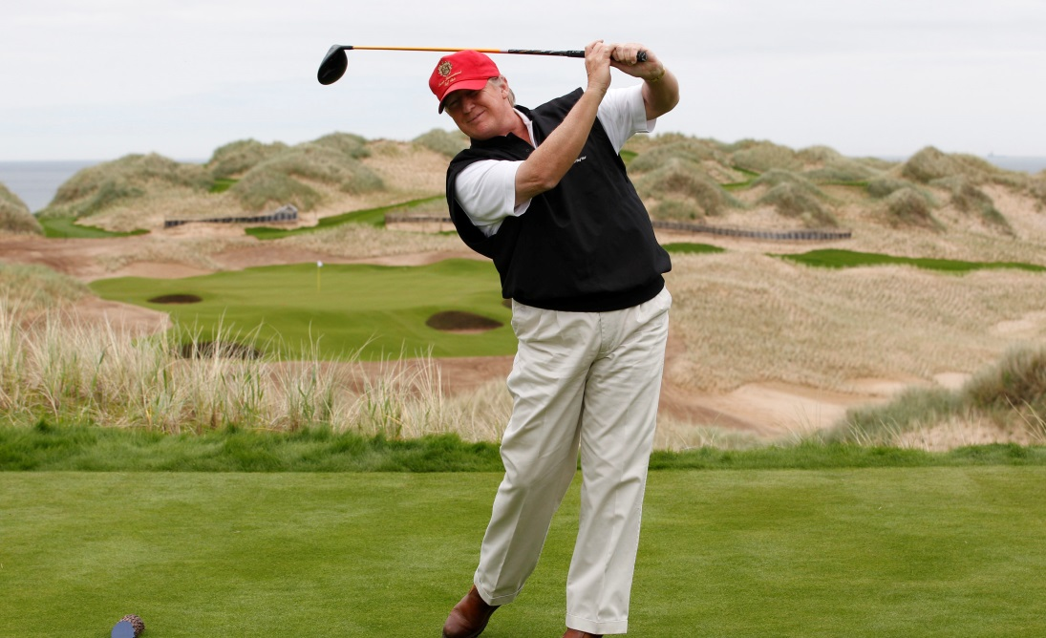
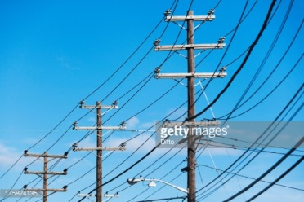
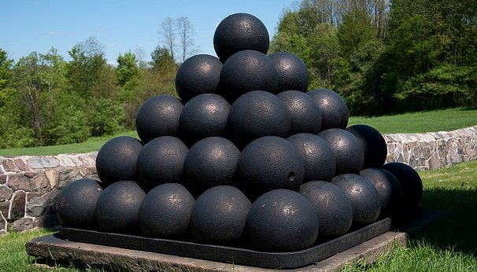
What do the following have in common

Slide 3
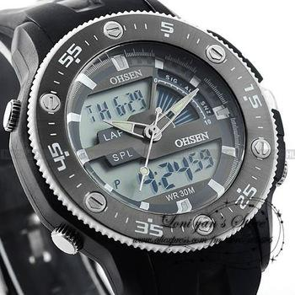
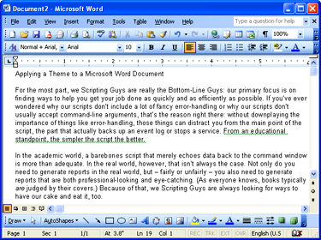
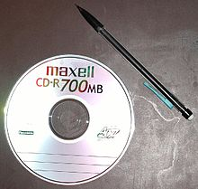
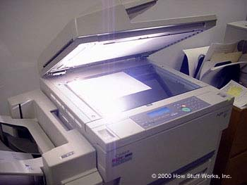
Analogy vs Digital
Notes:
Lets transmit an analogy signal
Copy tapes deteriorate
Photo copy deteerial
Copy a word doc – does ot deteriorr.
graceful degradation

Slide 4
continuous
Discrete

Slide 5
Lets transmit
a signal
1/ analogy
2/ digital

Slide 6
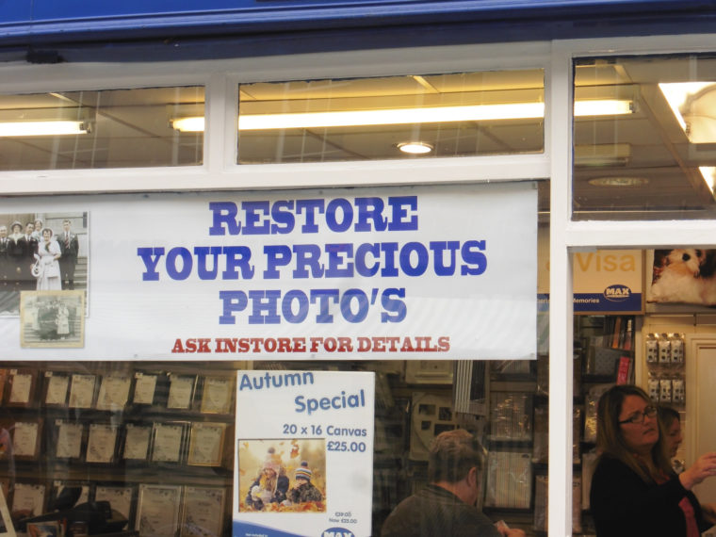
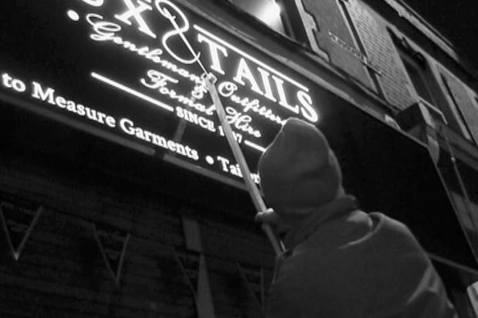
We do not verbalize punctuation
dot the i's and cross the t's
dot the is and cross the ts
String of 0s and 1s
String of 0’s and 1’s
We do not differentiate between these when we speak.

Slide 7
Grrr?
Boys school
Mens haircuts
Visitors carpark
Magistrates court
Where does the apostrophe go??

Slide 8
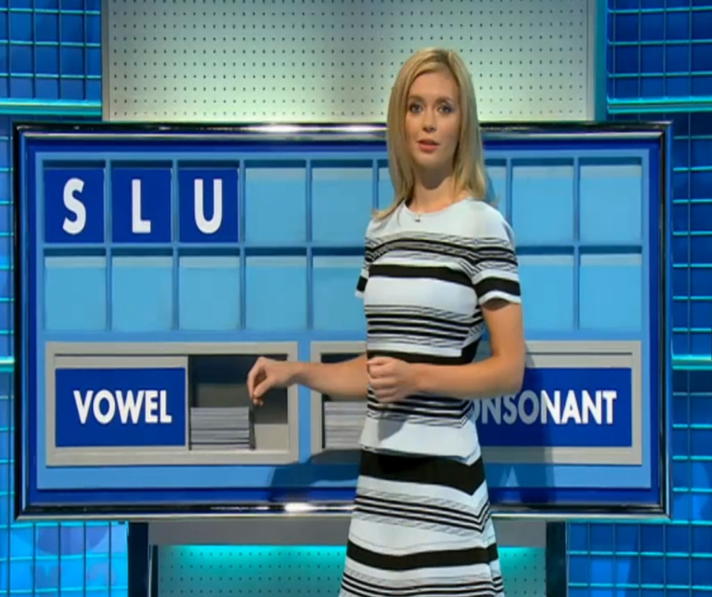
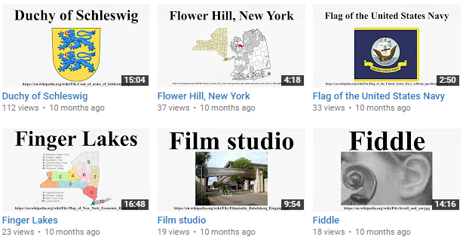
Vowels and Consonants
Vowels – message
Consonants – emotion/accent.
It is not what you say it is the way you say it
WikiAudio https://www.youtube.com/watch?v=-dYJ0u4U9aQ

Slide 9
What do the following sentences say.
Th qck brwn fx jmps vr th lzy dg
lv prs n th sprngtm.
Y cn d nythng bt nt vrythng.

Slide 10
answers
The quick brown fox jumped over the lazy dogs.
I love Paris in the springtime.
You can do anything but not everything.

Slide 11
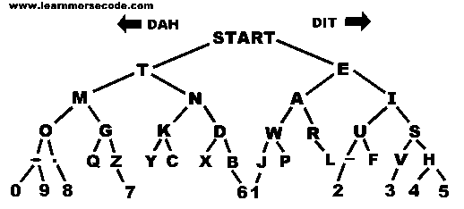
Morse code tree

Slide 12
Morse code tree
… --- … 2) --- -- --.

Slide 13
Morse code tree – no reducdancy
… --- … SOS 2) --- -- --. OMG

Slide 14
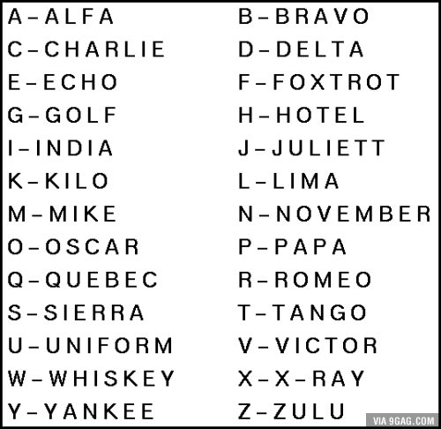
English is not Perfect
Essay – SA.
homophones
Read – past and present.
Phonetics code. Each sound has one symbols
Record record (noun and verb – import export) mark stress.
English alphabet is a poor encoding of sounds
How would you say ghoti.

Slide 15
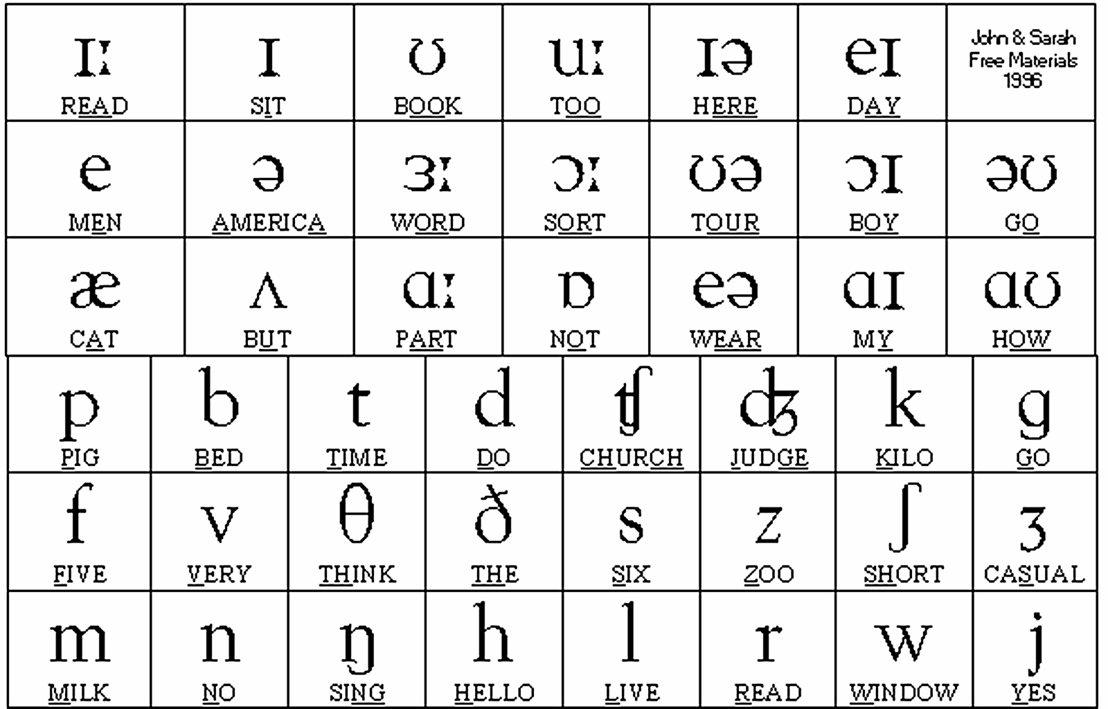
Ghoti = fish
gh = /f/ as in enough. o = /i/ as in women. ti= /sh/ as in nation.

Slide 16
Notes:
Try lip read brexit.
Bravo, romeo, echo,
Xray, india, tango.

Slide 18
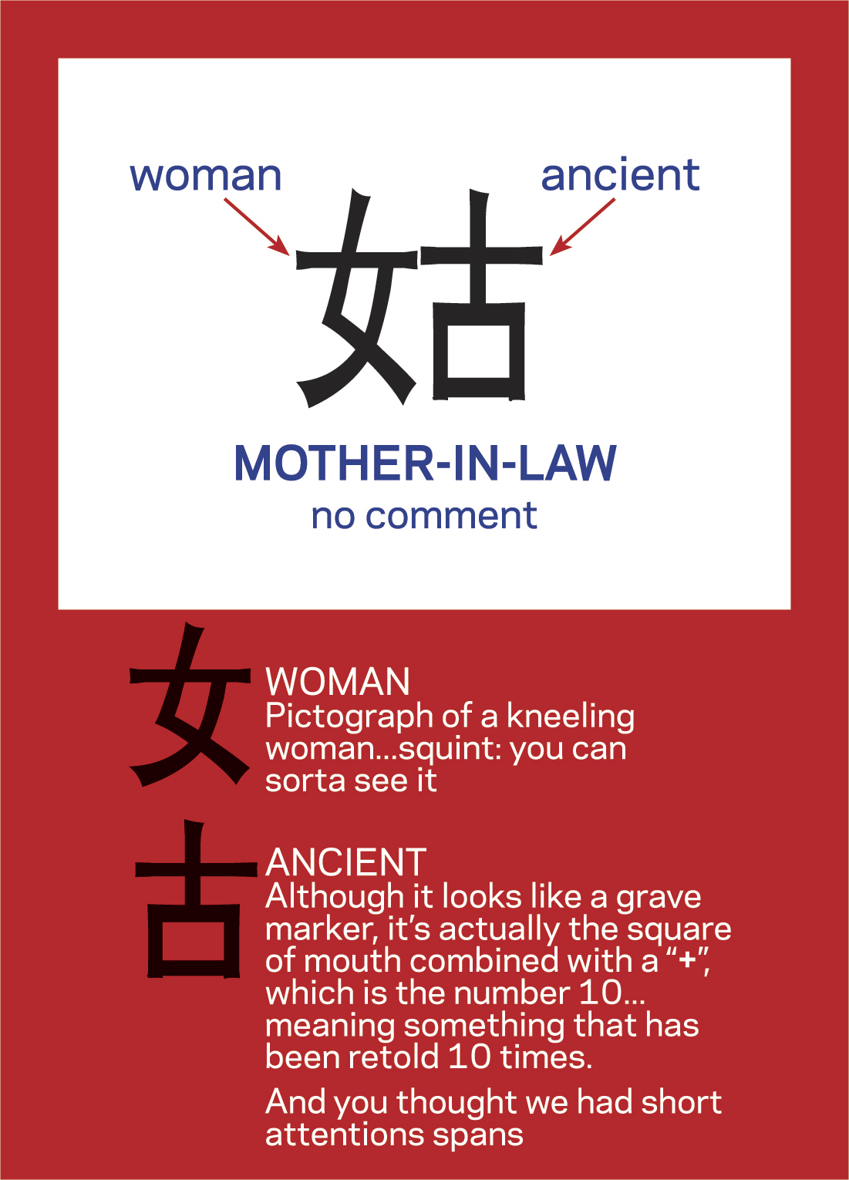
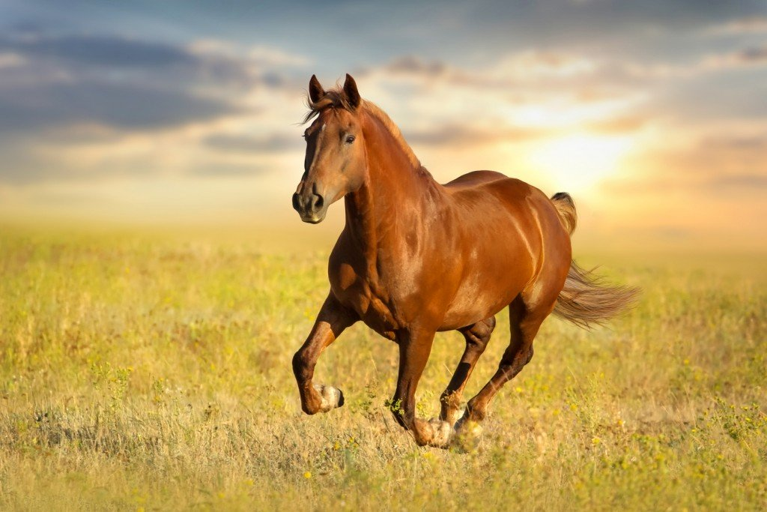

Slide 19
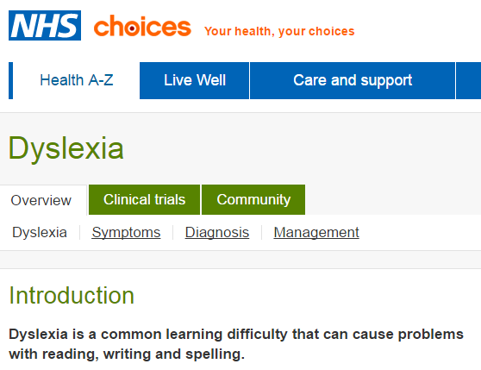
Hypothesis - phonetic languages
Do phonetic languages have less jokes.
Do phonetic languages have more consistent pronunciation?
Is dyslexia as common in countries with phonetic languages.

Slide 20
Redundancy in Natural Language
He put his hands in his pockets
彼は彼のポケットに彼の手を入れた
彼はポケットに彼の手を入れた
彼はポケットに手を入れた
ポケットに手を入れた
Notes:
Sparse langauge.
1st 2nd 3rd,

Slide 21
Emergency Numbers
999 UK
911 in USA
119 in Japan
Mobile phone numbers are separated.

Slide 22
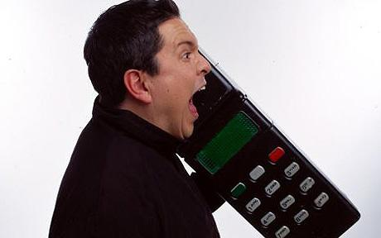
EXPT: misdial a mobile number – you probably do not get a valid number

Slide 23
True/false 0/1
Students need to transmit the following info.
Exam – question on binary arithmetic
Answers were 0 or 1
Exam – questions on logic
Answers are T or F (of course True/False)

Slide 24
Drawing a cube
A line 1st digit
0=left, 1=right
011
111
01
A square.
2nd digit
0=bottom
1=top
11
010
110
0
1
001
101
00
10
000
100
For example 010 = Left, top, front.
Think of coordinates in 3 dimensions
A cube.3rd digit0=front,1=back
The process is as follow;
Draw a line – label each end 0, 1.
Make a copy of this and join corresponding vertexes.
Add a new coordinate 0 or 1.
Repeat this process.

Slide 25
0111
1111
0110
1110
0101
0100
1100
1101
0010
1010
0000
1000
0011
1011
0001
1001
4th bit = inside or outside cube

Slide 26
1 bit – cannot tell if we made a mistake
A line 1st digit
0=left, 1=right
0
1
Notes:
If we make a mistake we do not know which we meant.

Slide 27
2 bits – we can detect mistakes, but cannot correct
01
11
A square.
2nd digit
0=bottom
1=top
00
10

Slide 28
3 bits – we can correct
Words
YES
NO
011
111
010
110
001
101
000
100
A cube.3rd digit0=front,1=back

Slide 29
3 bits – DISTANCE ONE APART
Words
YES
NO
011
111
010
110
CODE
WORDS
001
101
000
100
A cube.3rd digit0=front,1=back

Slide 30
3 bits – DISTANCE TWO APART
Words
YES
NO
011
111
010
110
CODE
WORDS
001
101
000
100
A cube.3rd digit0=front,1=back

Slide 31
3 bits – DISTANCE THREE APART
Words
YES
NO
011
111
010
110
CODE
WORDS
001
101
000
100
A cube.3rd digit0=front,1=back

Slide 32
1 = yes 0 = no CODE AS 111= YES, 000 = NO

Slide 33
What if there is a mistake
Notes:
Majority vote

Slide 34
Perfect code

Slide 35
In 7 dimension

Slide 36
7 edges going out

Slide 37
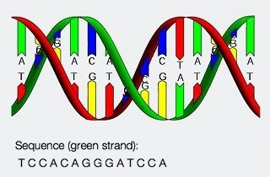
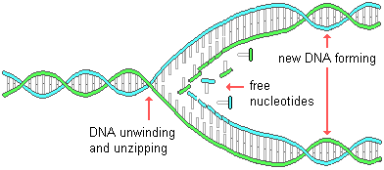
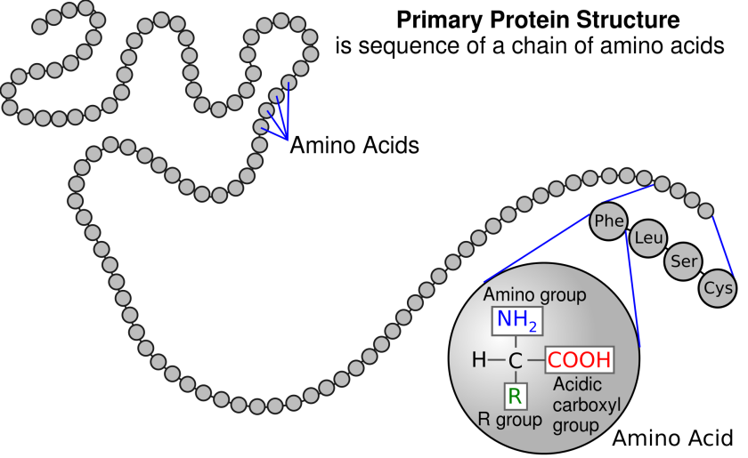
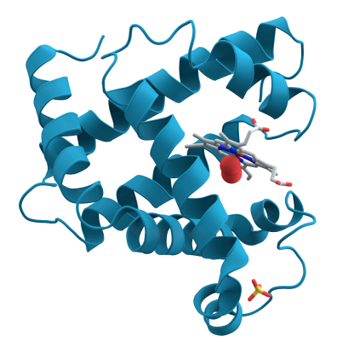
Genetic Code 1
4 BASES A-U C-G
20 AMINO ACIDS

Slide 38
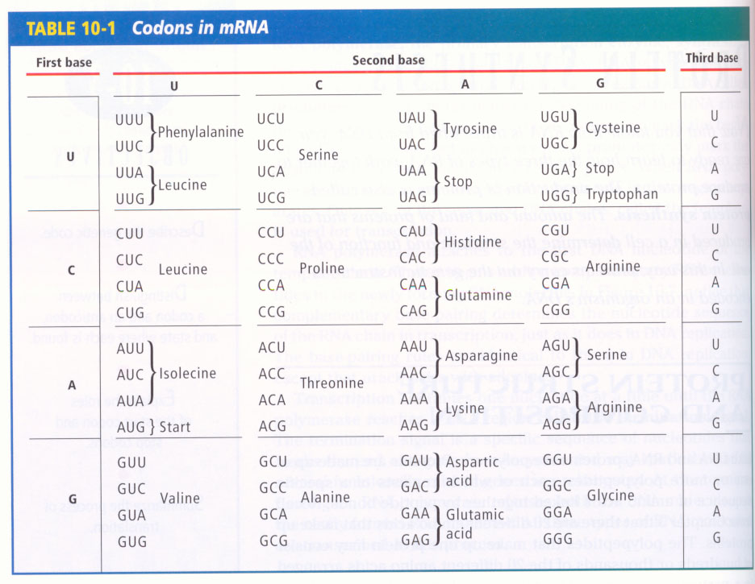
Genetic Code
Genetic Code 2

Slide 39
Genetic Code 3
No gaps
Use 3 bases (ATCG) not 2 or 4 for 21 code words (20 amino acids + stop)
Instantaneous – needed!
Even if mistake is made in last base – often okay – grouped (locality/redundancy)
Even if wrong amino acid – still has similar chemical properties.

Slide 41
Working in a bar
Teacher : touch the left wall
Notes:
Say “bar”
Lips “far or bar”

Slide 42
McGurk Effect
Say “bar”
Lips “far or bar”
https://youtu.be/G-lN8vWm3m0?t=1m15s
Notes:
Say “bar”
Lips “far or bar”

Slide 43
Add a Parity Bit to a message
Par = equal
Parity is zero (false) for EVEN 0, 2, 4, 6, ….
Parity is one (true) for ODD 1, 3, 5, …
MESSAGE = 1011
The “total” = 3, which is odd, parity is 1
Supplemented message = 10111
An extra “1” is added

Slide 44
Following message
Is the following message corrupted?
01011

Slide 45
Following message
Is the following message corrupted?
01011
The message is 0101, (first 4 bits)
sums to 2 (= 0+1+0+1)
which is EVEN
So parity should be 0
We see 01011 but expected 10100 (???)

Slide 46
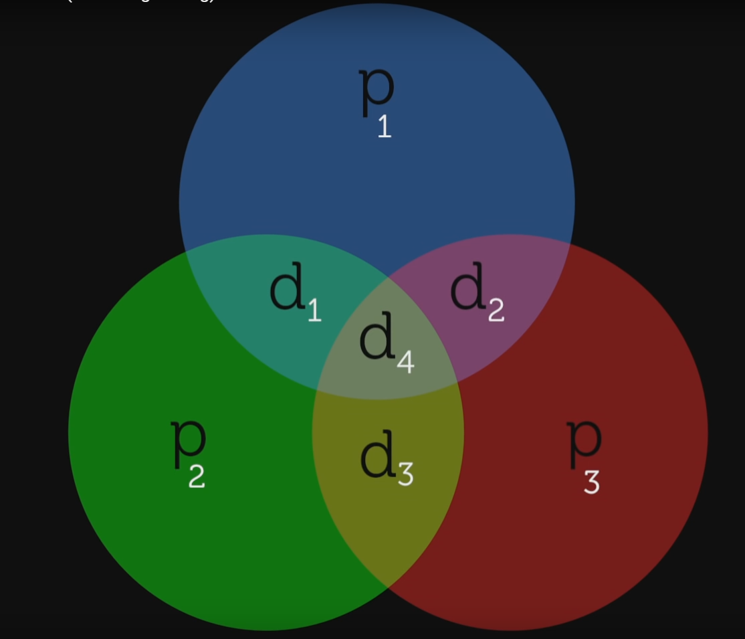
To detect AND correct
We need to add more parity bits
4 data bits
3 parity bits

Slide 47
Parity of 3 data bits in circle

Slide 48
Standard sequence (D=data, P=parity)

Slide 49
Parity is consistent.

Slide 50
OOPS we have a single error

Slide 51
2 or more parity bits will be incorrect

Slide 52
intersection tells us the corrupted bit

Slide 53
Parity bits carry no new information

Slide 54
Shortcut for hamming code
https://www.youtube.com/watch?v=JAMLuxdHH8o

Slide 55
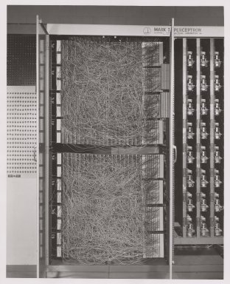
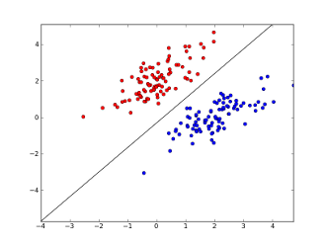
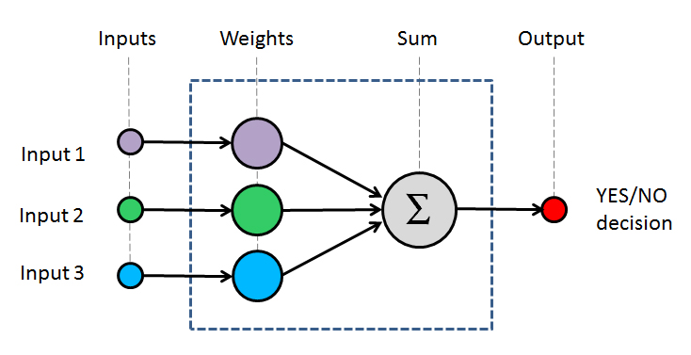
Perceptrons
male
female

Slide 56
Linearly Separable Data + Non-Linearly Separable Data +
Exam mark
Assessment mark

Slide 57
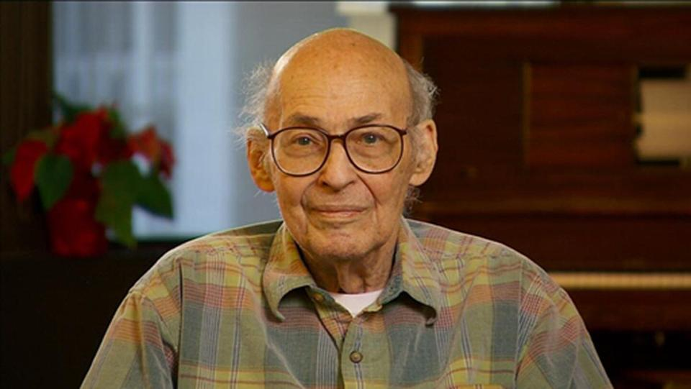
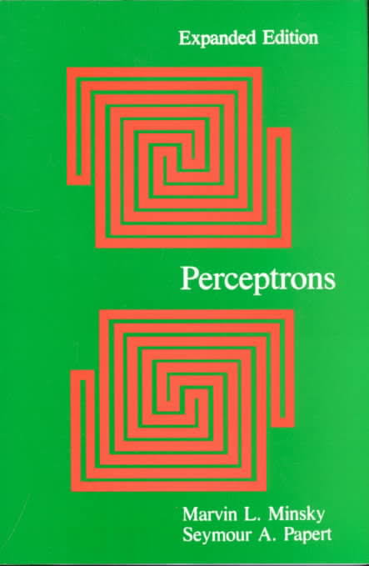
XOR PROBLEM
01
11
00
10
Can you draw a straight line to separate the ticks and crosses

Slide 58
Add a parity bit.
011
110
000
101

Slide 59
Now plot in 3D
Can we
Separate
With a
Line
now
011
111
010
110
001
101
000
100
A cube.3rd digit0=front,1=back

Slide 60
Join 4 cities with the least road length
X
X
X
X

Slide 61
Join 4 cities with the least road length
X
X
X
X

Slide 62
Join 4 cities with the least road length
X
X
X
X

Slide 63
Join 4 cities with the least road length
X
X
X
X

Slide 64
solution

Slide 65
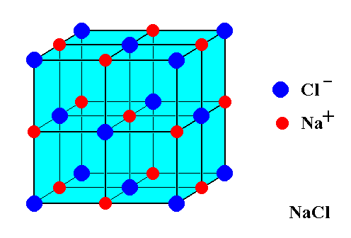
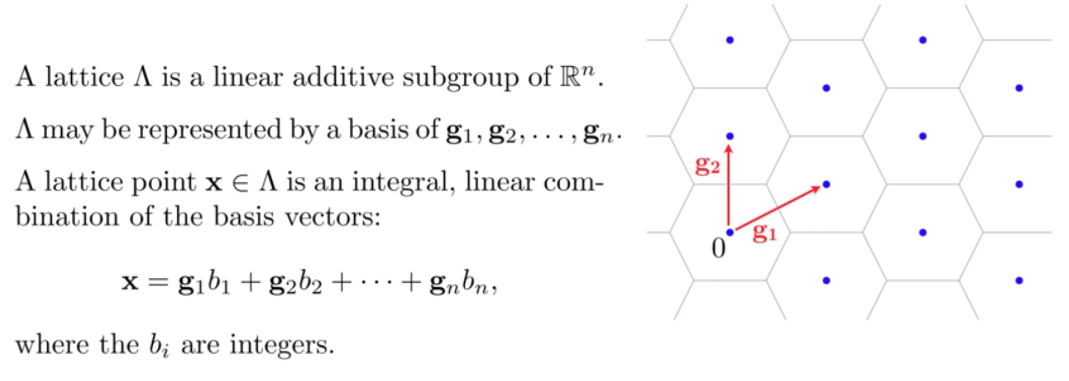

Slide 66
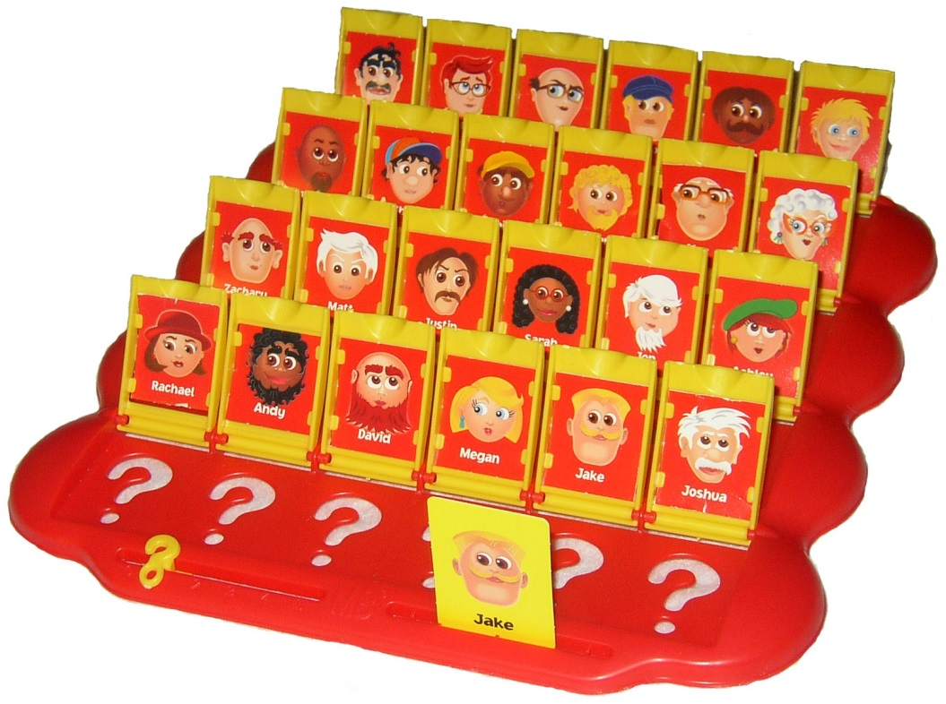
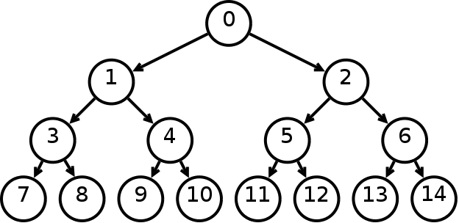
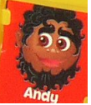
20 questions
You can ask yes/no questions. Not L/R
What is a good question? Phone book
How many questions on average?
Can use it as a code.
This is not proved in machine learning books.

Slide 69
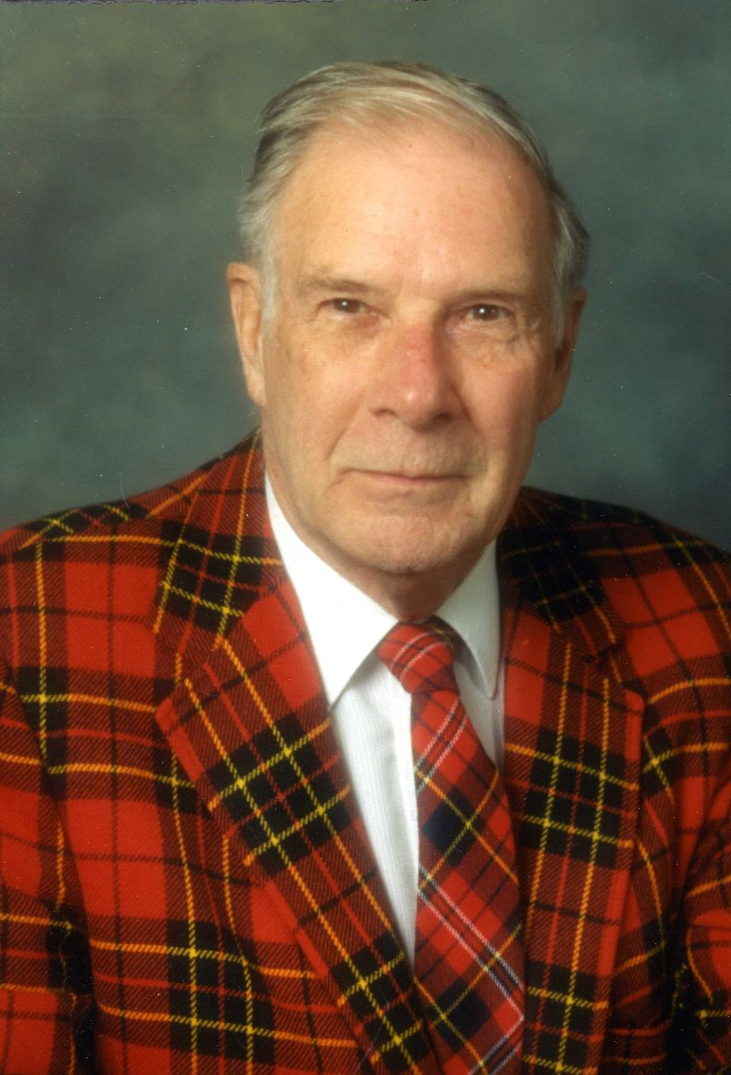
Richard Hamming
Richard Wesley Hamming was an American mathematician whose work had many implications for computer engineering and telecommunications. Wikipedia
Born: 11 February 1915, Chicago, Illinois, United States
Died: 7 January 1998, Monterey, California, United States
Field: Mathematics
Education: University of Illinois at Chicago (1942), University of Nebraska–Lincoln (1939), University of Chicago (1937)
Awards: Turing Award, IEEE Emanuel R. Piore Award

Slide 70
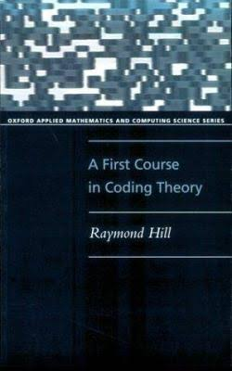
Books

