Slide 1
Dynamic Adaptive Automated Software Engineering
John Woodward
University of Stirling, Scotland
John.woodward@cs.stir.ac.uk

Slide 2
Dynamic Adaptive Automated Software Engineering
The DAASE project is funded £6.8 million from EPSRC brought up to approximate £12 million by the universities involved in matched funding.
http://gow.epsrc.ac.uk/NGBOViewGrant.aspx?GrantRef=EP/J017515/1
26 PhD studentships, 22 post doctoral research assistants and 6 additional lecturer appointments
Started mid 2012. Will run for 6 years.

Slide 3
DAASE AIM
DAASE will create a new approach to software engineering, placing adaptive automation at the heart of the development process and the products it creates.
Current Software Engineering: Current software development processes are expensive, laborious and error prone. They achieve adaptively at only a glacial pace, largely through enormous human effort, forcing highly skilled engineers to waste significant time adapting many tedious implementation details. Often, the resulting software is equally inflexible, forcing users to also rely on their innate human adaptively to find ‘workarounds’.

Slide 4
PARTNER UNIVERSTIES and PIs
University College London Prof. Mark Harman (Search Based Software Engineering),
The University of Birmingham Prof. Xin Yao (Evolutionary Computation),
The University of Stirling Prof. Edmund Burke (Hyper-heuristics and Decision Support),
The University of York Prof. John Clarke (Cryptography).

Slide 5
INDUSTRIAL PARTNERS

Slide 6
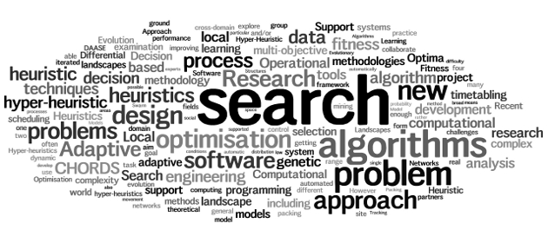
CHORDS Group at Stirling

Slide 7
Key strategic goals
Automating the heuristic design process:
Closing the gap between industrial/real world practice and scientific decision support research:

Slide 8
Automating the heuristic design process
This work is motivated by the goal of underpinning the development of computational methodologies that can automatically build decision support systems.
We aim to investigate the extent to which we can replace human decision making in the heuristic design process.
A particular focus is upon investigating transformational hyper-heuristic techniques to explore the extent to which we can automate the software engineering process.

Slide 9
Closing the gap between industrial/real world practice and scientific decision support research
We aim to explore dynamic and complex computational modelling and search techniques within the context of a broad range of real world problems across industry, commerce and the public sector.
We aim to establish new computational modelling approaches and automated search methodologies that push the boundaries of the capability of decision support systems and the levels of complexity that they are able to handle.
Moreover, we have the objective of developing a deeper theoretical understanding of complex real world problem solving scenarios in order to inform more effective practical decision support system development.

Slide 10
Automated Design of Heuristics
Applications
Combinatorial problems (bin packing, knapsack, travelling salesman problem)
Tailoring probability distributions
Genetically Improving (small to medium) program
Benefits
Automatically designed for specific problems
Human competitive results.
Scalable to larger instances of a problem.

Slide 11
Closing
Thank you for your attention
John.woodward@cs.stir.ac.uk
GECCO WORKSHOP on

