Slide 1
Using Genetic Programming to Learn Probability Distributions as Mutation Operators with Evolutionary Programming
Libin Hong, John Woodward, Ender Ozcan, Jingpeng Li
The university of Nottingham
John.Woodward@cs.stir.ac.uk
The University of Stirling

Slide 2
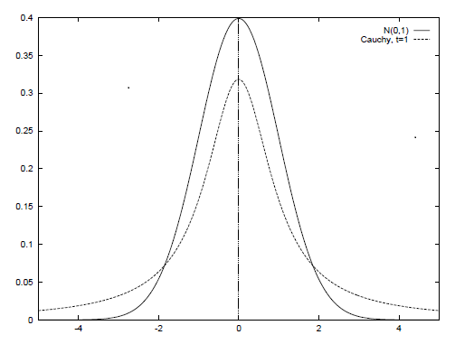
Summary of Abstract In Nutshell
Evolutionary programing optimizes functions by evolving a population of real-valued vectors (genotype).
Variation has been provided (manually) by probability distributions (Gaussian, Cauchy, Levy).
We are automatically generating probability distributions (using genetic programming).
Not from scratch, but from already well known distributions (Gaussian, Cauchy, Levy). We are “genetically improving probability distributions”.
We are evolving mutation operators for a problem class (a probability distributions over functions).
Genotype is
(1.3,...,4.5,…,8.7)
Before mutation
Genotype is
(1.2,...,4.4,…,8.6)
After mutation

Slide 3
Outline of Talk
Concept (Automatic vs. Manual Design)
Benchmarking Function Instances, Function Classes.
Function Optimization by Evolutionary Programming (Gaussian/Cauchy mutation).
Genetic Programming to design distributions.
Experimental Results.

Slide 4
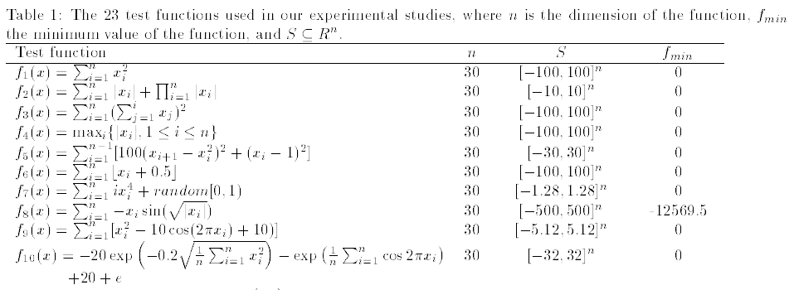
Optimization & Benchmark Functions
A set of 23 benchmark functions is typically used in the literature. Minimization
We use the first 10 but as problem classes.

Slide 5
Function Class 1 (of 10)
Machine learning needs to generalize.
We generalize to function classes.
y = x ^ 2 (a function)
y = a x ^ 2 (parameterised function)
y = a x ^ 2, a ~[1,2] (function class)
We do this for all 10 (23) functions.
Function classes are naturally occurring in domains (not forced for the sake of this paper).
The probability distribution we evolve fits the problem class.

Slide 6
Probability Distributions for Evolutionary Programming
1. Function optimization by Evolutionary Programming.
2. A population of real-valued vectors is varied “mutated” (perturbed) to generate new vectors which undergo evolutionary competition.
3. Mutation is typically provided by Gaussian and Cauchy probability distributions.
4. Can probability distributions be automatically generated which outperform the human nominated probability distributions?

Slide 7
Gaussian and Cauchy Distributions
A Gaussian distribution is used to model noise.
A Cauchy distribution is generated by one Gaussian divided by another Gaussian.
Cauchy (large jumps) good at start of search.
Gaussian (smaller jumps) good at end of search.
GAUSSIAN
CAUCHY

Slide 8
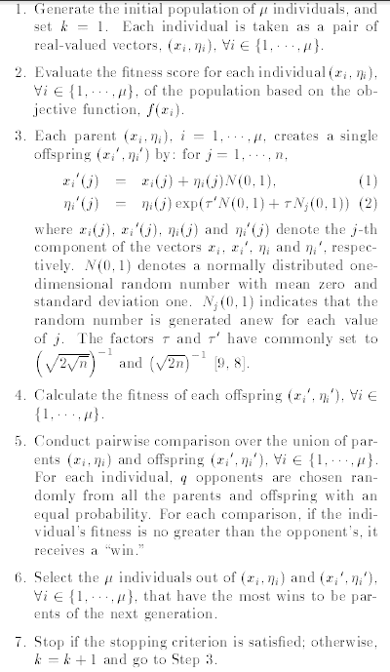
(Fast) Evolutionary Programming
Heart of algorithm is mutation
SO LETS AUTOMATICALLY DESIGN
EP mutates with a Gaussian.
Fast EP mutates with a Cauchy.
A generalization is mutate with a distribution D (generated with genetic programming)

Slide 9
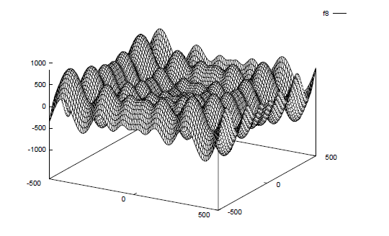
The 2 Dimensional Version of f8
Which is the best mutation operator,
Gaussian or Cauchy distribution?
Lets design a distribution automatically!

Slide 10
Meta and Base Learning
At the base level we are learning about a specific function.
At the meta level we are learning about the problem class.
We are just doing “generate and test” at a higher level
What is being passed with each blue arrow?
Conventional EP
Meta level
Function class
Probability
Distribution
Generator
Function to optimize
EP
base level

Slide 11
Compare Signatures (Input-Output)
Evolutionary Programming
(R^n -> R) -> R^n
Input is a function mapping real-valued vectors of length n to a real-value.
Output is a (near optimal) real-valued vector
(i.e. the solution to the problem instance)
Evolutionary Programming
Designer
[(R^n -> R)] ->
((R^n -> R) -> R^n)
Input is a list of functions mapping real-valued vectors of length n to a real-value (i.e. sample problem instances from the problem class).
Output is a (near optimal) (mutation operator for) Evolutionary Programming
(i.e. the solution method to the problem class)
We are raising the level of generality at which we operate.
Give a man a fish and he will eat for a day, teach a man to fish and…

Slide 12
Genetic Programming to Generate Probability Distributions
SPACE OF
PROBABILITY
DISTRIBUTIONS
GP Function Set {+, -, *, %}
GP Terminal Set {N(0, random)}
N(0,1) is a normal distribution.
For example a Cauchy distribution is generated by N(0,1)%N(0,1).
Hence the search space of probability distributions contains the two existing probability distributions used in EP but also novel probability distributions.
GAUSSIAN
CAUCHY
NOVEL
PROBABILITY
DISTRIBUTIONS

Slide 13
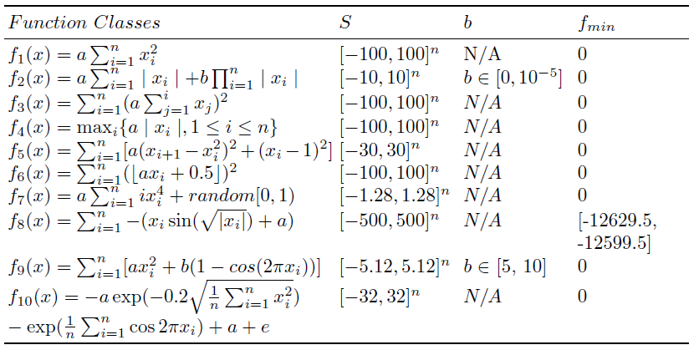
Ten Function Classes

Slide 14
Parameter Settings
Generation and population sizes are low,
but we have effectively seeded (or can be easily found) the population with good
probability distributions.

Slide 15
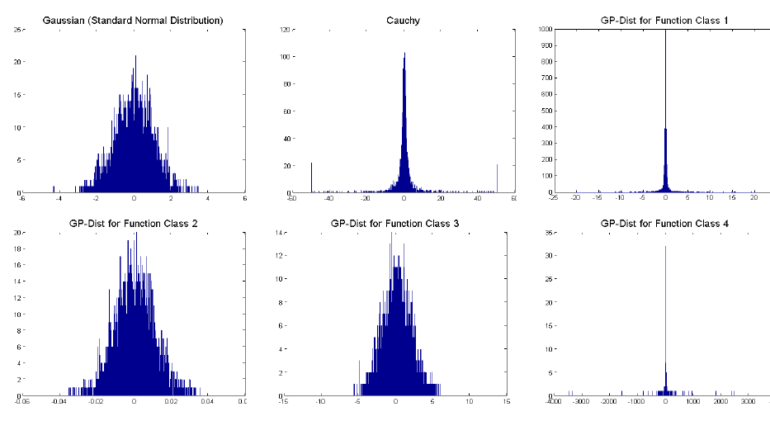
Evolved Probability Distributions 1

Slide 16
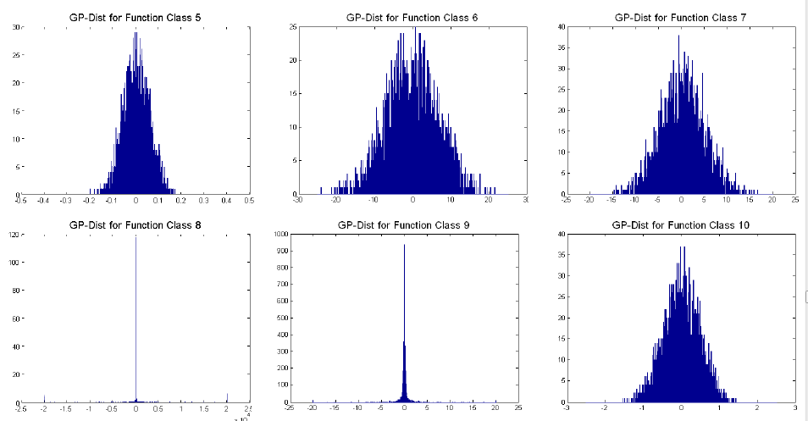
Evolved Probability Distributions 2

Slide 17
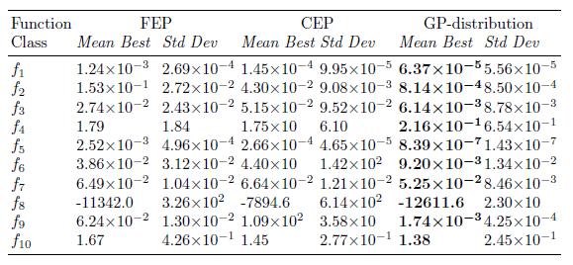
Means and Standard Deviations
These results are good for two reasons.
starting with a manually designed distributions.
evolving distributions for each function class.

Slide 18
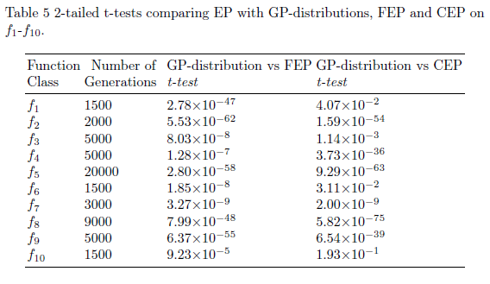
T-tests

Slide 19
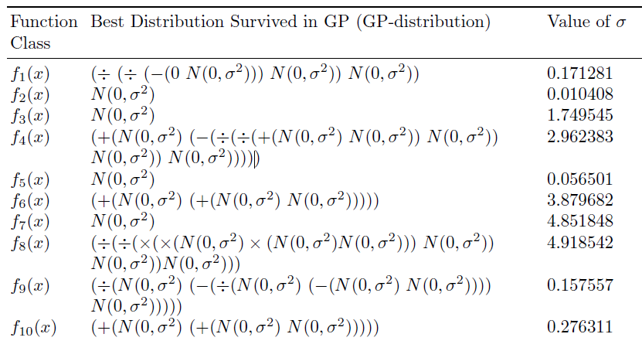
Evolved Probability Distributions

Slide 20
Differences with Standard Genetic Programming and Function Optimization
The final solution is part man-made (the Evolutionary Programming framework) and part machine-made (the probability distributions).
We (effectively) seed the initial population with already known good solutions (Gaussian and Cauchy). Don’t evolve from scratch.
We train to generalize across specific problem classes, therefore we do not test on single instances but many instances from a problem class.

Slide 21
Further Work
Compare with other algorithms (EP with Levy).
Only “single humped” probability distributions can be expressed in this framework Consider running GP for longer and stopping automatically (rather than pre-determined)
Do not have a single sigma for each automatically designed probability distribution
The current framework was sufficient to beat the two algorithms we compared against (Gaussian and Cauchy)

Slide 22
Summary & Conclusions
We are not proposing a new probability distribution. We are proposing a method to generate new probability distributions.
We are not comparing algorithms on benchmark instances (functions). We are comparing algorithms on distributions.
We are using an off-the-shelf method (Genetic Programming) to generate tailor-made solution methods to problem classes.

