Slide 1
Getting Started
See paper sheet
Create a directory using your full name in documents
In the directory, use notepad to create a file with extension .hs
Start WinGHCi and load the (empty) file

Slide 2
A Level Computer Science Introduction to Functional Programming
William Marsh
School of Electronic Engineering and Computer Science
Queen Mary University of London

Slide 3
Aims and Claims
Flavour of Functional Programming
…. how it differs from Imperative Programming (e.g. Python)
Claim that:
It is possible to program using functions
It is useful!
Better understanding of programming
I hope this is convincing
Only simple examples

Slide 4
How This Session Works
Talk
Do
Reflect
Repeat
…
Stop when times up

Slide 5
Outline
FP Topics
Reflections
A first functions
Composing function
Lists
If time (probably not)
Recursion
Map, Filter and Fold
Expressions, statements and variables
Sequence versus composition
How functions work
Recursion and loops
The best language
Challenge problems

Slide 6
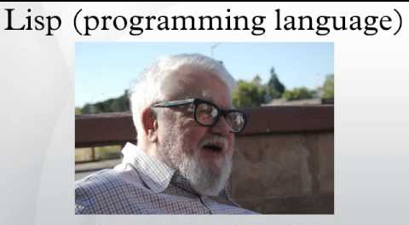
Functional Languages?
Many programming languages now have functional features
1958

Slide 7
First Function

Slide 8
A Simple Function
This function gives the larger of two numbers
Function name
Argument
bigger a b = if a > b then a else b
Is defined as …

Slide 9
Layout
Like Python, Haskell is layout sensitive
The following all work
bigger a b =
if a > b then a else b
bigger a b =
if a > b
then a
else b

Slide 10
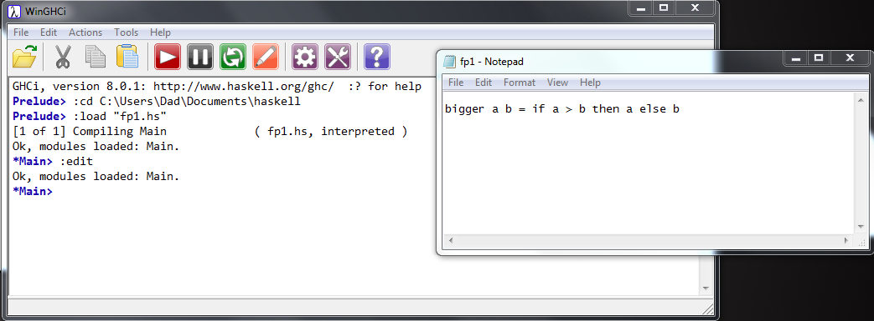
Getting Started with WinGHCi
WinGHCi is a shell
Use functions interactively
Use a text editor to edit the program
Notepad++ is better than notepad if you have it

Slide 11
Practical break
Section 1 of exercise sheet

Slide 12
Refection 1: Expressions, Statements and Variables

Slide 13
Expressions and Statement
Expression → value
Statement → command
Python: statements and expressions
Haskell: only expressions

Slide 14
The Assignment Statement
The most important statement:
Update the memory location ‘x’ with its current value plus 1
‘x’ is a variable
x = x + 1 # This is python
Python program is a sequence of assignments
Function may assign, so …
Expressions are not just values
Haskell has no statements
No assignment
No variables
Is it possible to program without variables?

Slide 15
No Variables?
My Haskell program seems to have variables
‘a’ and ‘b’ a names for values
Not memory locations
bigger a b =
if a > b then a else b

Slide 16
Functions
Maths (and Haskell)
Python
Result of a function depends only on its arguments
Calling a function does not change anything
Calling a function with the same arguments always gives the same result
Result of a function may depend on other variables
Calling a function may change variables
Calling a function a second time with the same arguments may give a different result

Slide 17
Function Composition

Slide 18
Composing Functions
One way to write bigger3
bigger3 a b c = bigger (bigger a b) c
Pass results to …

Slide 19
Composing Functions
Given a functions
Predict the results of
double a = 2 * a
square a = a * a
> double (double 5)
> double (square 3)
> square (double 3)

Slide 20
Composing Functions – Example
Surface area of a cylinder
circleArea r = pi * r * r
circleCircum r = 2 * pi * r
rectArea l h = l * h
cylinderArea r h =
2 * circleArea r +
rectArea (circleCircum r) h

Slide 21
Practical break
Section 2 of practical sheet

Slide 22
Refection 2: Sequence versus Composition

Slide 23
Python’s Invisible Statement
Sequence of assignments
Next statements on a new line
Many languages: S1 ; S2
… then
x = x + 1 # This is python
y = x * 2
x = 12
… then

Slide 24
Haskell’s Invisible Operator
Function application
circleArea r = pi * r * r
circleCircum r = 2 * pi * r
rectArea l h = l * h
cylinderArea r h =
2 * circleArea r +
rectArea (circleCircum r) h
apply
apply
apply
apply
apply
apply

Slide 25
Decomposition
Python
Haskell
Sequence of statements
… with names (functions)
Order of memory updates
Expressions
… with names (functions)
Argument and results
Functional composition ≠ sequencing of statements

Slide 26
Python’s Other Invisible Operator
Function call (application)
def circleArea(r): return math.pi * r * r
def circleCircum(r): return 2 * math.pi * r
def rectArea(l, h): return l * h
def cylinderArea(r, h):
return 2 * circleArea(r) + \
rectArea(circleCircum(r), h)
call
call
call
call
call

Slide 27
Recursion

Slide 28
Recursion
Can the definition of a function use the function being defined.
This is known as recursion
It can if
There is a non-recursive base case
Each recursive call is nearer the base case

Slide 29
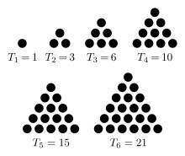
Recursion – Example
A triangle number counts the number of dots in an equilateral triangle (see picture)
We can define by:
Base case
trigNum 1 = 1
trigNum n = n + trigNum (n-1)
Recursive; smaller n

Slide 30
Patterns
The argument can match a pattern
Equivalent to:
Pattern
trigNum 1 = 1
trigNum n = n + trigNum (n-1)
trigNum n
| n == 1 = 1
| otherwise = n + trigNum (n-1)

Slide 31
Practical break
Section 3 of practical sheet

Slide 32
Refection 3: How Functions Work
Comparison with dry running a Python program

Slide 33
Example Python Program
# Enter two marks
# Save minimum
mark = int(input("Mark 1 > "))
total = mark
min = mark
mark = int(input("Mark 2 > "))
if mark < min:
min = mark
total = total + mark
# Calculate average
average = total / 2
# Calculate grade
if min < 30 or average < 50:
grade = "fail"
else:
grade = "pass"
Variables are:
mark
total
min
average
grade

Slide 34
Dry Running a Program
Table has column for each variable
Row for each step
Step | Variable
 | mark | total | min | average | grade
1 | 35
2 |  | 35
3 |  |  | 35
4 | 45
5 |  | 80
6 |  |  |  | 40
7 |  |  |  |  | fail
Memory
Sequence

Slide 35
Rewriting (Reduction)
Replace each call to a function by its definition
Replace arguments by expressions
trigNum 1 = 1
trigNum n = n + trigNum (n-1)
trigNum 3
= 3 + trigNum 2
= 3 + 2 + trigNum 1
= 3 + 2 + 1
= 6

Slide 36
Lists

Slide 37
Lists in Haskell
Haskell has lists … similar to Python
LISP
First functional language
‘List processing’
Example: [1, 2, 3]
Equivalent to:
1 : 2 : 3 : []
Cons
Empty list

Slide 38
Useful List Functions
Function | Description | Example
elem | Member of list | Main> elem 4 [1,2,3,4,5] True Main> elem 4 [1,3,5] False
head | First element of list | Main> head [2,4,6,8] 2
tail | List without first element | Main> tail [3,5,7,9] [5,7,9]
++ | Concatenate two lists | Main> [1,2,3] ++ [7,9] [1,2,3,7,9]

Slide 39
Ranges
Similar to Python
[1 .. 10]
First
Last

Slide 40
List Recursion
Many functions on lists are defined recursively
Base case: empty list
Recursive case: apply to tail of list
-- length of a list
len [] = 0
len (x:xs) = 1 + len xs
Base case
Recursive call
Pattern - empty
Pattern – not empty

Slide 41
Practical break
Section 4 of practical sheet

Slide 42
Refection 4: Recursion and Loops
How to do without loops

Slide 43
Recursion and Loops
Python
Haskell
While and for statements
Preferred
Recursion available
Some overheads
No loops!
No statements
Recursion preferred
Elegant syntax
Iteration & recursion equally expressive
Control value
Result so far
forLoop 0 _ x = x
forLoop n f x = forLoop (n-1) f (f n x)
sumup n = forLoop n (+) 0
Function in loop

Slide 44
Map, Filter and Fold
Functions that abstract common ways of processing a list
Called ‘recursive functions’

Slide 45
Two Similar Functions
Two functions that create a new list from an old one
The new list is the same length
Each new element is derived from the corresponding old element
-- Add 1 to each entry is a list
addOne [] = []
addOne (x:xs) = x+1:addOne xs
-- Square each entry in a list
square [] = []
square (x:xs) = x*x:square xs

Slide 46
Using Map
A function to apply a function to each element in a list
inc x = x + 1
-- Add 1 to each entry is a list
addOne ls = map inc ls
square x = x * x
-- Square each entry in a list
squares xs = map square xs

Slide 47
How is Map Defined?
Recursive definition of map
map f [] = []
map f x:xs = f x : map f xs
map inc [1,2,3]
= inc 1 : map inc [2,3]
= inc 1 : inc 2 : map inc [3]
= inc 1 : inc 2 : inc 3 : map inc []
= inc 1 : inc 2 : inc 3 : []
= [2, 3, 4]

Slide 48
Fold – Reducing a list
Combine the elements of a list
-- length of a list
len [] = 0
len (x:xs) = 1 + len xs
-- sum of a list
addUp [] = 0
addUp (x:xs) = x + addUp xs

Slide 49
Using Fold – Reducing a list
Combine the elements of a list
count x y = y + 1
-- length of a list
len xs = foldr count 0 xs
add x y = x + y
-- sum of a list
addUp xs = foldr add 0 xs

Slide 50
How is Foldr Defined?
Recursive definition of foldr
foldr f a [] = a
foldr f a x:xs = f x (foldr f a xs)
foldr add 0 [1,2,3]
= add 1 (foldr add 0 [2,3])
= add 1 (add 2 (foldr add 0 [3]))
= add 1 (add 2 (add 3 (foldr add 0 [])))
= add 1 (add 2 (add 3 0))
= add 1 (add 2 3)
= add 1 5
= 6

Slide 51
Filter
Select items from a list
Predicate
moreThan a b = b > a
Main> filter (moreThan 3) [3,2,5,1,7,8]
[5,7,8]

Slide 52
Map, Foldr, Filter – Summary
Function | Description
map | Apply function to each list element
filter | Select elements satisfying a predicate
foldr | Combine elements using a function
These are called recursive function
foldr is more general – it can be used to define the other two

Slide 53
Google Map Reduce
Very large datasets can be processed using the Map Reduce framework
Divide the list of input
Map function to each list (separate computers)
Reduce list of results (from the separate computers)

Slide 54
Practical break
Section 5 of practical sheet

Slide 55
Refection 5: The Best Language?

Slide 56
Programming Language
Between machine and users
More abstract
Haskell is ‘declarative’
Performance
Machine
C Java Haskell
User

Slide 57
Functional Programming in Practice
Functional languages
LISP – the original one
Haskell
Scala – compiles to JVM
F♯ – compiles to .NET
Influences
Java, Python, C♯
Python has versions of map and fold

Slide 58
Job Adverts (Feb 2020)

Slide 59
Summary
… and teaching FP

Slide 60
Functional Programming
We Have Covered
.. More Ideas
Programming with expressions
No statements
No assignment → no variables
No sequence → no loops
Composition of functions
Possible and practical
Programs can be shorter
Map and fold
Map and fold
List comprehension
Anonymous functions – lambda
Types
Numbers issue
Polymorphism
Input and output

Slide 61
Teaching FP
Practical skill?
… is there knowledge otherwise?
No types
Focus seems to be on:
Function definition
… using recursion
Program execution by rewriting
Is using FP to reflect on Imperative programming useful?

Slide 62
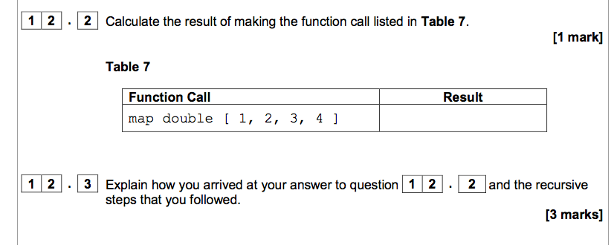

Slide 63
