Slide 1
To Get Started
Paper sheet
Online: http://www.eecs.qmul.ac.uk/~william/CAS-London-2020.html
Download sample programs
Create directory
Unzip
Recommend copy sample files before editing

Slide 2
Object Oriented Programming in A Level
William Marsh
[Original version co-authored with Melissa Bustamante]

Slide 3
Session Aim and Outline
Outline
Aims
Using classes: the Face
Attributes and the constructor
Reflection : Decomposition and design
Practical break
Reflection: How versus Why
Progression
Misconceptions
Python versus java
Be able to motivate the use of classes and objects
Be able to explain OOP in relations Abstraction and Decomposition
...progression in OOP
Be aware of issues for teaching OOP

Slide 4
A Face Class: Becoming a User of Objects
There are many examples of classes and object that are familiar

Slide 5
Using the Face Class
File class is a familiar example
Are we aware we use objects?
This is a variable. What is the type of its value?
from turtle import *
from Face import Face
f1 = Face(0, 0)
f1.draw()
f2 = Face(-200, 0)
f2.setSize(80)
f2.draw()
Draw methods: which face is drawn?

Slide 6
Objects and Methods
Name | Type | Description
f1, f2 | Variables; Objects of ‘Face’ class | A drawing of a face
Face | Class name; constructor | Create a Face object
setSize | Method of ‘Face’ class | Set size of the face
draw | Method of ‘Face’ class | Draw the face
‘Method’ is an OO word for function

Slide 7
Summary: Using Objects
Face representation is hidden
Method act (read or update) on objects
f2.setSize(80)
The object to be acted on
A second parameter: the size to set
The method: implements the action

Slide 8
Teaching Functional Decomposition
You have already learnt about functions
How they work
How to use them
Is it easy or hard to learn about functions?
What aspects are easier?
What aspects are harder?

Slide 9
Reflection: Abstraction and Decomposition
Motivation: What are we trying to achieve with classes?

Slide 10
Liskov and Guttag 1986 – Decomposition
A very small program consisting of no more than a few hundred lines can be implemented as a single monolithic unit.
However, as the size of the program increases such a ... structure is no longer reasonable ...
Instead the program must be decomposed into ... modules that together provide the desired function.
… how to decompose large programming problems into small ones … what kinds of modules are useful … [how] modules can be combined to solve the original problem

Slide 11
Two Different Aims for Learning OOP
How
Why
How to use classes
Create a new object
Use objects as variables (e.g. in a list)
How to create (declare) new classes
Add method and attributes
… and constructors
How to create sub-classes (inheritance)
Decomposing a problem using classes
Which classes to use?
What makes a good class?
How to do good abstractions
Analysis of the problem
How classes can interact
Software design

Slide 12
Summary
Emphasis continuity between OOP and previous programming
Use of objects and methods explained
Abstractions implemented using functions
Program decomposition; problem abstraction
Distinguish between learning syntax and
… practicing abstraction and program design
OOP is a new solution to the goal of decomposition using abstraction
Comparison with use of functions

Slide 13
Practical Work
Drawing Faces: Exercises 1 and 2

Slide 14
Declaring Your Own Classes
Key concepts

Slide 15
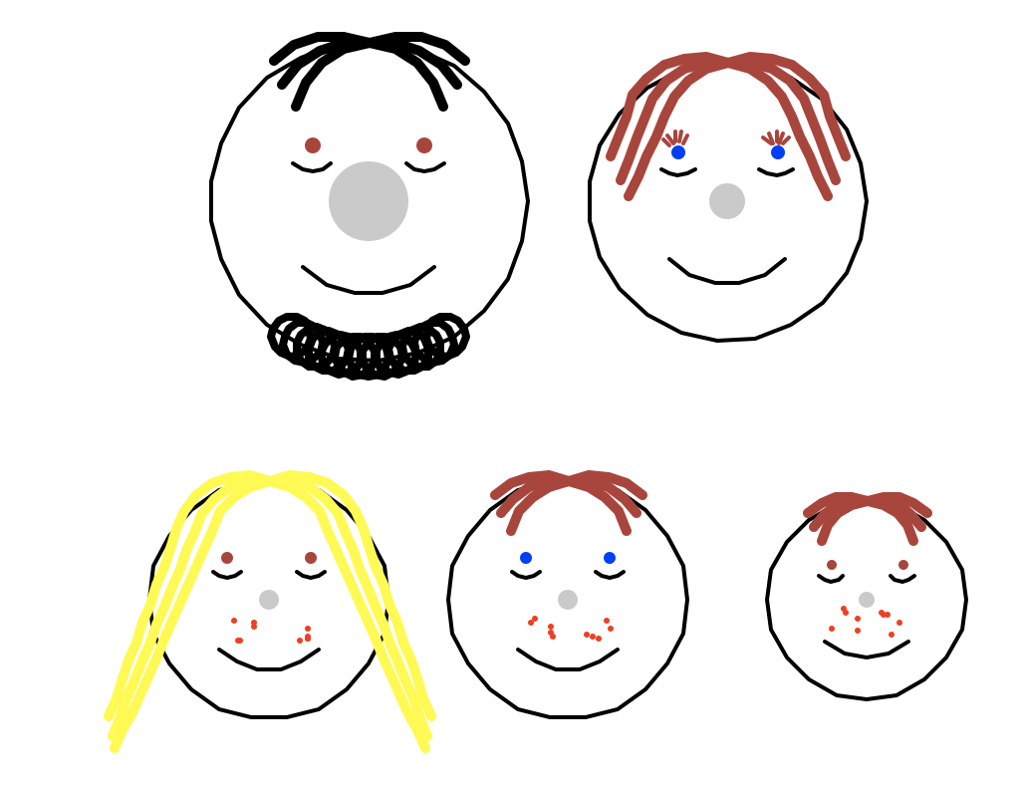
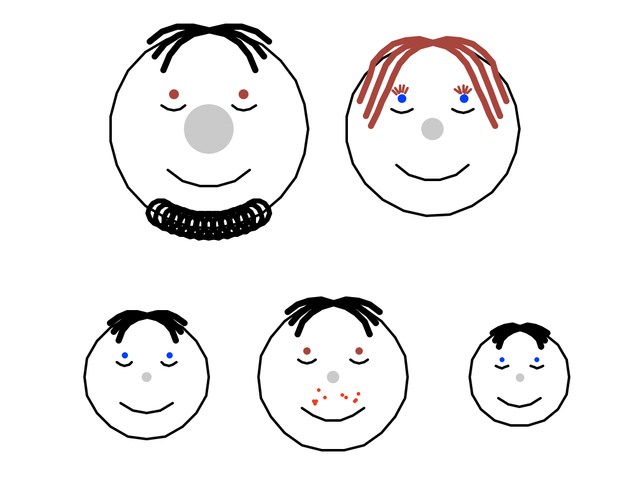
The Faces Example
Using Python turtle graphics
Good points
Visual and ?? Engaging (creative)
Class versus object distinction
Incremental
Limitations
Not typical of OO design
Complexity of drawing a distraction

Slide 16
Class Declaration
Constructor
from turtle import
class Face:
def __init__(self, xpos, ypos):
self.size = 50
self.coord = (xpos, ypos)
self.noseSize = 'normal'
def setSize(self, radius):
self.size = radius
def draw(self):
...
self.drawOutline()
...
Attributes
Method

Slide 17
Class Declaration
def goHome(self):
penup()
goto(self.coord)
setheading(0)
def drawOutline(self):
penup()
forward(self.size)
left(90)
pendown()
circle(self.size)
self.goHome()
from turtle import
class Face:
def __init__(self, xpos, ypos):
self.size = 50
self.coord = (xpos, ypos)
self.noseSize = 'normal'
def setSize(self, radius):
self.size = radius
def draw(self):
...
self.drawOutline()
...

Slide 18
Defining a Constructor
class Face:
def __init__(self, xpos, ypos):
self.size = 50
self.coord = (xpos, ypos)
self.noseSize = 'normal'
Constructor
Has a special name
May have parameters
Don’t forget ‘self’
Constructor name
Constructor parameter
Always ‘self’
Initialise attributes

Slide 19
Attributes – Good Practice
Attributes are not declared
In Python, nothing is!
Good practice to initialise all attributes in the constructor
Getters do not fail
Clear what the attributes are
Do not add more
class Face:
def __init__(self, xpos, ypos):
self.size = 50
self.coord = (xpos, ypos)
self.noseSize = 'normal'
def setSize(self, radius):
self.size = radius

Slide 20
Practical Work
Drawing Faces: Exercise 3 onwards

Slide 21
Teaching OOP in Python

Slide 22
Program Structure and Complexity
If & loops
x =
while x > :
y =
print
Program grows more complex in structure
Simpler elements remain
If & loop → part of function
Method → part of class
Functions
Function def
Function def
Main program
Initialise vars
Call functions
Classes & objects
class Friend:
def __init__()
def m1(a, b):
class Town:
def __init__()
def m1(a, b):
Main program
Create obj
Call methods

Slide 23
OOP Concepts
Concept | Details
Basic mechanics | Calling a method of an object Class as a template for data Class as a collection of methods
Constructors | Definition and use
Interaction | Object as a value (variable, list item, …) Object as an attribute value (has-a relationship) Object passed as a parameter
Abstraction and modelling | Class as a domain concept Methods (and constructor) have parameters
Inheritance | Superclass and subclasses Constructor called using super() Method inherited or overridden
Prerequisite knowledge: functions & parameters
Prerequisite knowledge: basic mechanisms

Slide 24
Misconception | Possible Evidence
Attributes in the wrong scope | Omission of self (assignment or use)
Confusion between class and object | No objects created Only one instance Inheritance rather than instance
Confusion between class and attribute | Many classes – all simple
Objects only contain data | No encapsulation Only get and set methods
Objects do not interact | All code in single class Classes defined but not imported Objects not used as attributes Objects never passed as parameters
Believing objects are copied not shared | Unnecessary copying Unexpected sharing
Also lack of prerequisite knowledge: functions & parameters

Slide 25
Python Issues for Teaching OOP
Usual OOP
Python
The attributes are declared
A class has a fixed set of attributes
Attributes can be hidden: access only by methods
Nothing is declared
Attributes appear when assigned to
Hiding is not enforced
Use Python to teach OOP
Avoid some Python tricks
Use only a subset
… explain later

Slide 26
Python versus Java
No declarations
Values are typed
Variable types are dynamic
Run time type checking
Syntax with indentation
Permissive philosophy
Declarations
Static typing of variables
Compile time type checking
Syntax with braces { }
Rigid philosophy

Slide 27
Summary
Object-oriented programming
Builds on more basic programming
A approach to program decomposition (decomposition take practice)
Previous experience learning decomposition
Progression: concepts not syntax
Proficiency with functions essential
Class versus object
Classes have attributes and methods
Constructor
Relationships between classes; objects as values
Inheritance
Python – some disadvantages

