Slide 1
Parallel Problem Solving from Nature
September 13-17, 2014
Ljubljana, Slovenia
Automatic Design of Algorithms via Hyper-heuristic Genetic Programming
John Woodward, Jerry Swan
John.Woodward@cs.stir.ac.uk; Jerry.Swan@cs.stir.ac.uk
CHORDS Research Group, Stirling University
http://www.maths.stir.ac.uk/research/groups/chords/
Notes:
Miller and langdon, SPECIAL ANOUNCEMENT
SELF CONTAINED
IMPROVE THIS TALK EACH TIME I GIVE IT
TAKE THE OTHER TALKS WITH ME TOO.

Slide 2
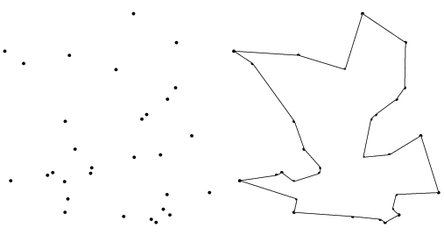
Conceptual Overview
Combinatorial problem e.g. Travelling Salesman
Exhaustive search ->heuristic?
Genetic Algorithm
heuristic – permutations
Travelling Salesman
Tour
Single tour NOT EXECUTABLE!!!
Genetic Programming
code fragments in for-loops.
Give a man a fish and he
will eat for a day.
Teach a man to fish and he
will eat for a lifetime.
Travelling Salesman Instances
TSP algorithm
Scalable? General?
New domains for GP
EXECUTABLE on MANY INSTANCES!!!
Notes:
If you are in the wrong room

Slide 3
Program Spectrum
Genetic Programming
{+, -, *, /}
{AND, OR, NOT}
First year university course
On Java, as part of a computer
Science degree
LARGE
Software
Engineering
Projects
Automatically
designed heuristics
(this tutorial)
Increasing “complexity”

Slide 4
Overview of Applications
 | SELECTION | MUTATION GA | BIN PACKING | MUTATION EP
Scalable performance | ? | ? | Yes - why | No - why
Generation ZERO | Rank, fitness proportional | NO – needed to seed. | Best fit | Gaussian and Cauchy
Problem class |  | Parameterized function | Item size | Parameterized function
Results Human Competitive | Yes | Yes | Yes | Yes
Algorithm iterate over | Population | Bit-string | Bins | Vector
Search Method | Random Search | Iterative Hill-Climber | Genetic Programming | Genetic Programming
Type Signatures | R^2->R | B^n->B^n | R^3->R | ()->R
Reference | [16] | [15] | [6,9,10,11] | [18]

Slide 5
Plan: From Evolution to Automatic Design
  (assume knowledge of Evolutionary Computation)
  Evolution, Genetic Algorithms and Genetic Programming (1)
  Motivations (conceptual and theoretical) (4)
  Examples of automatic generation
  Genetic Algorithms (selection and mutation) (8)
  Bin packing (9)
  Evolutionary Programming (12)
  8. Wrap up. Closing comments (6)
  9. Questions (during AND after…) Please ☺
  Now is a good time to say you are in the wrong room ☺

Slide 6



Evolution GA/GP
Feedback loop
Humans
Computers
Generate and test: cars, code, models, proofs, medicine, hypothesis.
Evolution (select, vary, inherit).
Fit for purpose
Generate
Test
Inheritance
Off-spring
have similar
Genotype
(phenotype)
PERFECT
CODE [3]

Slide 7
Theoretical Motivation 1
Metaheuristic a
Search
space
Objective
Function f
P (a, f)
x1
x1
x1
1.
2.
3.
X1.
X2.
X3.
Y1.
Y2.
Y3.
SOLUTION
PROBLEM
A search space contains the set of all possible solutions.
An objective function determines the quality of solution.
A (Mathematical idealized) metaheuristic determines the sampling order (i.e. enumerates i.e. without replacement). It is a (approximate) permutation. What are we learning?
Performance measure P (a, f) depend only on y1, y2, y3
Aim find a solution with a near-optimal objective value using a Metaheuristic . ANY QUESTIONS BEFORE NEXT SLIDE?
Notes:
Temptation is to just write a search algorithm.

Slide 8

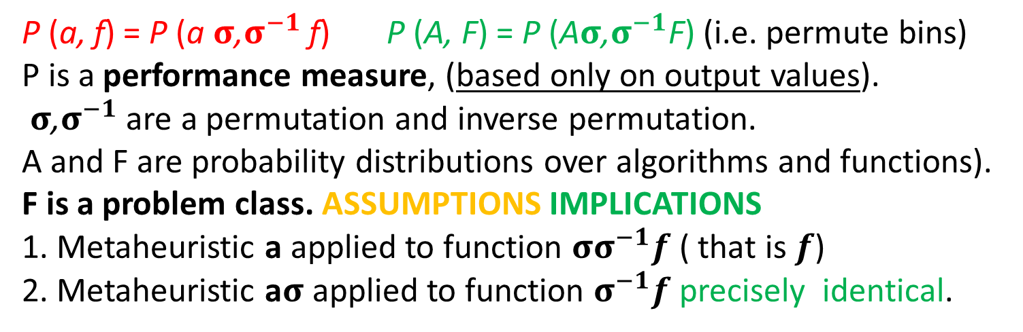
Theoretical Motivation 2
Search
space
permutation
σ
Objective
Function f
Metaheuristic a
$${\text{σ}}^{−1}$$
x1
x1
x1
x1
x1
1.
2.
3.
1.
2.
3.
1.
2.
3.
1.
2.
3.
1.
2.
3.
P (a, f) = P (a$σ$,$σ^{−1}$ f) P (A, F) = P (A$σ$,$σ^{−1}$F) (i.e. permute bins)
P is a performance measure, (based only on output values).
$σ$,$σ^{−1}$ are a permutation and inverse permutation.
A and F are probability distributions over algorithms and functions).
F is a problem class. ASSUMPTIONS IMPLICATIONS
1. Metaheuristic a applied to function ${σσ}^{−1}f$ ( that is $f$)
2. Metaheuristic a$σ$ applied to function $σ^{−1}f$ precisely identical.
Notes:
Not finite, not computable, not all function, not closed under permutation, focussed sets.
Implications. Do not propose a metaheuristic in isolation .
Assumptions - no revisiting, count number of evaluations (ignore execution time. )

Slide 9
Theoretical Motivation 3 [1,14]
The base-level learns about the function.
The meta-level learn about the distribution of functions
The sets do not need to be finite (with infinite sets, a uniform distribution is not possible)
The functions do not need to be computable.
We can make claims about the Kolmogorov Complexity of the functions and search algorithms.
p(f) (the probability of sampling a function )is all we can learn in a black-box approach.

Slide 10



One Man – One/Many Algorithm
Researchers design heuristics by hand and test them on problem instances or arbitrary benchmarks off internet.
Presenting results at conferences and publishing in journals. In this talk/paper we propose a new algorithm…
1. Challenge is defining an algorithmic framework (set) that includes useful algorithms. Black art
2. Let Genetic Programming select the best algorithm for the problem class at hand. Context!!! Let the data speak for itself without imposing our assumptions.
In this talk/paper we propose a 10,000 algorithms…
Heuristic1
Heuristic1
Automatic
Design
Heuristic2
Heuristic2
Heuristic10,000
Heuristic3
Notes:
Ga
Ga’
Ga ‘ version 2.o
Ga ‘ version 2.o hydidized with knobs and whistles.

Slide 11
Evolving Selection Heuristics [16]
Rank selection
P(i) α i
Probability of selection is proportional to the index in sorted population
Fitness Proportional
P(i) α fitness(i)
Probability of selection is proportional to the fitness
Fitter individuals are more likely to be selected in both cases.
Current population (index, fitness, bit-string)
1 5.5 0100010 | 2 7.5 0101010 | 3 8.9 0001010 | 4 9.9 0111010
0001010 | 0111010 | 0001010 | 0100010
Next generation

Slide 12
Framework for Selection Heuristics
Selection heuristics operate in the following framework
for all individuals p in population
select p in proportion to value( p );
To perform rank selection replace value with index i.
To perform fitness proportional selection replace value with fitness
rank selection is the program.
fitness proportional
These are just two programs in our search space.
Space of
Programs.

Slide 13
Selection Heuristic Evaluation
Selection heuristics are generated by random search in the top layer.
heuristics are used as for selection in a GA on a bit-string problem class.
A value is passed to the upper layer informing it of how well the function performed as a selection heuristic.
test
Generate and test
X2
Generate a selection
heuristic
Program space
of selection heuristics
test
Framework for
selection heuristics.
Selection function plugs
into a Genetic Algorithm
Genetic Algorithm
bit-string problem
Problem class:
A probability distribution
Over bit-string problems
Genetic Algorithm
bit-string problem

Slide 14
Experiments for Selection
Train on 50 problem instances (i.e. we run a single selection heuristic for 50 runs of a genetic algorithm on a problem instance from our problem class).
The training times are ignored
  we are not comparing our generation method.
  we are comparing our selection heuristic with rank and fitness proportional selection.
Selection heuristics are tested on a second set of 50 problem instances drawn from the same problem class.

Slide 15
Problem Classes
A problem class is a probability distribution of problem instances.
Generate values N(0,1) in interval [-1,1] (if we fall outside this range we regenerate)
Interpolate values in range [0, 2^{num-bits}-1]
Target bit string given by Gray coding of interpolated value.
The above 3 steps generate a distribution of target bit strings which are used for hamming distance problem instances. “shifted ones-max”

Slide 16
Results for Selection Heuristics
 | Fitness Proportional | Rank | generated-selector
mean | 0.831528 | 0.907809 | 0.916088
std dev | 0.003095 | 0.002517 | 0.006958
min | 0.824375 | 0.902813 | 0.9025
max | 0.838438 | 0.914688 | 0.929063
Performing t-test comparisons of fitness-proportional selection and rank selection against generated heuristics resulted in a p-value of better than 10^-15 in both cases. In both of these cases the generated heuristics outperform the standard selection operators (rank and fit-proportional).

Slide 17
Take Home Points
automatically designing selection heuristics.
We should design heuristics for problem classes i.e. with a context/niche/setting.
This approach is human-competitive (and human cooperative).
Meta-bias is necessary if we are to tackle multiple problem instances.
Think frameworks not individual algorithms – we don’t want to solve problem instances we want to solve classes (i.e. many instances from the class)!

Slide 18
Meta and Base Learning [15]
At the base level we are learning about a specific function.
At the meta level we are learning about the probability distribution.
We are just doing “generate and test” on “generate and test”
What is being passed with each blue arrow?
Training/Testing and Validation
Meta level
Function class
Mutation operator designer
function
mutation
Function to optimize
GA
base level
Conventional GA

Slide 19
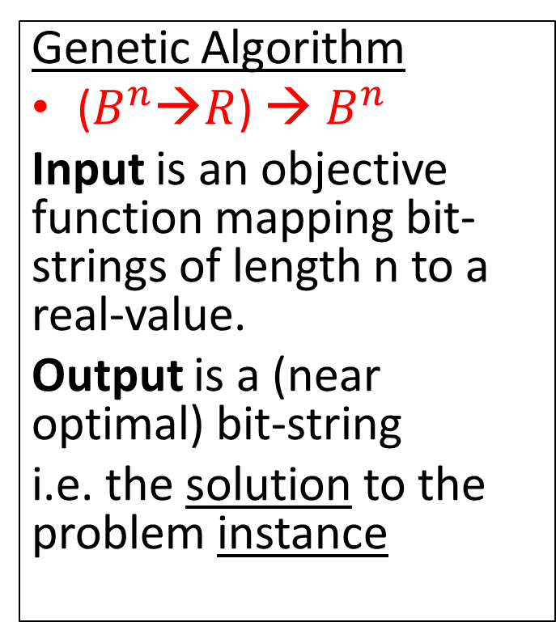
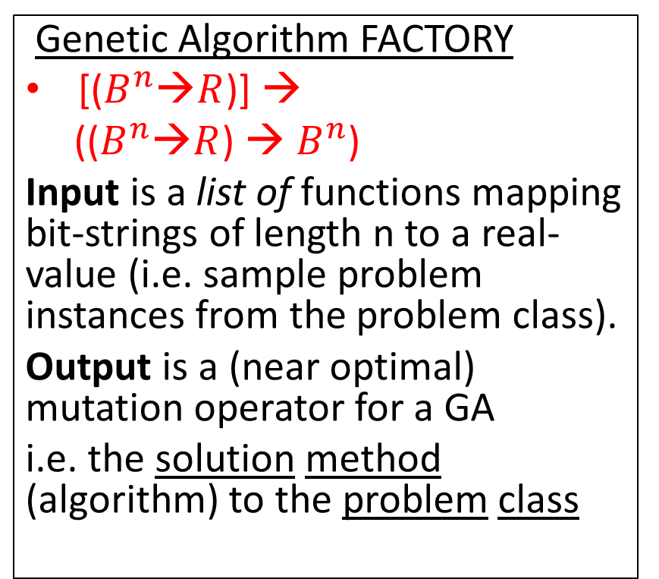
Compare Signatures (Input-Output)
Genetic Algorithm
($B^{n}$→$R$) → $B^{n}$
Input is an objective function mapping bit-strings of length n to a real-value.
Output is a (near optimal) bit-string
i.e. the solution to the problem instance
Genetic Algorithm FACTORY
[($B^{n}$→$R$)] →
(($B^{n}$→$R$) → $B^{n}$)
Input is a list of functions mapping bit-strings of length n to a real-value (i.e. sample problem instances from the problem class).
Output is a (near optimal) mutation operator for a GA
i.e. the solution method (algorithm) to the problem class
We are raising the level of generality at which we operate.
Notes:
Fish the north sea dry…

Slide 20
Two Examples of Mutation Operators
One point mutation flips ONE single bit in the genome (bit-string).
(1 point to n point mutation)
Uniform mutation flips ALL bits with a small probability p. No matter how we vary p, it will never be one point mutation.
Lets invent some more!!!
☹ NO, lets build a general method (for problem class)
BEFORE
0 | 1 | 1 | 0 | 0 | 0
AFTER
0 | 1 | 1 | 0 | 1 | 0
BEFORE
0 | 1 | 1 | 0 | 0 | 0
AFTER
0 | 0 | 1 | 0 | 0 | 1
What probability distribution of problem instances are these intended

Slide 21
Off-the-Shelf metaheuristic to Tailor-Make mutation operators for Problem Class
novel
mutation
heuristics
search
space
Meta-level
Genetic Programming
Iterative Hill Climbing
(mutation operators)
x
x
x
x
Fitness
value
Mutation
operator
One
Point
mutation
Uniform
mutation
Genetic Algorithm
Base-level
Two search spaces
Commonly used
Mutation operators

Slide 22
Building a Space of Mutation Operators
Inc | 0
Dec | 1
Add | 1,2,3
If | 4,5,6
Inc | -1
Dec | -2
Program counter pc | 2
WORKING REGISTERS
110 | -1 | +1 | 43 | …
INPUT-OUTPUT REGISTERS
-20 | -1 | +1 | 20 | …
A program is a list of instructions and arguments.
A register is set of addressable memory (R0,..,R4).
Negative register addresses means indirection.
A program can only affect IO registers indirectly.
positive (TRUE) negative (FALSE) on output register.
Insert bit-string on IO register, and extract from IO register

Slide 23
Arithmetic Instructions
These instructions perform arithmetic operations on the registers.
Add Ri ← Rj + Rk
Inc Ri ← Ri + 1
Dec Ri ← Ri − 1
Ivt Ri ← −1 ∗ Ri
Clr Ri ← 0
Rnd Ri ← Random([−1, +1]) //mutation rate
Set Ri ← value
Nop //no operation or identity

Slide 24
Control-Flow Instructions
These instructions control flow (NOT ARITHMETIC). They include branching and iterative imperatives.
Note that this set is not Turing Complete!
If if(Ri > Rj) pc = pc + |Rk| why modulus?
IfRand if(Ri < 100 * random[0,+1]) pc = pc + Rj//allows us to build mutation probabilities WHY?
Rpt Repeat |Ri| times next |Rj| instruction
Stp terminate

Slide 25
Expressing Mutation Operators
Line UNIFORM ONE POINT MUTATION
0 Rpt, 33, 18 Rpt, 33, 18
1 Nop Nop
2 Nop Nop
3 Nop Nop
4 Inc, 3 Inc, 3
5 Nop Nop
6 Nop Nop
7 Nop Nop
8 IfRand, 3, 6 IfRand, 3, 6
9 Nop Nop
10 Nop Nop
11 Nop Nop
12 Ivt,−3 Ivt,−3
13 Nop Stp
14 Nop Nop
15 Nop Nop
16 Nop Nop
Uniform mutation
Flips all bits with a
fixed probability.
4 instructions
One point mutation
flips a single bit.
6 instructions
Why insert NOP?
We let GP start with these programs and mutate them.

Slide 26
7 Problem Instances
Problem instances are drawn from a problem class.
7 real–valued functions, we will convert to discrete binary optimisations problems for a GA.
number function
1 x
2 sin2(x/4 − 16)
3 (x − 4) ∗ (x − 12)
4 (x ∗ x − 10 ∗ cos(x))
5 sin(pi∗x/64−4) ∗ cos(pi∗x/64−12)
6 sin(pi∗cos(pi∗x/64 − 12)/4)
7 1/(1 + x /64)

Slide 27
Function Optimization Problem Classes
To test the method we use binary function classes
We generate a Normally-distributed value t = −0.7 + 0.5 N (0, 1) in the range [-1, +1].
We linearly interpolate the value t from the range [-1, +1] into an integer in the range [0, 2^num−bits −1], and convert this into a bit-string t′.
To calculate the fitness of an arbitrary bit-string x, the hamming distance between x and the target bit-string t′ is calculated (giving a value in the range [0,numbits]). This value is then fed into one of the 7 functions.

Slide 28
Results – 32 bit problems
Problem classes Means and standard deviations | Uniform Mutation | One-point mutation | generated-mutation
p1 mean | 30.82 | 30.96 | 31.11
p1 std-dev | 0.17 | 0.14 | 0.16
p2 mean | 951 | 959.7 | 984.9
p2 std-dev | 9.3 | 10.7 | 10.8
p3 mean | 506.7 | 512.2 | 528.9
p3 std-dev | 7.5 | 6.2 | 6.4
p4 mean | 945.8 | 954.9 | 978
p4 std-dev | 8.1 | 8.1 | 7.2
p5 mean | 0.262 | 0.26 | 0.298
p5 std-dev | 0.009 | 0.013 | 0.012
p6 mean | 0.432 | 0.434 | 0.462
p6 std-dev | 0.006 | 0.006 | 0.004
p7 mean | 0.889 | 0.89 | 0.901
p7 std-dev | 0.002 | 0.003 | 0.002

Slide 29
Results – 64 bit problems
Problem classes Means and stand dev | Uniform Mutation | One-point mutation | generated-mutation
p1 mean | 55.31 | 56.08 | 56.47
p1 std-dev | 0.33 | 0.29 | 0.33
p2 mean | 3064 | 3141 | 3168
p2 std-dev | 33 | 35 | 33
p3 mean | 2229 | 2294 | 2314
p3 std-dev | 31 | 28 | 27
p4 mean | 3065 | 3130 | 3193
p4 std-dev | 36 | 24 | 28
p5 mean | 0.839 | 0.846 | 0.861
p5 std-dev | 0.012 | 0.01 | 0.012
p6 mean | 0.643 | 0.643 | 0.663
p6 std-dev | 0.004 | 0.004 | 0.003
p7 mean | 0.752 | 0.7529 | 0.7684
p7 std-dev | 0.0028 | 0.004 | 0.0031

Slide 30
p-values T Test for 32 and 64-bit functions on the7 problem classes
 | 32 bit | 32 bit | 64 bit | 64 bit
class | Uniform | One-point | Uniform | One-point
p1 | 1.98E-08 | 0.0005683 | 1.64E-19 | 1.02E-05
p2 | 1.21E-18 | 1.08E-12 | 1.63E-17 | 0.00353
p3 | 1.57E-17 | 1.65E-14 | 3.49E-16 | 0.00722
p4 | 4.74E-23 | 1.22E-16 | 2.35E-21 | 9.01E-13
p5 | 9.62E-17 | 1.67E-15 | 4.80E-09 | 4.23E-06
p6 | 2.54E-27 | 4.14E-24 | 3.31E-24 | 3.64E-28
p7 | 1.34E-24 | 3.00E-18 | 1.45E-28 | 5.14E-23

Slide 31
Rebuttal to Reviews
1. Did we test the new mutation operators against standard operators (one-point and uniform mutation) on different problem classes?
NO – the mutation operator is designed (evolved) specifically for that class of problem.
2. Are we taking the training stage into account?
NO, we are just comparing mutation operators in the testing phase – Anyway how could we meaningfully compare “brain power” (manual design) against “processor power” (evolution).
3. Train for all functions – NO, we are specializing.

Slide 32
Additions to Genetic Programming
1. final program is part human constrained part (for-loop) machine generated (body of for-loop).
2. In GP the initial population is typically randomly created. Here we (can) initialize the population with already known good solutions (which also confirms that we can express the solutions). (improving rather than evolving from scratch) – standing on shoulders of giants. Like genetically modified crops – we start from existing crops.
3. Evolving on problem classes (samples of problem instances drawn from a problem class) not instances.
NOW OVER TO JERRY SWAN

Slide 33
Problem Classes Do Occur
Problem classes are probability distributions over problem instances.
Travelling Salesman
  Distribution of cities over different counties
  E.g. USA is square, Japan is long and narrow.
Bin Packing & Knapsack Problem
  The items are drawn from some probability distribution.
Problem classes do occur in the real-world
Next slides demonstrate problem classes and scalability with on-line bin packing.

Slide 34
On-line Bin Packing Problem [9,11]
A sequence of items packed into as few a bins as possible.
Bin size is 150 units, items uniformly distributed between 20-100.
Different to the off-line bin packing problem where the set of items.
The “best fit” heuristic, places the current item in the space it fits best (leaving least slack).
It has the property that this heuristic does not open a new bin unless it is forced to.
Array of bins
Range of
Item size
20-100
150 =
Bin
capacity
Items packed so far
Sequence of pieces to be packed

Slide 35
Genetic Programming applied to on-line bin packing
Not obvious how to link
Genetic Programming to combinatorial problems.
The GP tree is applied to each
bin with the current item and placed in the bin with
The maximum score
C capacity
E emptiness
Fullness is
irrelevant
The space is
important
Terminals supplied to Genetic Programming
Initial representation {C, F, S}
Replaced with {E, S}, E=C-F
F fullness
S size
S size

Slide 36
How the heuristics are applied (skip)
%
C
-
C
+
-15
-3.75
3
4.29
1.88
S
F
70
120
85
70
90
60
45
30
30

Slide 37
The Best Fit Heuristic
Best fit = 1/(E-S). Point out features.
Pieces of size S, which fit well into the space remaining E, score well.
Best fit applied produces a set of points on the surface,
The bin corresponding to the maximum score is picked.
emptiness
Piece size

Slide 38
Our best heuristic.
Similar shape to best fit – but curls up in one corner.
Note that this is rotated, relative to previous slide.

Slide 39
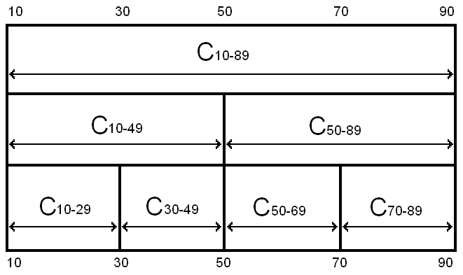
Robustness of Heuristics
= all legal results
= some illegal results
Notes:
Even though the problem is the same, and the hard constraints are the same, the heuristics can fail to stay within the hard constraints if they are asked to pack piece sizes they have not seen before
The safeguards against giving illegal solutions that work in one class will not work in another

Slide 40
Testing Heuristics on problems of much larger size than in training
Table I | H trained100 | H trained 250 | H trained 500
100 | 0.427768358 | 0.298749035 | 0.140986023
1000 | 0.406790534 | 0.010006408 | 0.000350265
10000 | 0.454063071 | 2.58E-07 | 9.65E-12
100000 | 0.271828318 | 1.38E-25 | 2.78E-32
Table shows p-values using the best fit heuristic, for heuristics trained on
different size problems, when applied to different sized problems
1. As number of items trained on increases, the probability decreases (see next slide).
2. As the number of items packed increases, the probability decreases (see next slide).

Slide 41
Compared with Best Fit
Amount
evolved
heuristics
beat
best fit by.
Number of pieces
packed so far.
Averaged over 30 heuristics over 20 problem instances
Performance does not deteriorate
The larger the training problem size, the better the bins are packed.

Slide 42
Compared with Best Fit
Zoom in
of previous
slide
Amount
evolved
heuristics
beat
best fit by.
The heuristic seems to learn the number of pieces in the problem
Analogy with sprinters running a race – accelerate towards end of race.
The “break even point” is approximately half of the size of the training problem size
If there is a gap of size 30 and a piece of size 20, it would be better to wait for a better piece to come along later – about 10 items (similar effect at upper bound?).

Slide 43
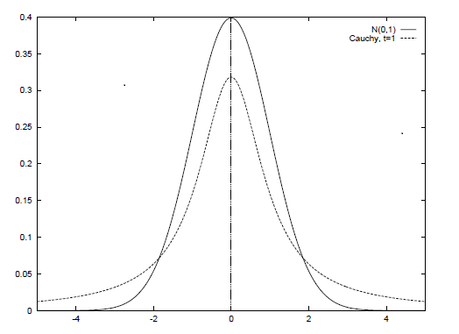
Designing Mutation Operators for Evolutionary Programming [18]
Evolutionary programing optimizes functions by evolving a population of real-valued vectors (genotype).
Variation has been provided (manually) by probability distributions (Gaussian, Cauchy, Levy).
We are automatically generating probability distributions (using genetic programming).
Not from scratch, but from already well known distributions (Gaussian, Cauchy, Levy). We are “genetically improving probability distributions”.
We are evolving mutation operators for a problem class (a probability distributions over functions).
NO CROSSOVER
Genotype is
(1.3,...,4.5,…,8.7)
Before mutation
Genotype is
(1.2,...,4.4,…,8.6)
After mutation

Slide 44
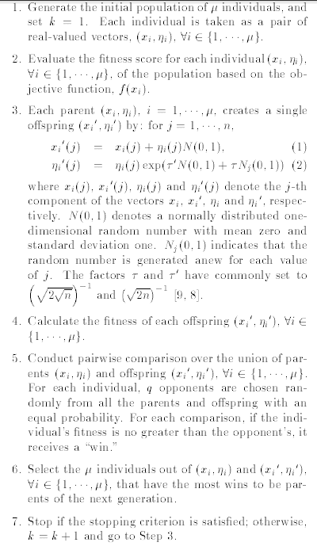
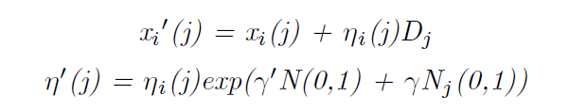
(Fast) Evolutionary Programming
Heart of algorithm is mutation
SO LETS AUTOMATICALLY DESIGN
EP mutates with a Gaussian
FEP mutates with a Cauchy
A generalization is mutate with a distribution D (generated with genetic programming)

Slide 45

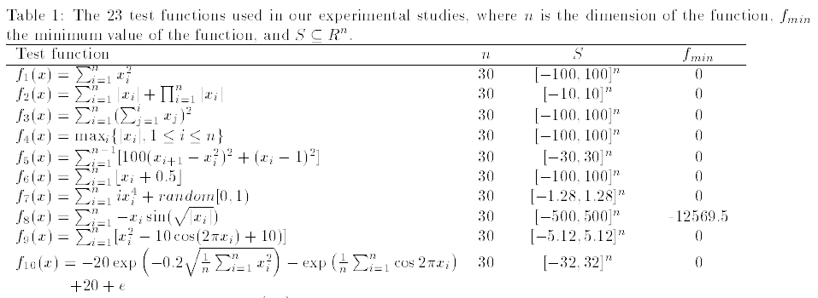
Optimization & Benchmark Functions
A set of 23 benchmark functions is typically used in the literature. Minimization
We use them as problem classes.

Slide 46
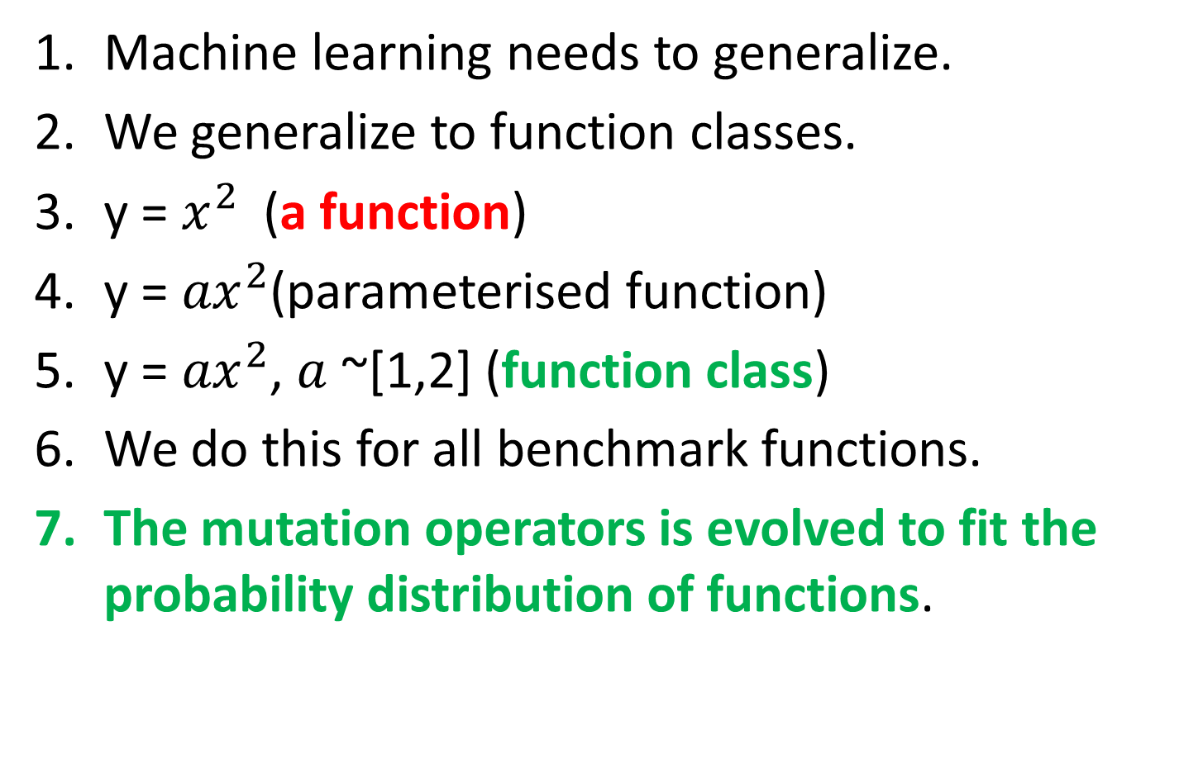
Function Class 1
Machine learning needs to generalize.
We generalize to function classes.
y = $x^{2}$(a function)
y = ${ax}^{2}$(parameterised function)
y = ${ax}^{2}$, $a$ ~[1,2] (function class)
We do this for all benchmark functions.
The mutation operators is evolved to fit the probability distribution of functions.

Slide 47
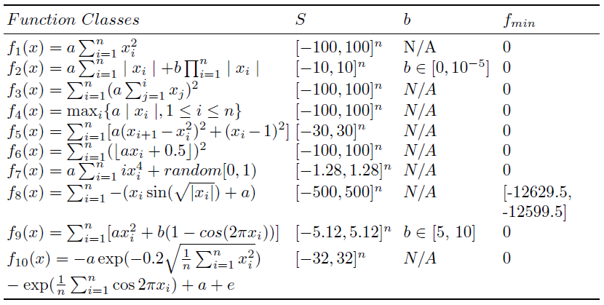
Function Classes 2

Slide 48
Meta and Base Learning
At the base level we are learning about a specific function.
At the meta level we are learning about the problem class.
We are just doing “generate and test” at a higher level
What is being passed with each blue arrow?
Conventional EP
Meta level
Function class
Probability
Distribution
Generator
Function to optimize
EP
base level

Slide 49
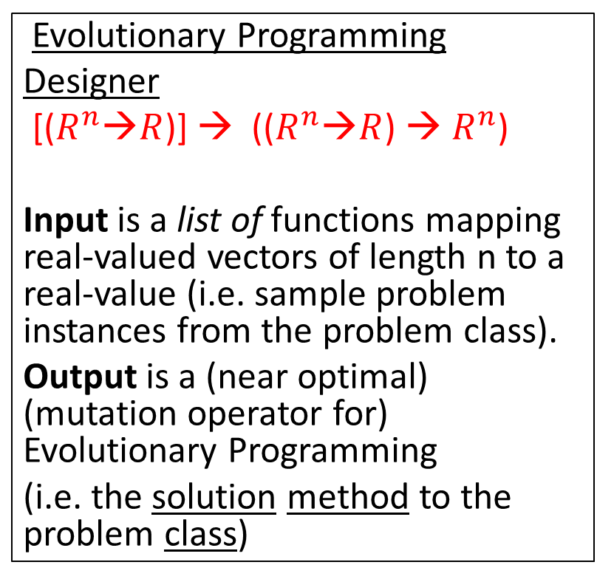
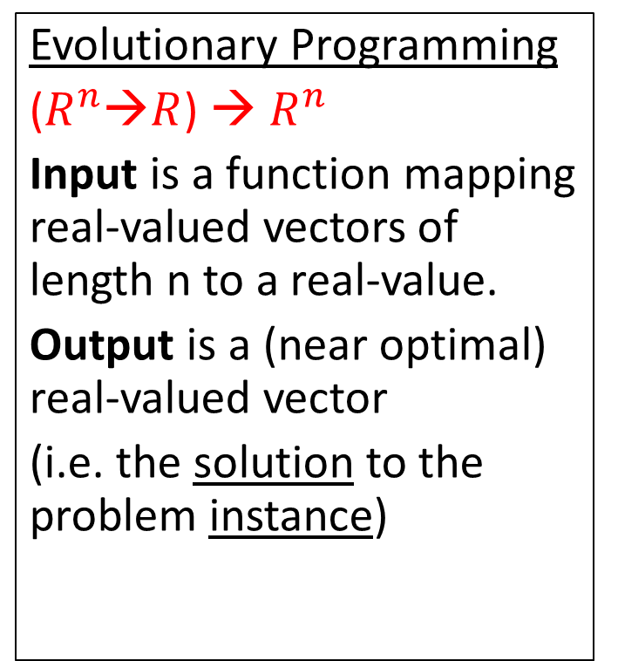
Compare Signatures (Input-Output)
Evolutionary Programming
($R^{n}$→$R$) → $R^{n}$
Input is a function mapping real-valued vectors of length n to a real-value.
Output is a (near optimal) real-valued vector
(i.e. the solution to the problem instance)
Evolutionary Programming
Designer
[($R^{n}$→$R$)] → (($R^{n}$→$R$) → $R^{n}$)
Input is a list of functions mapping real-valued vectors of length n to a real-value (i.e. sample problem instances from the problem class).
Output is a (near optimal) (mutation operator for) Evolutionary Programming
(i.e. the solution method to the problem class)
We are raising the level of generality at which we operate.

Slide 50
Genetic Programming to Generate Probability Distributions
SPACE OF
PROBABILITY
DISTRIBUTIONS
GP Function Set {+, -, *, %}
GP Terminal Set {N(0, random)}
N(0,1) is a normal distribution.
For example a Cauchy distribution is generated by N(0,1)%N(0,1).
Hence the search space of probability distributions contains the two existing probability distributions used in EP but also novel probability distributions.
GAUSSIAN
CAUCHY
NOVEL
PROBABILITY
DISTRIBUTIONS

Slide 51
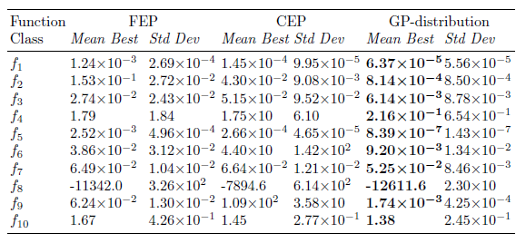
Means and Standard Deviations
These results are good for two reasons.
starting with a manually designed distributions (Gaussian).
evolving distributions for each function class.

Slide 52
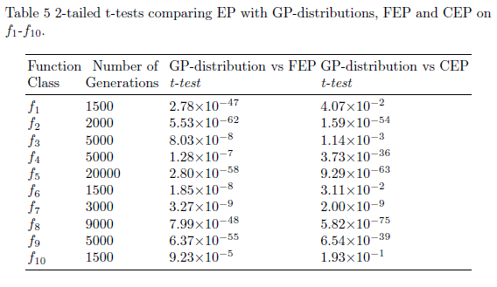
T-tests

Slide 53
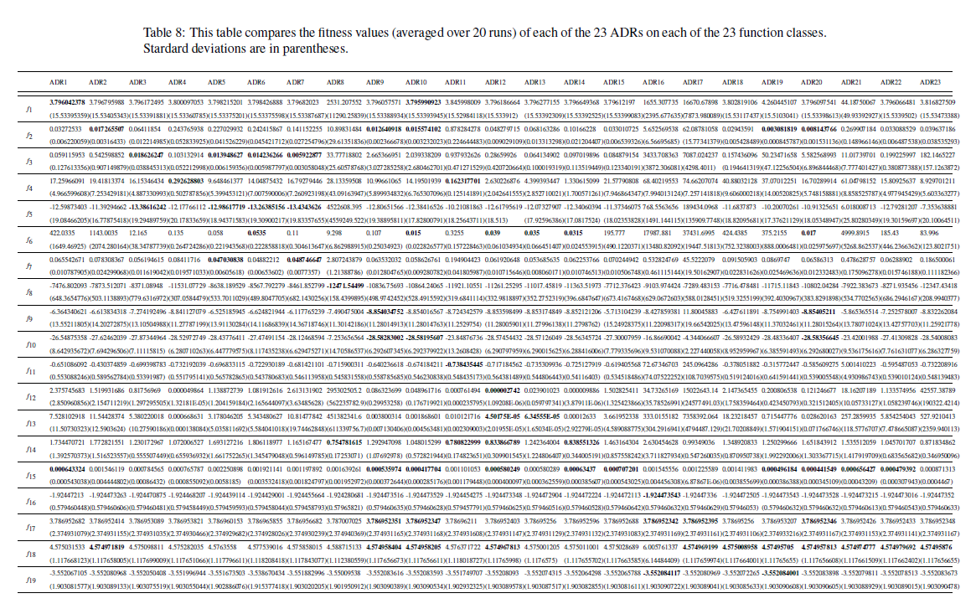
Performance on Other Problem Classes

Slide 54
Step by Step Guide to Automatic Design of Algorithms [8, 12]
Study the literature for existing heuristics for your chosen domain (manually designed heuristics).
Build an algorithmic framework or template which expresses the known heuristics (todo ref)
Let Genetic Programming supply variations on the theme.
Train and test on problem instances drawn from the same probability distribution (like machine learning). Constructing an optimizer is machine learning (this approach prevents “cheating”).

Slide 55
A Brief History (Example Applications) [5]
Image Recognition – Roberts Mark
Travelling Salesman Problem – Keller Robert
Boolean Satisfiability – Fukunaga, Bader-El-Den
Data Mining – Gisele L. Pappa, Alex A. Freitas
Decision Tree - Gisele L. Pappa et. al.
Selection Heuristics – Woodward & Swan
Bin Packing 1,2,3 dimension (on and off line) Edmund Burke et. al. & Riccardo Poli et. al.
Bug Location – Shin Yoo
Job Shop Scheduling - Mengjie Zhang

Slide 56
Comparison of Search Spaces
If we tackle a problem instance directly, e.g. Travelling Salesman Problem, we get a combinatorial explosion. The search space consists of solutions, and therefore explodes as we tackle larger problems.
If we tackle a generalization of the problem, we do not get an explosion as the distribution of functions expressed in the search space tends to a limiting distribution. The search space consists of algorithms to produces solutions to a problem instance of any size.
The algorithm to tackle TSP of size 100-cities, is the same size as The algorithm to tackle TSP of size 10,000-cities

Slide 57
A Paradigm Shift?
One person
proposes one
algorithm
and tests it
in isolation.
One person proposes a
family of algorithms
and tests them
in the context of
a problem class.
Algorithms investigated/unit time
Human cost (INFLATION) machine cost MOORE’S LAW
conventional approach new approach
Previously one person proposes one algorithm
Now one person proposes a set of algorithms
Analogous to “industrial revolution” from hand made to machine made. Automatic Design.
Notes:
What could you do after this talk you could not do before.

Slide 58
Conclusions
Heuristic are trained to fit a problem class, so are designed in context (like evolution). Let’s close the feedback loop! Problem instances live in classes.
We can design algorithms on small problem instances and scale them apply them to large problem instances (TSP, child multiplication).
Notes:
I hope if you are a researcher in the field it has made you think
If you do not know how to write an algorithm, don’t write it, let the computer write it. .

Slide 59
Overview of Applications
 | SELECTION | MUTATION GA | BIN PACKING | MUTATION EP
Scalable performance | ? | ? | Yes - why | No - why
Generation ZERO | Rank, fitness proportional | NO – needed to seed. | Best fit | Gaussian and Cauchy
Problem class |  | Parameterized function | Item size | Parameterized function
Results Human Competitive | Yes | Yes | Yes | Yes
Algorithm iterate over | Population | Bit-string | Bins | Vector
Search Method | Random Search | Iterative Hill-Climber | Genetic Programming | Genetic Programming
Type Signatures | R^2->R | B^n->B^n | R^3->R | ()->R
Reference | [16] | [15] | [6,9,10,11] | [18]

Slide 60
SUMMARY
We can automatically design algorithms that consistently outperform human designed algorithms (on various domains).
Humans should not provide variations– genetic programing can do that.
We are altering the heuristic to suit the set of problem instances presented to it, in the hope that it will generalize to new problem instances (same distribution - central assumption in machine learning).
The “best” heuristics depends on the set of problem instances. (feedback)
Resulting algorithm is part man-made part machine-made (synergy)
not evolving from scratch like Genetic Programming,
improve existing algorithms and adapt them to the new problem instances.
Humans are working at a higher level of abstraction and more creative. Creating search spaces for GP to sample.
Algorithms are reusable, “solutions” aren’t. (e.g. tsp algorithm vs route)
Opens up new problem domains. E.g. bin-packing.

Slide 61
End of File ☺
Thank you for listening
I am glad to take any
  comments (+,-)
  Criticisms
  Please email me any references.
  http://www.cs.stir.ac.uk/~jrw/

Slide 62
References 1
1. Woodward J. Computable and Incomputable Search Algorithms and Functions. IEEE International Conference on Intelligent Computing and Intelligent Systems (IEEE ICIS 2009) November 20-22,2009 Shanghai, China.
2. John Woodward. The Necessity of Meta Bias in Search Algorithms. International Conference on Computational Intelligence and Software Engineering 2010. CiSE 2010.
3. Woodward, J. & Bai, R. (2009) Why Evolution is not a Good Paradigm for Program Induction; A Critique of Genetic Programming 2009 World Summit on Genetic and Evolutionary Computation (2009 GEC Summit) June 12-14 Shanghai, China
4. J. Swan, J. Woodward, E. Ozcan, G. Kendall, E. Burke. “Searching the Hyper-heuristic Design Space,” Cognitive Computation
5. G.L. Pappa, G. Ochoa, M.R. Hyde, A.A. Freitas, J. Woodward, J. Swan “Contrasting meta-learning and hyper-heuristic research” Genetic Programming and Evolvable Machines.
6. Burke E. K., Hyde M., Kendall G., and Woodward J. 2011. Automating the Packing Heuristic Design Process with Genetic Programming. Evolutionary Computation

Slide 63
References 2
7. Burke, E. K. and Hyde, M. R. and Kendall, G. and Woodward, J., A Genetic Programming Hyper-Heuristic Approach for Evolving Two Dimensional Strip Packing Heuristics, IEEE Transactions on Evolutionary Computation, 2010.
8. E. K. Burke, M. R. Hyde, G. Kendall, G. Ochoa, E. Ozcan and J. R. Woodward (2009) Exploring Hyper-heuristic Methodologies with Genetic Programming, Computational Intelligence: Collaboration, Fusion and Emergence, In C. Mumford and L. Jain (eds.), Intelligent Systems Reference Library, Springer, pp. 177-201
9. Burke E. K., Hyde M., Kendall G., and Woodward J. R. Scalability of Evolved On Line Bin Packing Heuristics Proceedings of Congress on Evolutionary Computation 2007 September 2007
10. Poli R., Woodward J. R., and Burke E. K. A Histogram-matching Approach to the Evolution of Bin-packing Strategies Proceedings of Congress on Evolutionary Computation 2007 September 2007.
11. Burke E. K., Hyde M., Kendall G., and Woodward J. Automatic Heuristic Generation with Genetic Programming: Evolving a Jack-of-all-Trades or a Master of One Proceedings of Genetic and Evolutionary Computation Conference 2007 London UK.
12. John Woodward and Jerry Swan, Template Method Hyper-heuristics Metaheuristic Design Patterns (MetaDeeP) GECCO 2014, Vancouver.

Slide 64
References 3
13. Saemundur O. Haraldsson and John R. Woodward, Automated Design of Algorithms and Genetic Improvement: Contrast and Commonalities, 4th Workshop on Automatic Design of Algorithms GECCO 2014, Vancouver.
14. John R. Woodward, Simon P. Martin and Jerry Swan, Benchmarks That Matter For Genetic Programming, 4th Workshop on Automatic Design of Algorithms GECCO 2014, Vancouver.
15. J. Woodward and J. Swan, "The Automatic Generation of Mutation Operators for Genetic Algorithms" in 2nd Workshop on Evolutionary Computation for designing Generic Algorithms, GECCO 2012, Philadelphia. DOI: http://dx.doi.org/10.1145/2330784.2330796.
16. John Robert Woodward and Jerry Swan. Automatically designing selection heuristics. In GECCO 2011 1st workshop on evolutionary computation for designing generic algorithms pages 583-590, Dublin, Ireland, 2011.
17. E. K. Burke, M. Hyde, G. Kendall, G. Ochoa, E. Ozcan, and J. Woodward (2009). A Classification of Hyper-heuristics Approaches, Handbook of Metaheuristics, International Series in Operations Research & Management Science, M. Gendreau and J-Y Potvin (Eds.), Springer.
18. Libin Hong and John Woodward and Jingpeng Li and Ender Ozcan. Automated Design of Probability Distributions as Mutation Operators for Evolutionary Programming Using Genetic Programming. Proceedings of the 16th European Conference on Genetic Programming, EuroGP 2013, volume 7831, pages 85-96,

