Slide 1
Cmprssd Vw f Infrmtn Thry: A Compressed View of Information John Woodward jrw@cs.stir.ac.uk
Is a picture really worth 1000 words?
Does the Complete Works of Shakespeare contain more information in its original language or a translation?
Why is tossing a coin the best way to make a decision? What is your best defence when interrogated?
Why is the original scientific paper outlining information theory still relevant?

Slide 2
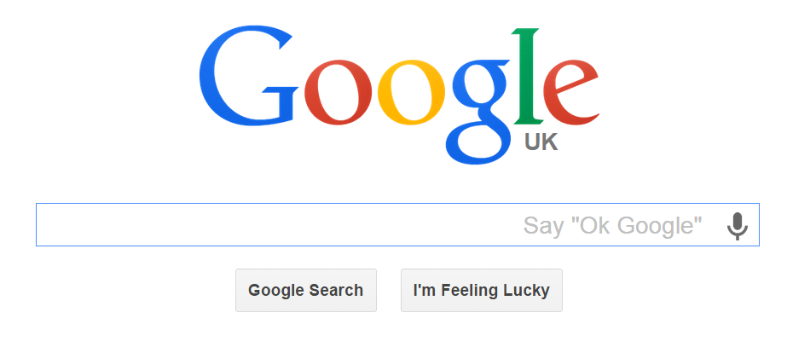
Information Age
probability / coding theory
Transmit, share, copy, digest, delete, evaluate, interpret, value, ignore
Shannon entropy is concerned with the transmission of a message
Algorithmic information theory is concerned with the information content of the message itself.
1948

Slide 3
Hangman
3 games

Slide 4
Hangman
3 games
Stirring (8) – English has some predictably so that makes it interesting.
Random letters – not interesting
All the same letter – not interesting

Slide 5
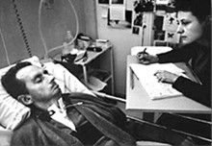
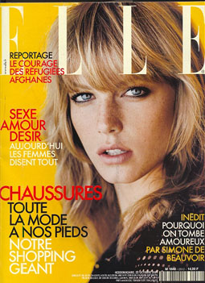
The diving bell and the butterfly

Slide 6
The diving bell and the butterfly
ABCDEFGHIJKLMNOPQSTUVWXYZ
A is 1 time unit
B is 2
C is 3
Z is 26

Slide 7
The diving bell and the butterfly
ABCDEFGHIJKLMNOPQSTUVWXYZ

Slide 8
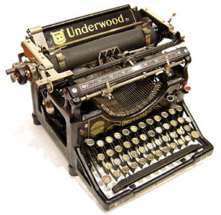
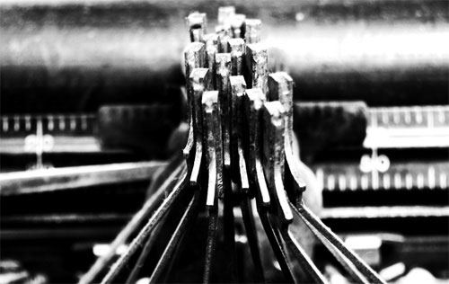
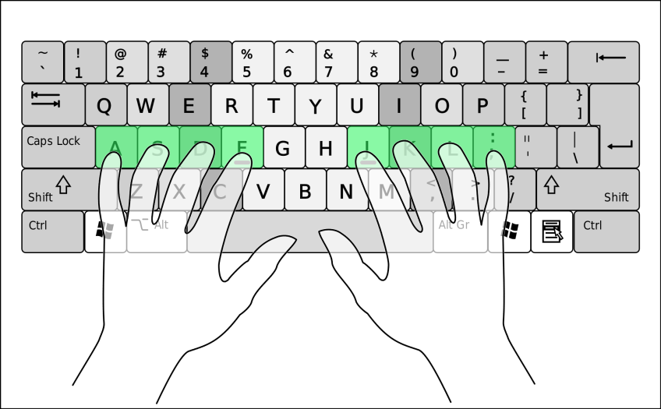
Frequency of a Symbol
Typewriter QWERTY
Computer QWERTY???

Slide 9
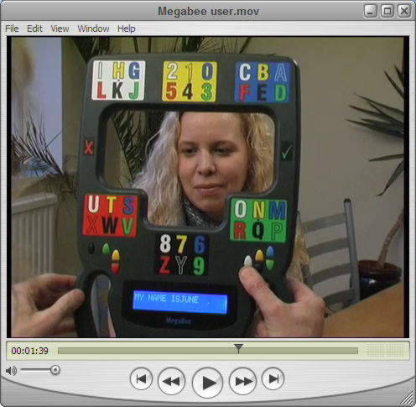
Frequency of a Symbol
Typewriter QWERTY
Computer QWERTY???
Megabee HAWKING movie https://www.youtube.com/watch?v=BtMeI3xGtcM

Slide 11
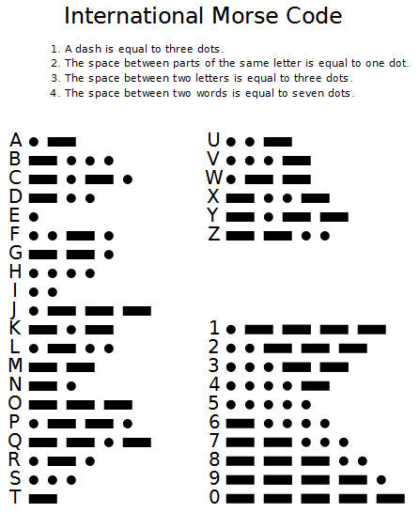
Morse Code
How many symbols are in the Morse code?
1, 2, 3, 4, 5
https://www.youtube.com/watch?v=Z5uyK5MrsTs

Slide 12
Morse Code
Contains 4 symbols
Morse did basic frequency analysis
Within 15% of optimum.
https://www.youtube.com/watch?v=Z5uyK5MrsTs

Slide 13
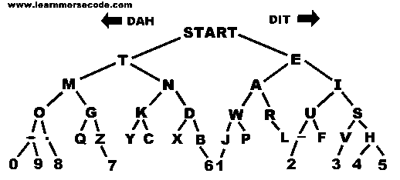
Morse code tree
A few gaps

Slide 14
Morse code tree
… --- … 2) --- -- --.

Slide 15
Morse code tree
… --- … SOS 2) --- -- --. OMG

Slide 16
Graph of Morse Code

Slide 17
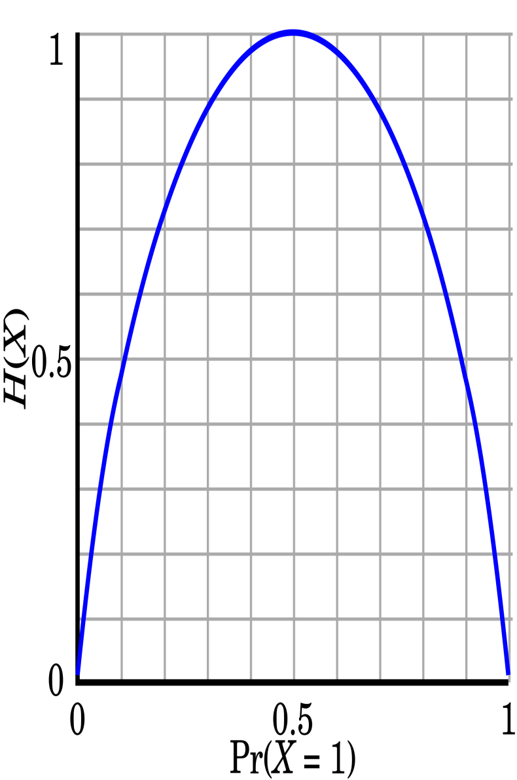
Coin Tossing
A fair coin
A double headed/ tailed coin
Gambler’s fallacy – each toss is independent.
Symmetric,
monotonic

Slide 18
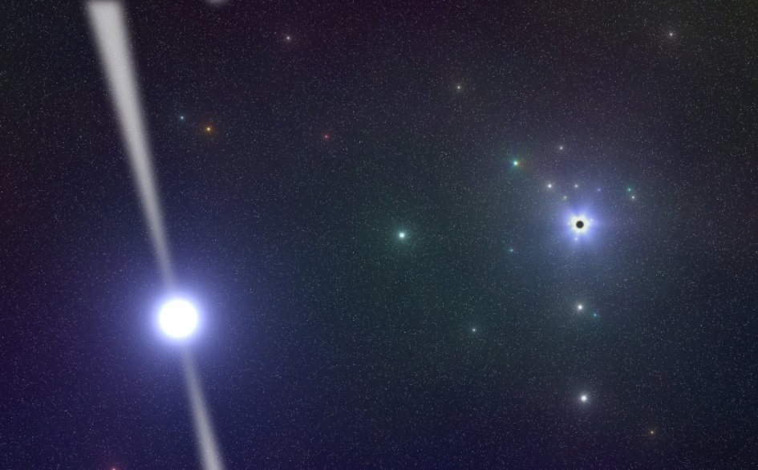
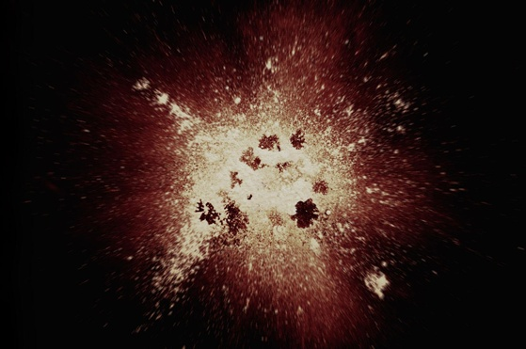
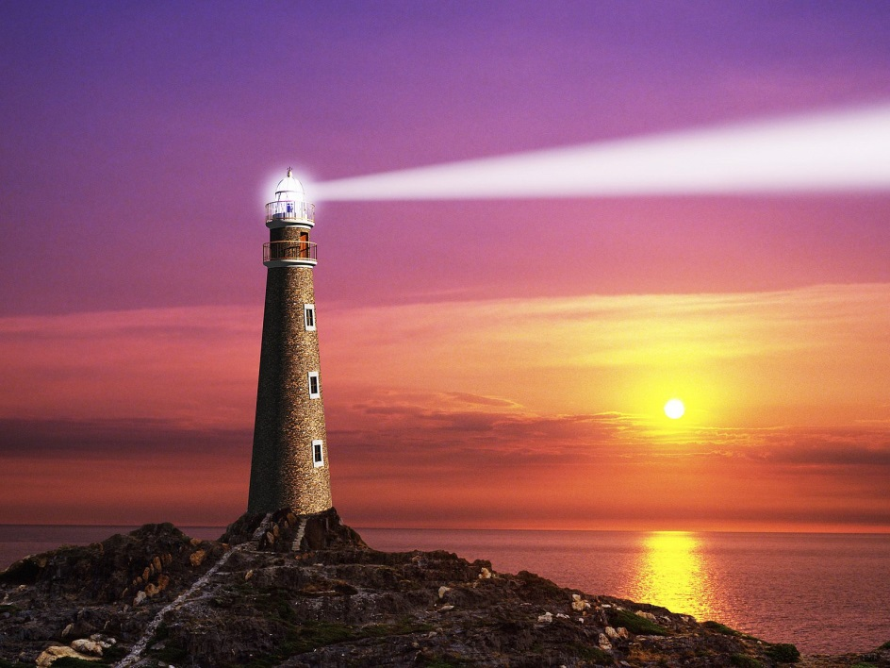
Big Bang and Pulsars
Examples of high and low entropy events

Slide 19
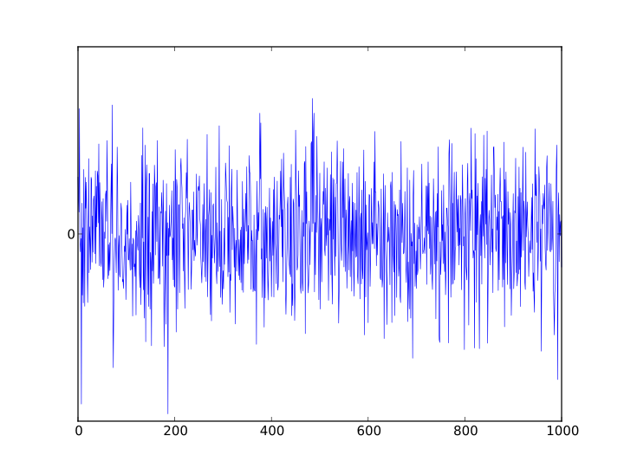
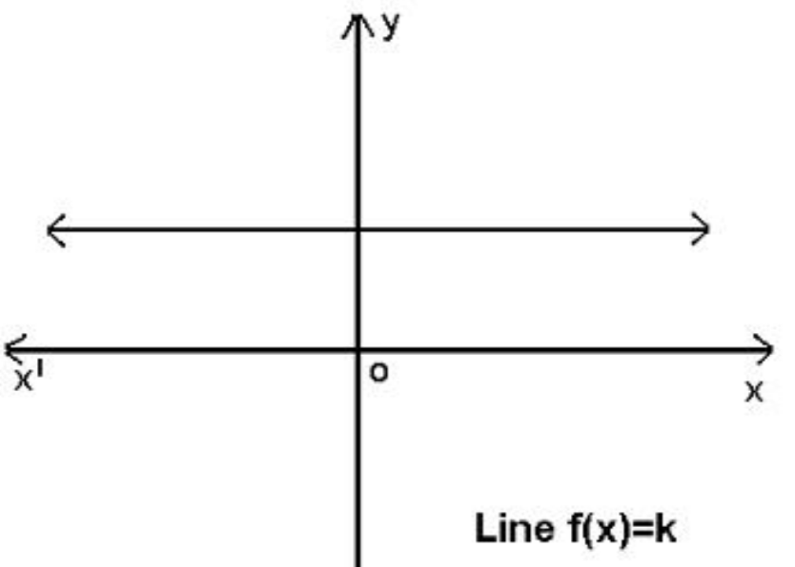
White Noise, constant function

Slide 20
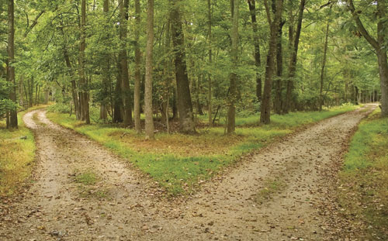
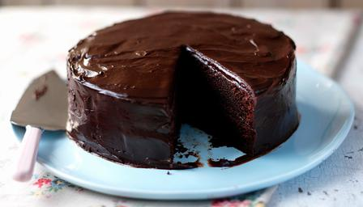
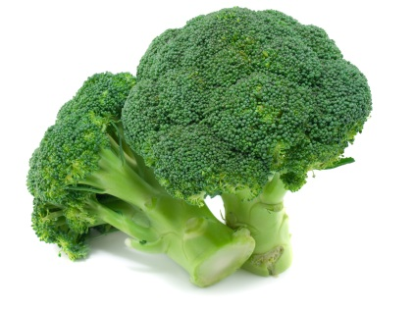
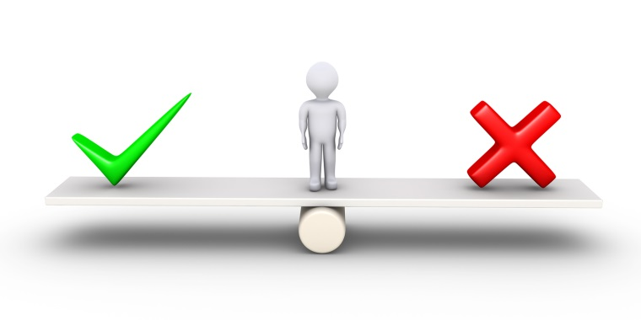
Making a Decision
If you cannot make a rational decision …toss a fair coin.
This has maximum “surprize” or least predictability.
With a friend – chocolate cake or broccoli.
http://en.wikipedia.org/wiki/The_Dice_Man – makes decisions by rolling a dice.

Slide 21
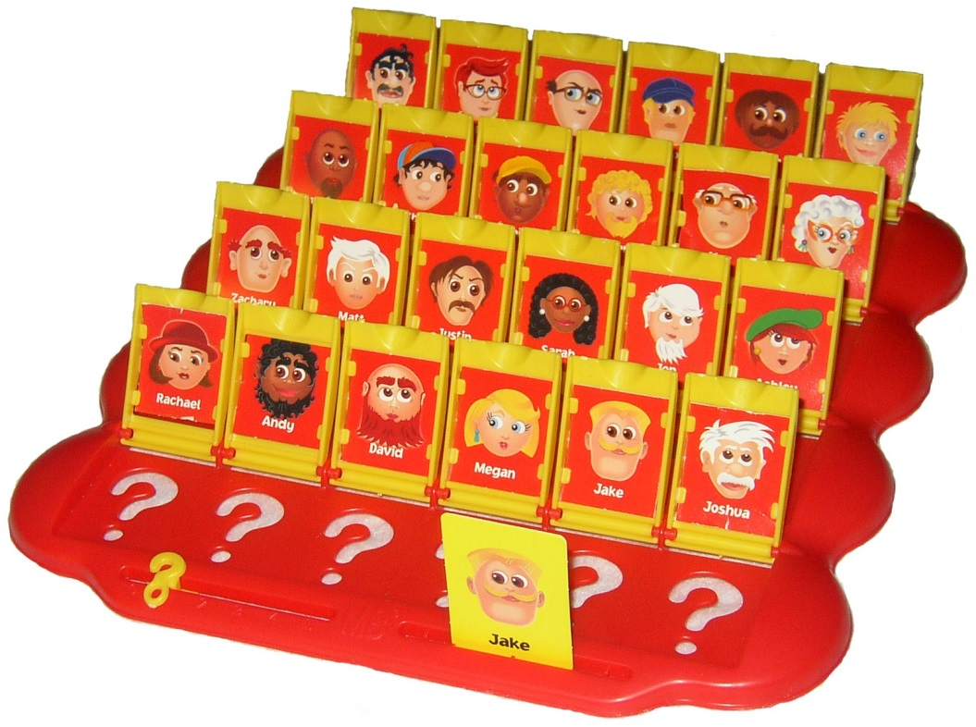
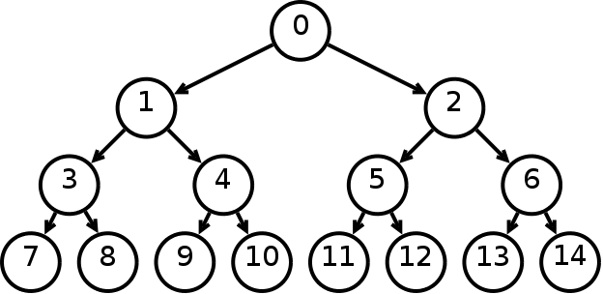
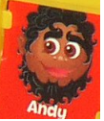
20 questions
You can ask yes/no questions. Not L/R
What is a good question? Phone book
How many questions on average?
Can use it as a code.
This is not proved in machine learning books.

Slide 22
Two Possible Codes
4 choices
Log 4 = 2
A – two bits of information
T – two bits of information
C – two bits of information
G – two bits of information
0
1
0
1
0
1
A
T
C
G
SYMBOL | CODE
A | "00"
T | "01"
C | "10"
G | "11"
TOTAL | 8

Slide 23
Two Possible Codes
1
0
A
0
1
0
1
T
0
1
0
1
0
1
A
T
C
G
C
G
SYMBOL | CODE
A | "00"
T | "01"
C | "10"
G | "11"
SYMBOL | CODE
A | "0"
T | "10"
C | "110"
G | "111"
TOTAL | 8
TOTAL | 9

Slide 24
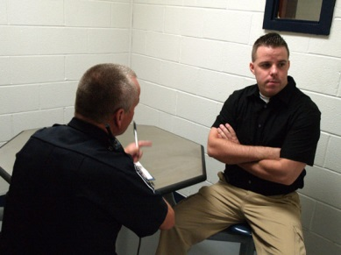
Police Interview
Police may ask you to repeat your statement. Why.
This is a tactic
Or they may ask you for details in a different order.
“no comment interview” https://www.youtube.com/watch?v=q4f_vi7yKuU
What is the information content?
Neither confirm nor deny

Slide 25
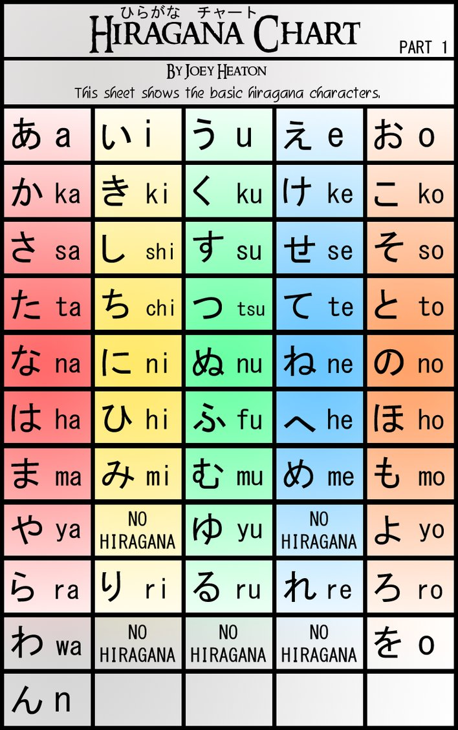
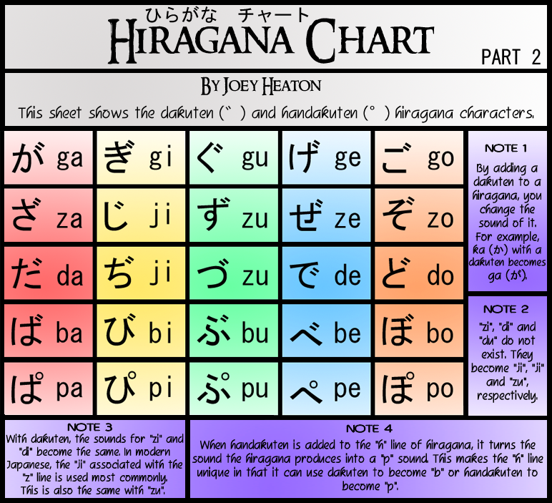
Linguistics.
zs, td, pb, fv ???
`` – how much info?
shorthand.
Lip reading.

Slide 26
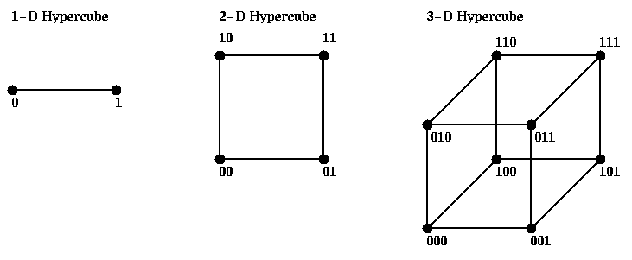
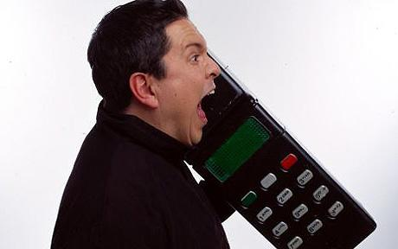
Redundancy
Cmprssd Vw f Infrmtn Thry
English (Monday, Wednesday, Friday)
Japanese (Mon, Wed, Fri)
Texting “r u 3 2nite” – like Telegrams.
Juliet, Romeo, Whisky
vowels, accent and feeling, consonants are the content of the message (I love you /come on).
Linux commands are compressed English rm remove, cp copy.
Adding redundantly to a message is the opposite of compressing it.
Phone numbers should not clash.

Slide 27
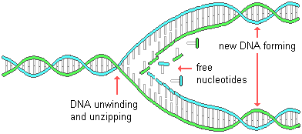
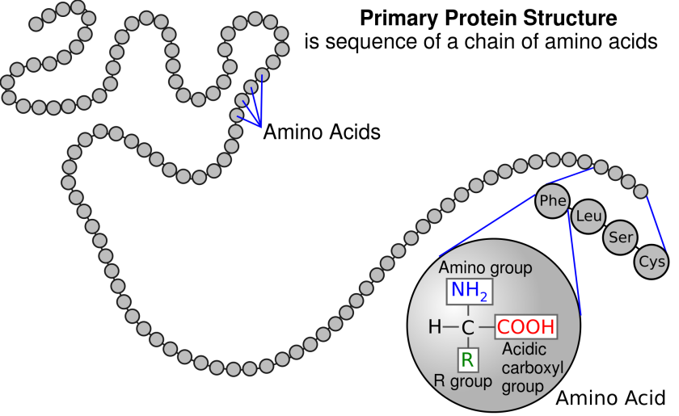
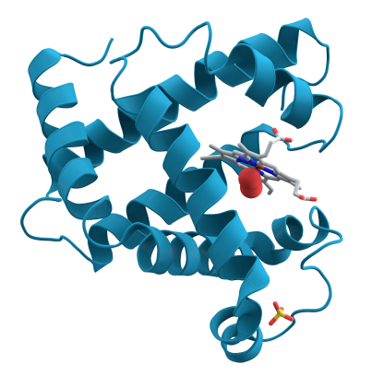
Genetic Code 1
Which strand of DNA contains more information
left or right?
resulting amino acid?
4 BASES A-T C-G
20 AMINO ACIDS

Slide 28
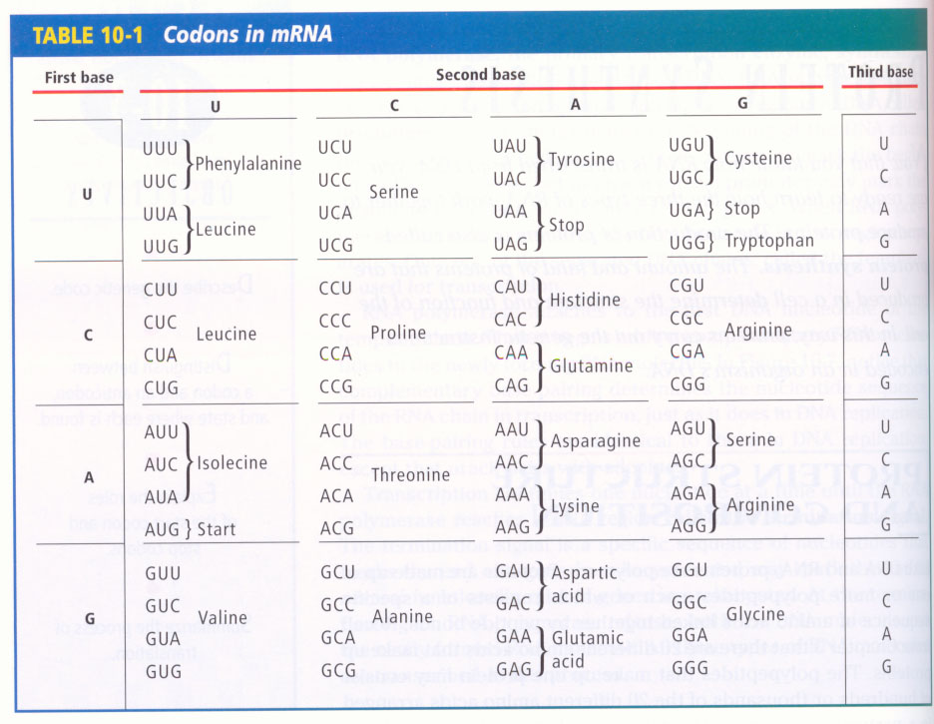
Genetic Code
Genetic Code 1

Slide 29
Genetic Code 3
No gaps
Use 3 bases (ATCG) not 2 or 4.
Instantaneous – needed!
Even if mistake is made in last base – often okay – grouped
Even if wrong amino acid – still has similar chemical properties.

Slide 30
Lossless/Lossy Compression
https://www.youtube.com/watch?v=QEzhxP-pdos

Slide 31
Incompressible
bit strings
length 3
Not all strings are compressible.
We want to compress all bit strings of length 3, to be shorter.
proof – pigeon hole principle.
In fact most strings are not compressible – “RENAMING”
0 | 0 | 0 | 0
0 | 0 | 1 | 1
0 | 1 | 0 | 2
0 | 1 | 1 | 3
1 | 0 | 0 | 4
1 | 0 | 1 | 5
1 | 1 | 0 | 6
1 | 1 | 1 | 7
“” | 0 | 1 | 00 | 01 | 10 | 11
Bit strings of length <= 2

Slide 32
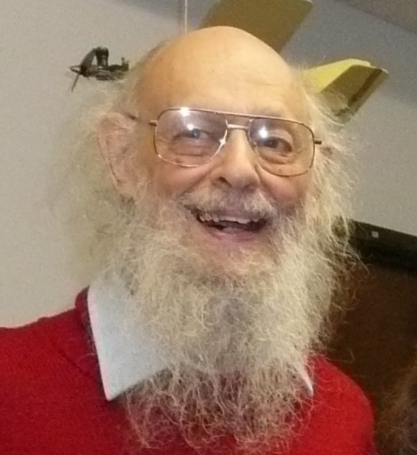
Kolmogorov Complexity
“0000000000000…”
“0010010010010…”
“1011010010110…”

Slide 33
Kolmogorov Complexity
“0000000000000…” repeat 60 times “0”
“0010010010010…” repeat 20 times “001”
“1011010010110…” print “1011010010110…”

Slide 34
Kolmogorov Complexity
“0000000000000…” repeat 60 times “0”
“0010010010010…” repeat 20 times “001”
“1011010010110…” print “1011010010110…”
According to probability theory they are all equally likely?
If there is a pattern, we can write a rule and implement it on a computer.
Kolmogorov complexity is the length of the shortest computer program to print the string and halt.
Which string above have high/low Kolmogorov complexity???
Amazing fact – it is independent of the computer you run it on.
Kolmogorov complexity is a generalization of Shannon entropy.

Slide 35
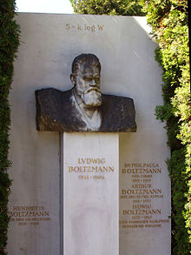
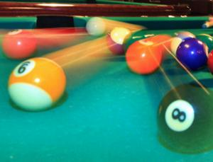
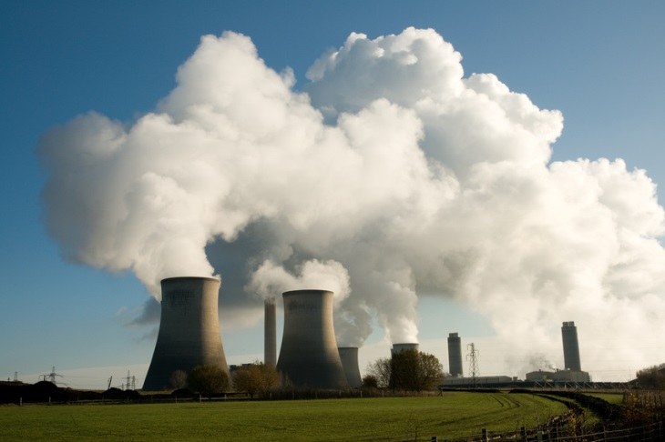
2nd Law of Thermodynamics
Entropy (disorder) increases (statistically) (closed system)
things naturally become untidy (definition of untidy?).
Only irreversible law of physics
S = K log W
W = number microstate corresponding to that microstate

Slide 36
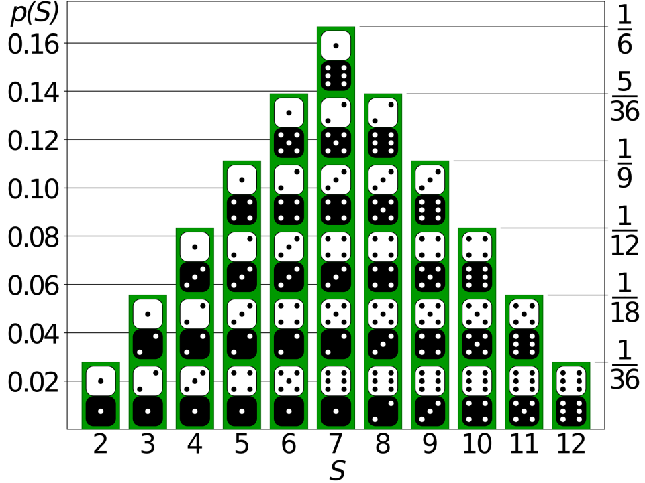
2nd law e.g. Vibrate 2 Dice on a Tray
Microstate
Values on each dice
E.g. 3,5
Macrostate
Sum
8=3+5
probabilities

Slide 37
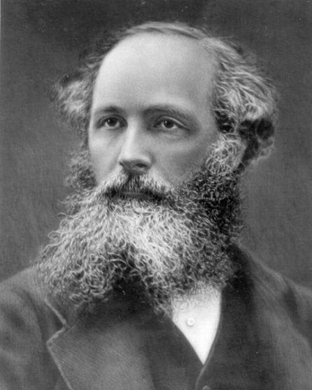
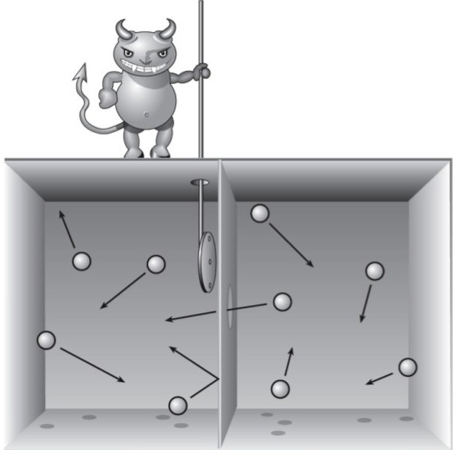
Maxwell’s Demon 1
The demon can
separate the atoms.
ENERGY FOR FREE

Slide 38
Maxwell’s Demon 2
Divide cylinder into 8
We can do work (energy) on the gas by compressing either piston. Log v1/v2
We can half push the pistons in order e.g. 010 (left, right, left)
We have reduced the entropy of the gas.
K log (#microstates)
3 bits of information

Slide 39
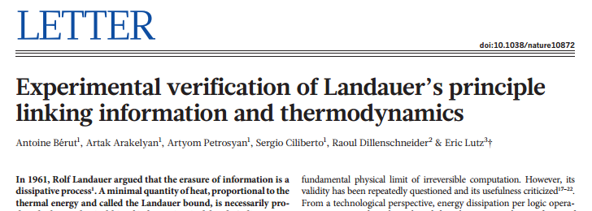
Experimental verification of Landauer’s principle
Irreversible transformation K T ln 2 (delete a BIT)
Nature 483, 187–189 (08 March 2012) doi:10.1038/nature10872Received 11 October 2011 Accepted 17 January 2012 Published online 07 March 2012
http://www.nature.com/nature/journal/v483/n7388/full/nature10872.html

Slide 40
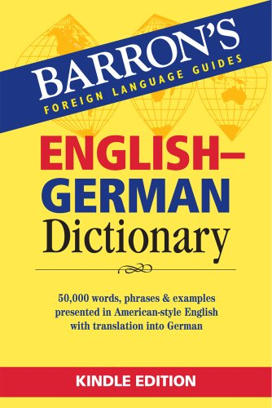
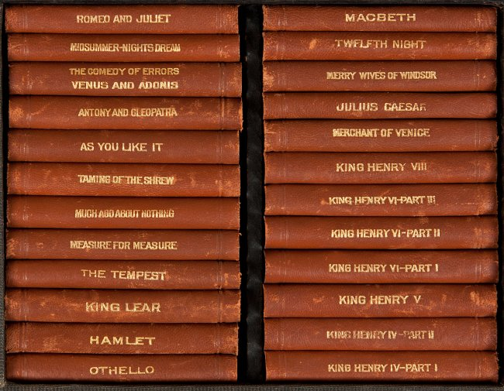
Information and Translating
digit | word
1 | one
2 | two
3 | three
4 | four
… | …
Which contains more “information”
5,6,4…
five, six, four, …
Now consider Shakespeare in English and German.
If we translate word for word – the number of pages would increase (10%).
If we have a dictionary – this is a “one off cost” in principle.

Slide 41
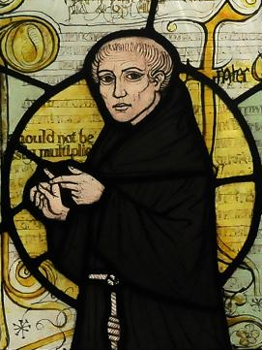
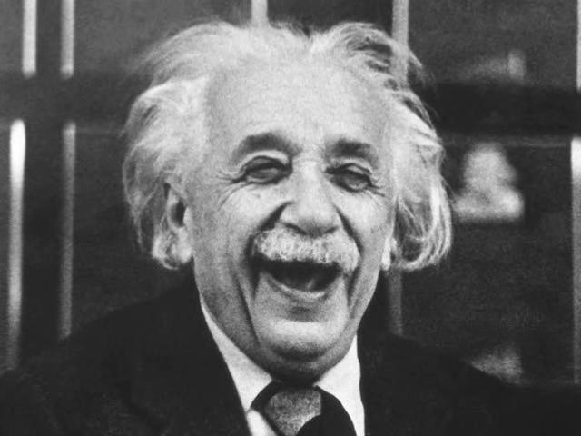
OCCAM’S RAZOR
KEEP IT SIMPLE
Black hypothesis, blue data
Given two hypotheses pick the simpler. Simple is better
Everything should be made as simple as possible, but not simpler.
What is next in the sequence
2,4,6,8,?????????
1, 2, 4, 8, 16, ????????

Slide 42
OCCAM’S RAZOR
KEEP IT SIMPLE
Black hypothesis, blue data
Given two hypotheses pick the simpler. Simple is better
Everything should be made as simple as possible, but not simpler.
What is next in the sequence
2,4,6,8, ”WHO DO WE APPRECIATE”
1, 2, 4, 8, 16, ????????

Slide 43
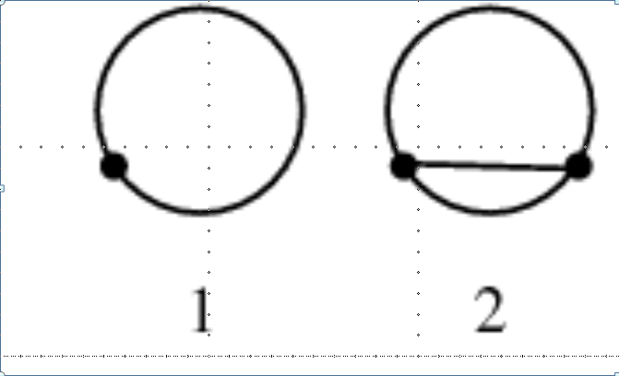
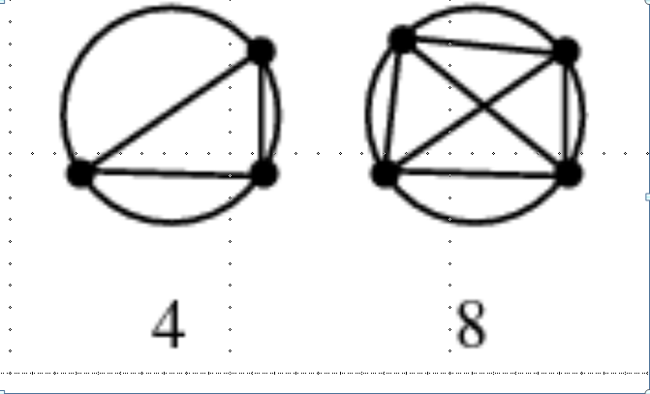
What is next in sequence, ..
1, 2, 4, 8, 16, 31, 57, 99, 163, 256
In mathematic we can understand/see the rule.
In physics we can only test hypothesis and make “guesses”.

Slide 44
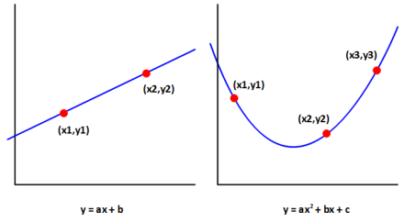
Experimental Approach
We make a number of observations
We make a model consistent with our measurements.
We make predictions and test them.
We revise our model.
Measurements
Output data
dependent
variable
Input data
Independent
variable
We should prefer the simpler rule, not because it is simple,
but because it corresponds more frequently to the observations

Slide 45
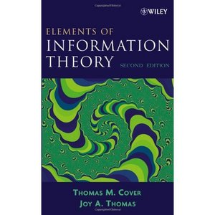
Which book?

Slide 46
Which book?
Toss a coin

Slide 47
- …. .
. -. -..

Slide 48
- …. .
. -. -..
The end

Slide 49
Next Public Lecture
http://www.maths.stir.ac.uk/lectures/
2nd April (2 weeks)
Ant hills, traffic jams and social segregation: modelling the world from the bottom up Dr Savi Maharaj

