Slide 1
Cmprssd Vw f Infrmtn Thry: A Compressed View of Information John Woodward jrw@cs.stir.ac.uk
Is a picture really worth 1000 words?
Does the Complete Works of Shakespeare contain more information in its original language or a translation?
Why is tossing a coin the best way to make a decision?
What is your best defence when interrogated?
Why is the original scientific paper outlining information theory still relevant?

Slide 2
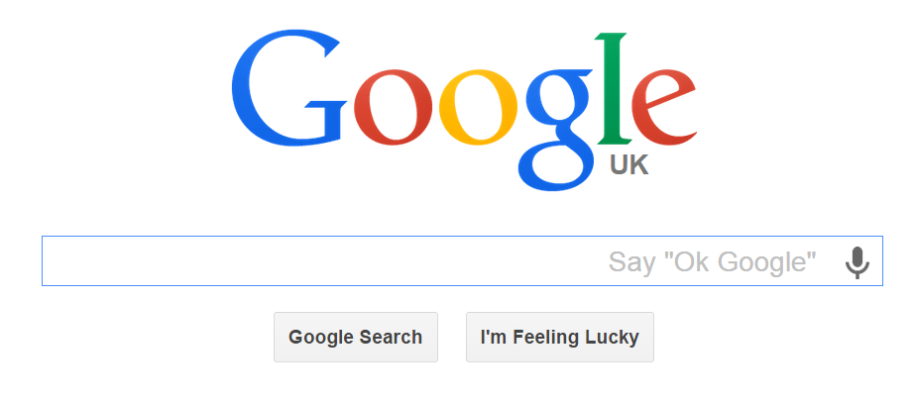
Information Age
probability / coding theory
Transmit, share, copy, digest, delete, evaluate, interpret, value, ignore
Shannon entropy is concerned with the transmission of a message
Algorithmic information theory is concerned with the information content of the message itself.
1948

Slide 3
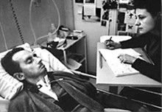
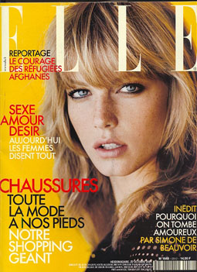
The diving bell and the butterfly

Slide 4
The diving bell and the butterfly
ABCDEFGHIJKLMNOPQRSTUVWXYZ
Move you finger L -> R
A is 1 time unit
B is 2
C is 3
Z is 26
e.g. “BUT” 2 + 21 + 20 “SECONDS”

Slide 5
The diving bell and the butterfly
ABCDEFGHIJKLMNOPQSTUVWXYZ

Slide 6
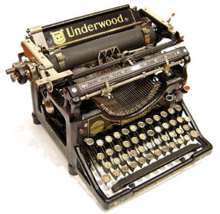
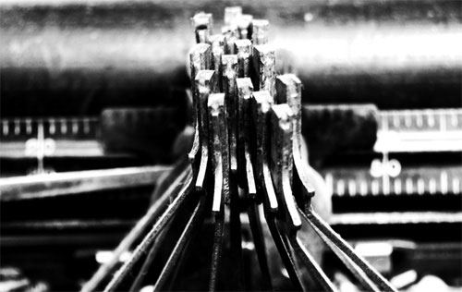
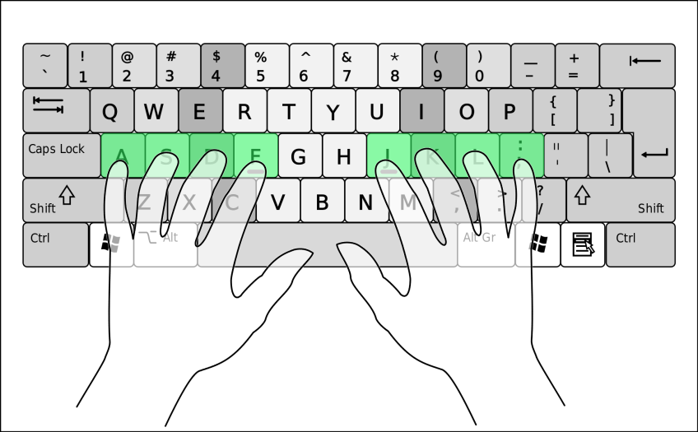
Frequency of a Symbol
Typewriter QWERTY
Computer QWERTY???

Slide 7
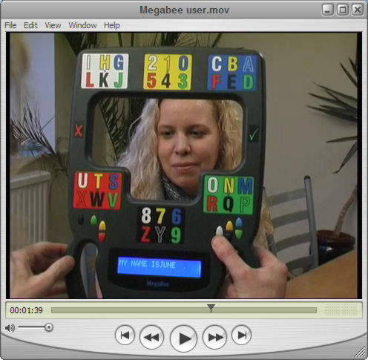
Frequency of a Symbol
Typewriter QWERTY
Computer QWERTY???
Megabee HAWKING movie https://www.youtube.com/watch?v=BtMeI3xGtcM

Slide 9
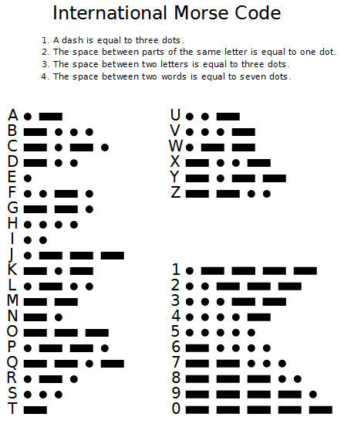
Morse Code
How many symbols are in the Morse code?
1, 2, 3, 4, 5
https://www.youtube.com/watch?v=Z5uyK5MrsTs

Slide 10
Morse Code
Contains 4 symbols.
Morse did basic frequency (probabilistic) analysis.
Within 15% of optimum.
https://www.youtube.com/watch?v=Z5uyK5MrsTs

Slide 11
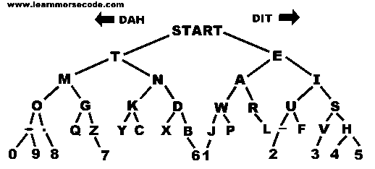
Morse code tree
THESE SHOULD BE THE KEYS ON YOUR COMPUTER
3 gaps
Most frequent letters

Slide 12
Morse code tree
… --- … 2) --- -- --.

Slide 13
Morse code tree
… --- … SOS 2) --- -- --. OMG

Slide 14
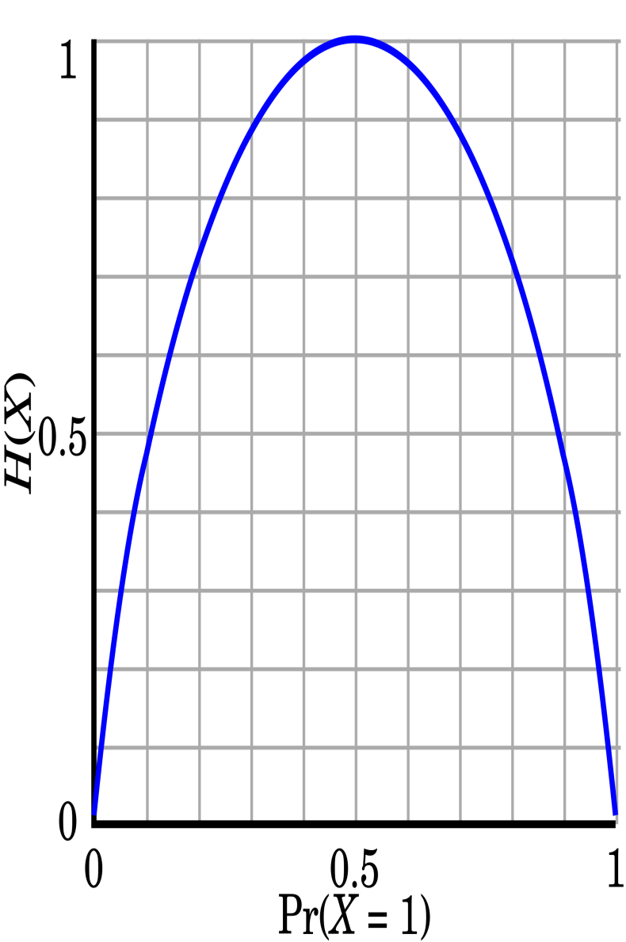
Coin Tossing
A fair coin
A double headed/ tailed coin
Gambler’s fallacy – each toss is independent.
Symmetric,
monotonic

Slide 15
Coin Tossing
A fair coin
A double headed/ tailed coin
Gambler’s fallacy – each toss is independent.
Symmetric,
monotonic

Slide 16
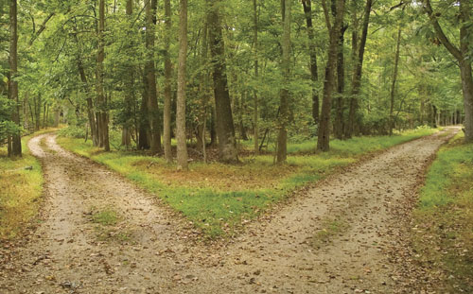
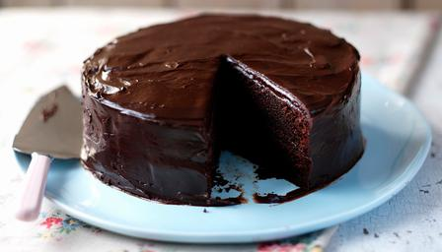
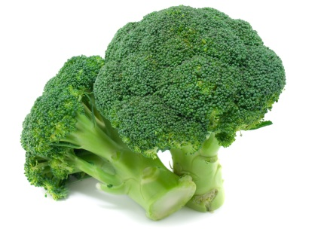
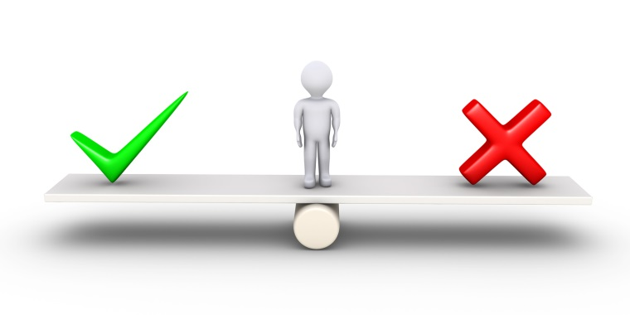
Making a Decision
If you cannot make a rational decision …toss a fair coin. MAXIMUM ENTROPY
This has maximum “surprize” or least predictability.
With a friend – chocolate cake or broccoli.
http://en.wikipedia.org/wiki/The_Dice_Man – makes decisions by rolling a dice.

Slide 17
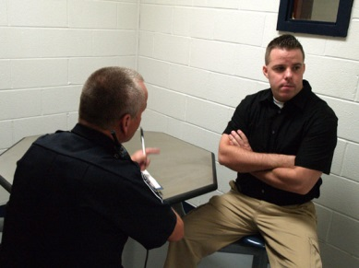
Police Interview
Police may ask you to repeat your statement. Why.
This is a tactic
Or they may ask you for details in a different order.
“no comment interview”
MINIMUM ENTROPY
https://www.youtube.com/watch?v=q4f_vi7yKuU
What is the information content?
Neither confirm nor deny

Slide 18
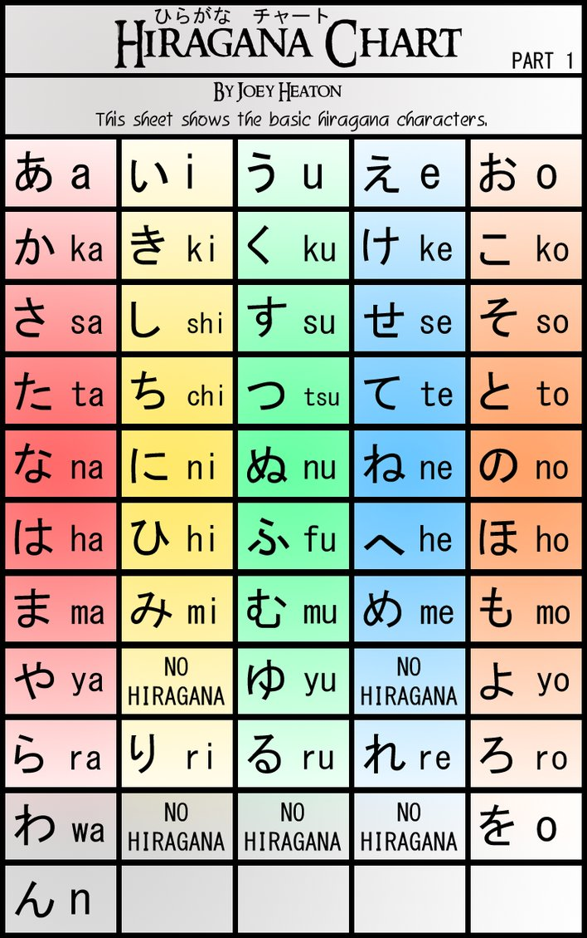
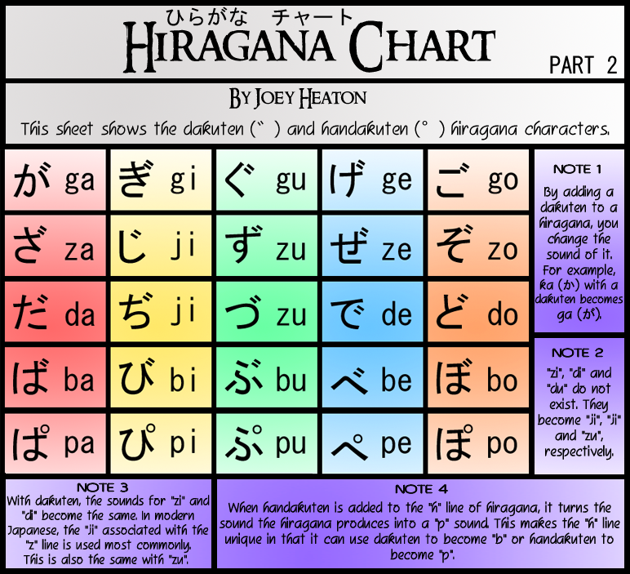
Linguistics.
zs, td, pb, fv ???
`` – how much info?
shorthand.
Lip reading.

Slide 19
Linguistics.
zs, td, pb, fv ???
`` – how much info?
shorthand.
Lip reading.

Slide 20
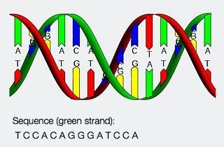
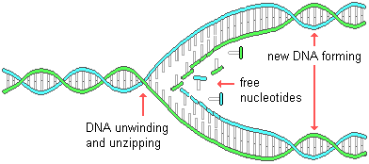
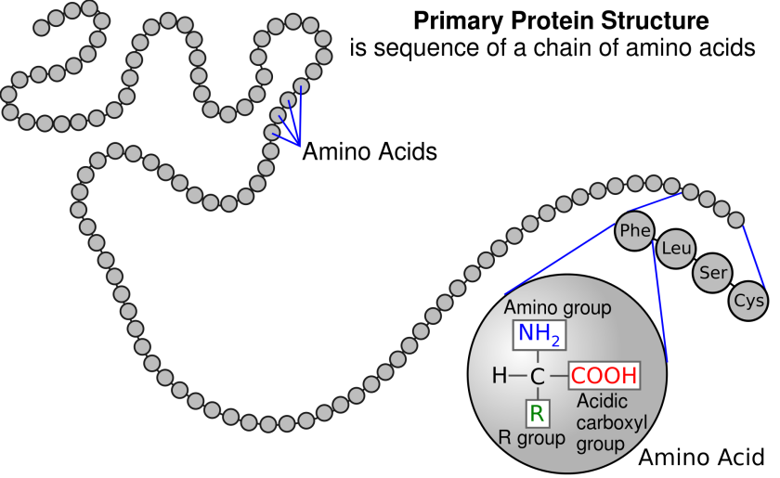
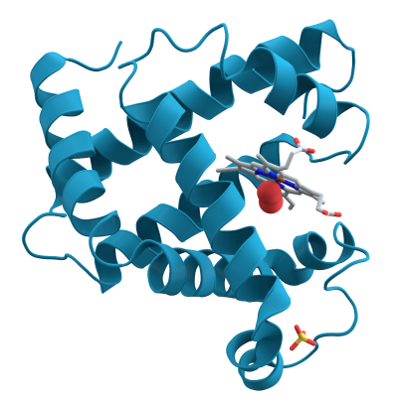
Genetic Code 1
4 BASES A-U C-G
20 AMINO ACIDS

Slide 21
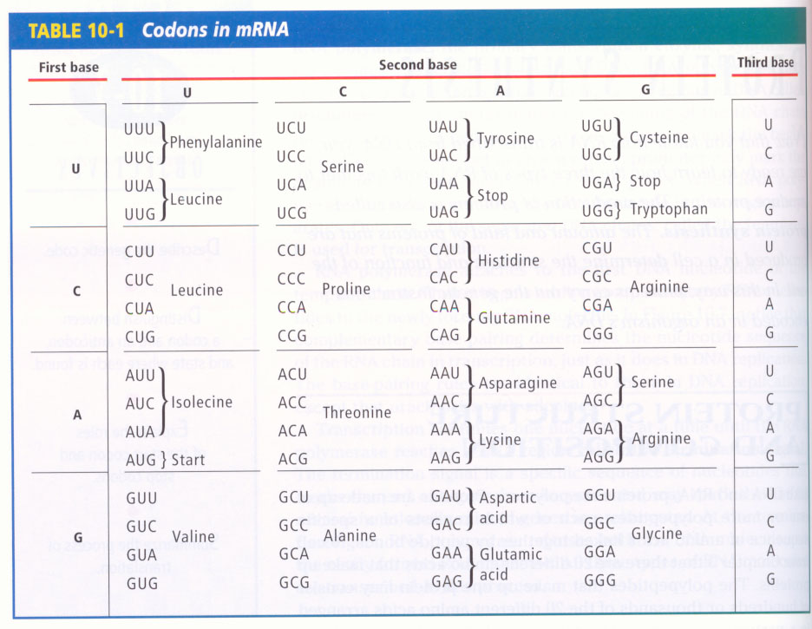
Genetic Code
Genetic Code 2

Slide 22
Genetic Code 3
No gaps
Use 3 bases (ATCG) not 2 or 4 for 21 code words (20 amino acids + stop)
Instantaneous – needed!
Even if mistake is made in last base – often okay – grouped (locality/redundancy)
Even if wrong amino acid – still has similar chemical properties.

Slide 23
Half Time ☺
Transmitting information – Shannon entropy.
Algorithmic complexity – the information in the message.

Slide 24
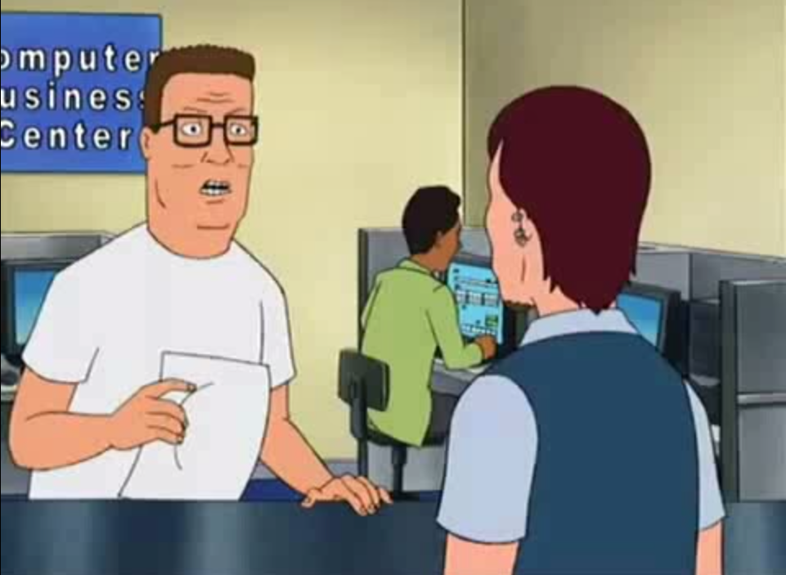
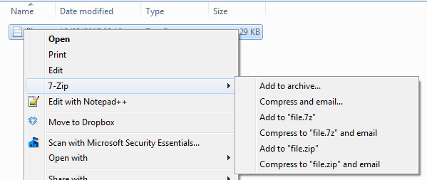
Lossless/Lossy Compression
https://www.youtube.com/watch?v=QEzhxP-pdos

Slide 25
Compress A File
8 bit strings
length = 3
Not all strings are compressible.
We want to compress all bit strings of length 3, to be shorter.
proof – pigeon hole principle.
In fact most strings are not compressible – “RENAMING”
0 | 0 | 0 | 0
0 | 0 | 1 | 1
0 | 1 | 0 | 2
0 | 1 | 1 | 3
1 | 0 | 0 | 4
1 | 0 | 1 | 5
1 | 1 | 0 | 6
1 | 1 | 1 | 7
“” | 0 | 1 | 00 | 01 | 10 | 11
7 Bit strings of length <= 2

Slide 26
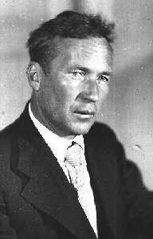
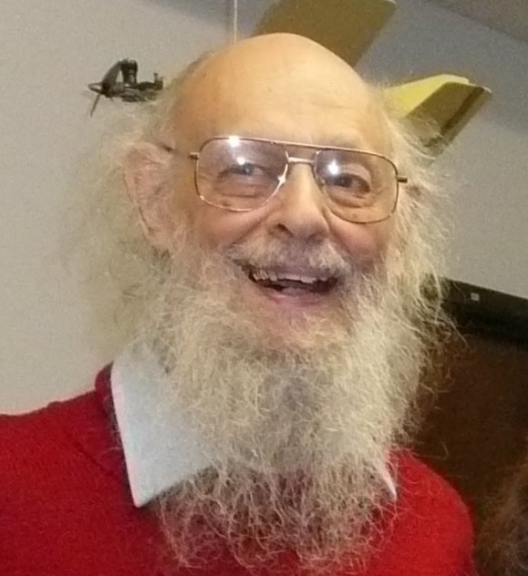
Kolmogorov Complexity
“0000000000000…”
“0010010010010…”
“1011010010110…”

Slide 27
Kolmogorov Complexity
“0000000000000…” repeat 60 times “0”
“0010010010010…” repeat 20 times “001”
“1011010010110…” print “1011010010110…”

Slide 28
Kolmogorov Complexity
“0000000000000…” repeat 60 times “0”
“0010010010010…” repeat 20 times “001”
“1011010010110…” print “1011010010110…”
According to probability theory they are all equally likely?
If there is a pattern, we can write a rule and implement it on a computer.
Kolmogorov complexity of a bit string is the length of the shortest computer program to print the string and halt.
Can be thought of as a measure of compressibility.
Amazing fact – it is independent of the computer you run it on.
Which string above have high/low Kolmogorov complexity???
Kolmogorov complexity is a generalization of Shannon entropy.

Slide 29
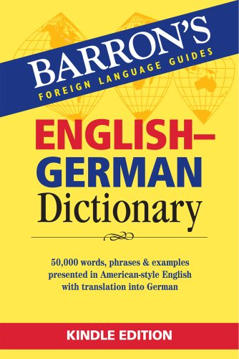
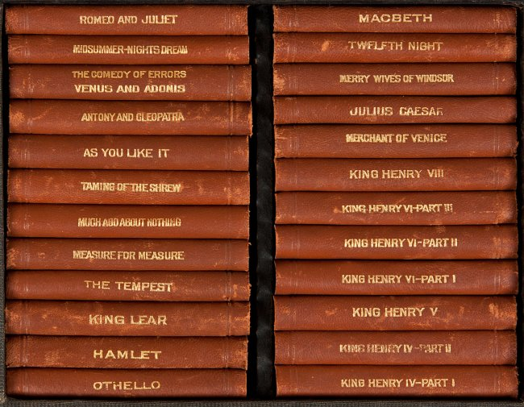
Information and Translating
digit | word
1 | one
2 | two
3 | three
4 | four
… | …
Which contains more “information”
5,6,4…
five, six, four, …
Now consider Shakespeare in English and German.
If we translate word for word – the number of pages would increase (10%).
If we have a dictionary – this is a “one off cost” in principle – an increase of fixed amount!!!!

Slide 30
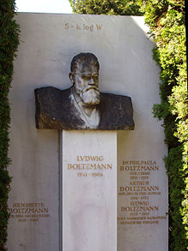
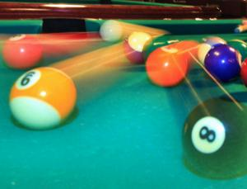
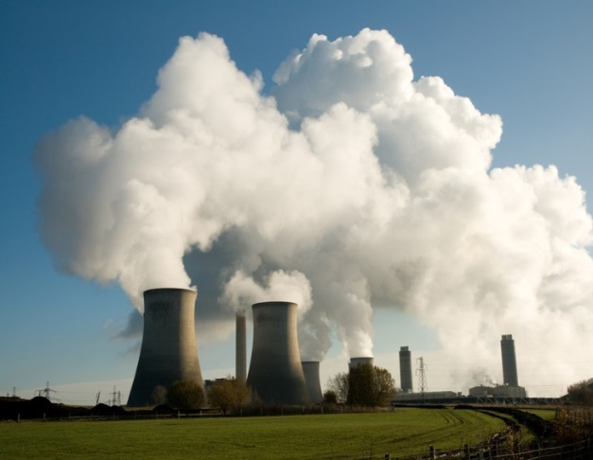
2nd Law of Thermodynamics
Entropy (disorder) increases (statistically) (closed system)
things naturally become untidy (definition of untidy?).
Only irreversible law of physics
S = K log W
W = number microstates corresponding to that macrostate (ratio)

Slide 31
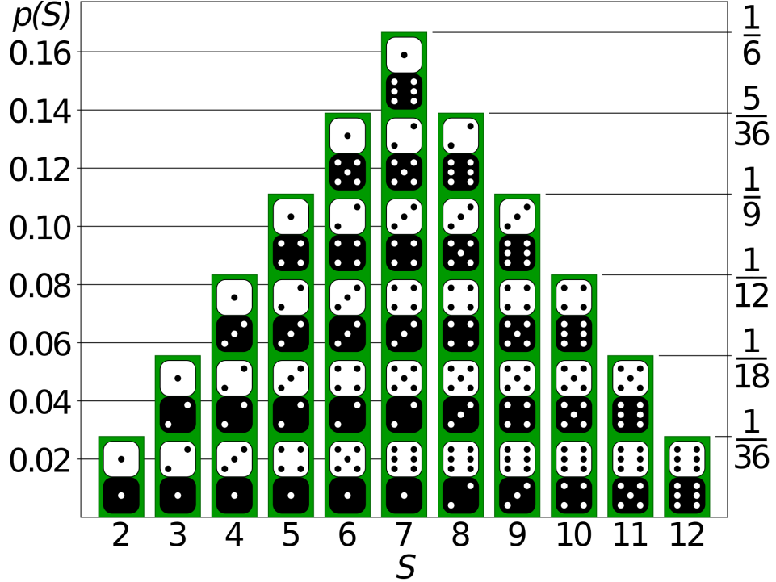
2nd law e.g. Vibrate 2 Dice on a Tray
Microstate
Values on each dice
E.g. 3,5
Macrostate
Sum
E.g. 8=3+5
probabilities

Slide 32
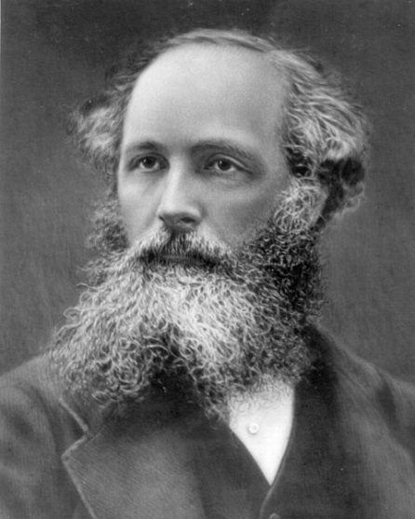
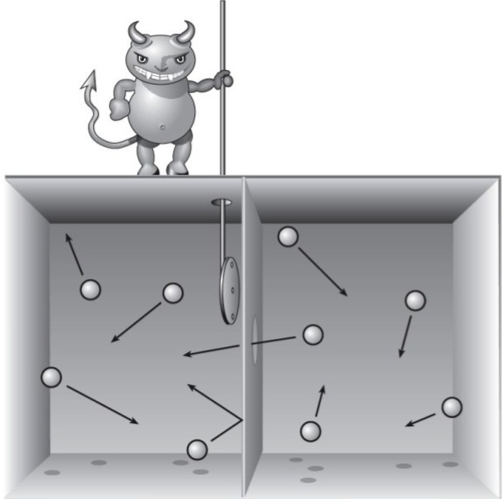
Maxwell’s Demon 1860s
The demon can
separate the atoms.
ENERGY FOR FREE

Slide 33
Maxwell’s Demon 2
Divide cylinder into 8
We can do work (energy) on the gas by compressing either piston. Log v1/v2
We can half push the pistons in order e.g. 010 (left, right, left)
We have reduced the entropy of the gas.
K log (#microstates)
3 bits of information

Slide 34
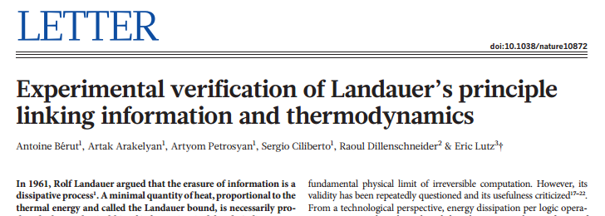
Experimental verification of Landauer’s principle
Irreversible transformation K T ln 2 (delete a BIT)
Nature 483, 187–189 (08 March 2012) doi:10.1038/nature10872Received 11 October 2011 Accepted 17 January 2012 Published online 07 March 2012
http://www.nature.com/nature/journal/v483/n7388/full/nature10872.html

Slide 35
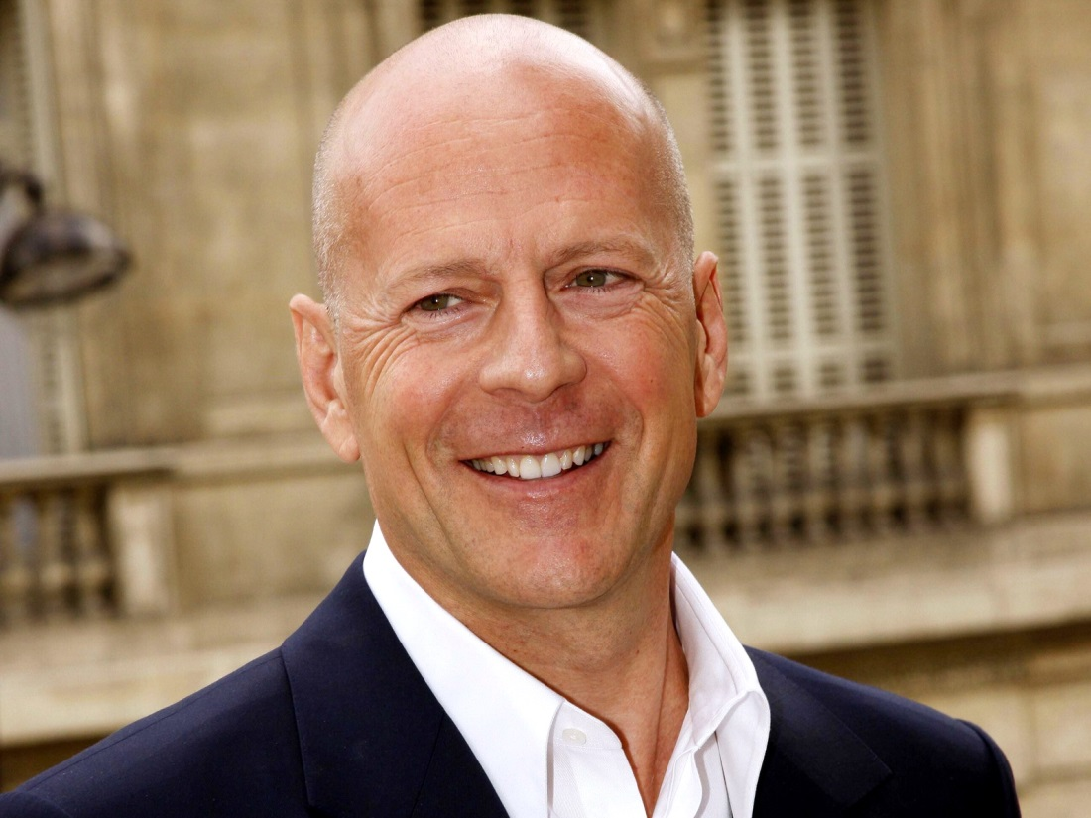
Bald Man
What does he say to the barber each time.
How much “information” is contained in his hair

Slide 36
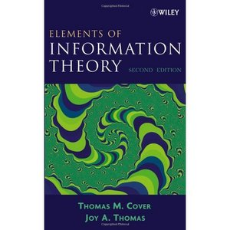
Which book?

Slide 37
Which book?
Toss a coin!!!!

Slide 38
- …. .
. -. -..

Slide 39
- …. .
. -. -..
The end

Slide 40
Next Public Lecture
http://www.maths.stir.ac.uk/lectures/
2nd April (2 weeks)
Ant hills, traffic jams and social segregation: modelling the world from the bottom up Dr Savi Maharaj

