Slide 1
The 18th Online World Conference on Soft Computing in Industrial Applications
World Wide Web, 1-12 December 2014
Automatic Design of Algorithms via Hyper-heuristic Genetic Programming
John Woodward John.Woodward@cs.stir.ac.uk
CHORDS Research Group, Stirling University
Computational Heuristics, Operations Research and Decision Support
http://www.maths.stir.ac.uk/research/groups/chords/
Notes:
Miller and langdon, SPECIAL ANOUNCEMENT
SELF CONTAINED
IMPROVE THIS TALK EACH TIME I GIVE IT
TAKE THE OTHER TALKS WITH ME TOO.

Slide 2
If you want to follow
If you want to down load the slides and follow.
Each slide is numbered (BOTTOM RIGHT)
Each slide has a title.
Bullet points have numbers.
I will refer to these as we go.
You can refer to these in question period.
References are given e.g. [12]
To download slides http://www.cs.stir.ac.uk/~jrw/talks/talks.html

Slide 3
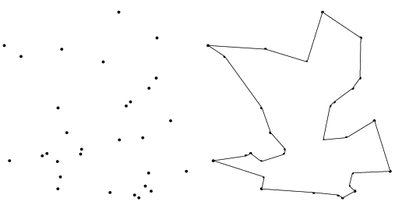
Conceptual Overview
Combinatorial problem e.g. Travelling Salesman
Exhaustive search ->heuristic?
Genetic Programming
code fragments in for-loops.
Travelling Salesman Instances
TSP algorithm
Genetic Algorithm
heuristic – permutations
EXECUTABLE on MANY INSTANCES!!!
Give a man a fish and he
will eat for a day.
Teach a man to fish and he
will eat for a lifetime.
Travelling Salesman
Tour – list of cities
Scalable? General?
New domains for GP
Single tour NOT EXECUTABLE!!!
Notes:
If you are in the wrong room

Slide 4
Program Spectrum
1. Genetic Programming
{+, -, *, /}
{AND, OR, NOT}
3. First year university course
On Java, as part of a computer
Science degree
4. LARGE
Software
Engineering
Projects
2. Automatically
designed heuristics
(this tutorial)
Increasing “complexity”

Slide 5
Overview of Applications
 | SELECTION | MUTATION GA | BIN PACKING | MUTATION EP
Scalable performance | ? | ? | Yes - why | No - why
Generation ZERO | Rank, fitness proportional | NO – needed to seed. | Best fit | Gaussian and Cauchy
Problem class |  | Parameterized function | Item size | Parameterized function
Results Human Competitive | Yes | Yes | Yes | Yes
Algorithm iterate over | Population | Bit-string | Bins | Vector
Search Method | Random Search | Iterative Hill-Climber | Genetic Programming | Genetic Programming
Type Signatures | R^2->R | B^n->B^n | R^3->R | ()->R
Reference | [16] | [15] | [6,9,10,11] | [18]

Slide 6
Plan: From Evolution to Automatic Design
  (assume knowledge of Evolutionary Computation)
  Evolution, Genetic Algorithms and Genetic Programming
  Examples of automatic generation
  Genetic Algorithms (selection and mutation)
  4. Motivations (conceptual and theoretical)
  5. More examples
  Bin packing
  Evolutionary Programming
  8. Wrap up. Closing comments
  9. Questions (during AND after…) Please ☺
  Now is a good time to say you are in the wrong room ☺

Slide 7
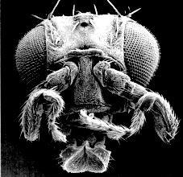
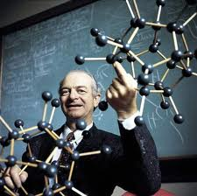

Generate and Test (Search) Examples
Manufacturing e.g. cars
Evolution “survival of the fittest”
“The best way to have a good idea is to have lots of ideas” (Pauling).
Computer code (bugs+specs)
Medicines
Scientific Hypotheses, Proofs, …
Feedback loop
Humans
Computers
Generate
Test
Notes:
http://neurophilosophy.wordpress.com/2006/08/09/the-role-of-hox-genes-in-development/
What is wrong with the test and generate method for programs.
GENERALIZE “The best way to have a good idea is to have lots of ideas” (Pauling).

Slide 8



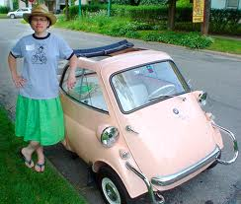
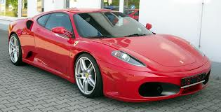
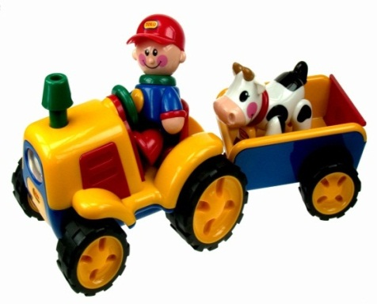
Fit For Purpose
Evolution generates organisms on a particular environment (desert/arctic).
Ferrari vs. tractor (race track or farm)
Similarly we should design meta-heuristics for particular problem class.
“in this paper we propose a new mutation operator…” “what is it for…”
Adaptation?
Colour?
Notes:
A cactus is a specialised leaf. What colour is a polar bear.
TEA CUP AND TEA SPOON.

Slide 9

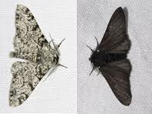
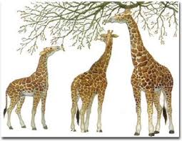
Natural/Artificial Evolutionary Process [3]
  1. variation (difference)
  2. selection (evaluation)
  3. inheritance (a)sexual reproduction)
Inheritance
Off-spring
have similar
Genotype
(phenotype)
PERFECT
CODE
Mutation/Variation
New genes introduced
into gene pool
Selection
Survival of the fittest
Peppered moth evolution
Notes:
Sexual reproduction is not necessary for evolution.
Why do giraffes have long necks.

Slide 10


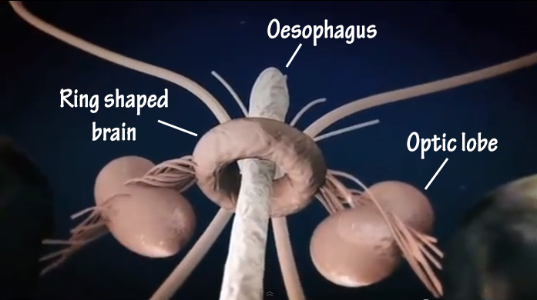
(Un) Successful Evolutionary Stories [3]
40 minutes to copy DNA but only 20 minutes to reproduce.
Ants know way to nest.
3D noise location
Bull dogs…
Giant Squid brains
Wheels?
Notes:
3D – two ears define a circle.
Wheels 1. bacteria, 2. hedgehog, 3. tumble weed.
What is wrong with a big head. (fontella)
Sheep 2X wool, cows 5X milk

Slide 11
Meta-heuristics / Computational Search
x1
Space of
permutation
solutions
e.g. test case
Prioritisation
(ORDERING).
x1
Space of bit
string solutions
e.g. test case
Minimization
SUBSET SELECTION
Space of programs
e.g. robot control,
Regression,
classification
123
132
213
231
312
321
x1
00
01
10
11
incR1
decR2
clrR3
A set of candidate solutions (search space)
Permutations O(n!), Bit strings O(2^n), Program O(?)
For small n, we can exhaustively search.
For large n, we have to sample with Metaheuristic /Search algorithm. Combinatorial explosion.
Trade off sample size vs. time.
GA and GP are biologically motivated meta-heuristics.

Slide 12
Genetic Algorithms (Bit-strings) [12]
Breed a population
of BIT STRINGS.
1. Assign a
Fitness value
to each bit string, Fit(01010010000) = 99.99
Combinatorial Problem / encoding
Representation
TRUE/FASLE
in Boolean satifiability (CNF),
Knapsack (weight/cost),
Subset sum=0…
01110010110
01110010110
01011110110
01011111110
01010010000
…
3. Mutate each individual
01110010110
One point mutation
01110011110
2. Select the better/best with higher probability from the population to be promoted to the next generation …
Notes:
Any problem on a computer can be represented as a bit string.
e.g. knapsack problem, combinatorial problems.

Slide 13
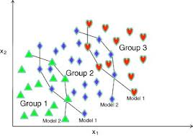
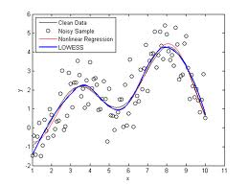
Linear Genetic Programming [12]
weight
Breed a population
of PROGRAMS.
1. Assign a
Fitness value
to each program,
Fit(Rpt R1, Clr R4,…) = 99.99
Inc R1, R2=R4*R4…
Rpt R1, Clr R4,Cpy R2 R4
R4=Rnd, R5=Rnd,…
If R1<R2 inc R3,
…
height
Programs for
Classification,
and Regression.
3. Mutate each individual
Rpt R1 R2, Clr R4, Cpy R2 R4
One point mutation
Rpt R1 R2, Clr R4, STP
2. Select the better/best with higher probability from the population to be promoted to the next generation. Discard the worst.
output
input
Notes:
Any problem on a computer can be represented as a bit string.
e.g. knapsack problem, combinatorial problems.

Slide 14
Genetic Programming Terms
Programs are build from a function and terminal set.
Function set {+,-,*, /} {AND, OR, NOT}, {IF, REPEAT, …}
Terminal set {a, b, c} {x,y,z}
Fitness function – tells you the quality of your program.
Crossover, mutation, selection

Slide 15



One Man – One/Many Algorithm
Researchers design heuristics by hand and test them on problem instances or arbitrary benchmarks off internet.
Presenting results at conferences and publishing in journals. In this talk/paper we propose a new algorithm…
1. Challenge is defining an algorithmic framework (set) that includes useful algorithms. Black art
2. Let Genetic Programming select the best algorithm for the problem class at hand. Context!!! Let the data speak for itself without imposing our assumptions.
In this talk/paper we propose a 10,000 algorithms…
Heuristic1
Heuristic1
Automatic
Design
Heuristic2
Heuristic2
Heuristic10,000
Heuristic3
Notes:
Ga
Ga’
Ga ‘ version 2.o
Ga ‘ version 2.o hydidized with knobs and whistles.

Slide 16
Evolving Selection Heuristics [16]
Rank selection
P(i) α i
Probability of selection is proportional to the index in sorted population
Fitness Proportional
P(i) α fitness(i)
Probability of selection is proportional to the fitness
In both cases fitter individuals are more likely to be selected.
Current population (index, fitness, bit-string)
1 5.5 0100010 | 2 7.5 0101010 | 3 8.9 0001010 | 4 9.9 0111010
0001010 | 0111010 | 0001010 | 0100010
Next generation

Slide 17
Framework for Selection Heuristics [16]
Space/set of
Selection
algorithms.
Selection heuristics operate in the following framework
for all individuals p in population {
select p in proportion to value( p );}
To perform rank selection replace value with index i.
To perform fitness proportional selection replace value with fitness
rank selection is the program.
fitness proportional
These are just two programs in our search space.

Slide 18
Selection Heuristic Evaluation [16]
Selection heuristics are generated by random search in the top layer.
heuristics are used as for selection in a GA on a bit-string problem class.
A value is passed to the top layer informing it of how well the function performed as a selection heuristic.
test
Generate and test
Generate and test
Generate a selection
heuristic
Program space
of selection heuristics
4
3
test
Framework for
selection heuristics.
Selection function plugs
into a Genetic Algorithm
Genetic Algorithm
2
1
bit-string problem
Problem class:
A probability distribution
Over bit-string problems
Genetic Algorithm
bit-string problem

Slide 19
Experiments for Selection
Train on 50 problem instances (i.e. we run a single selection heuristic for 50 runs of a genetic algorithm on a problem instance from our problem class).
The training times are ignored
  we are not comparing our generation method.
  we are comparing our selection heuristic with rank and fitness proportional selection.
Selection heuristics are tested on a second set of 50 problem instances drawn from the same problem class.

Slide 20
Problem Classes [14]
A problem class is a probability distribution of problem instances.
MOST RESEARCHERS OPERATE AT ON INSTANCES.
(SEE http://www.ntu.edu.sg/home/epnsugan/ competition)
Generate values N(0,1) in interval [-1,1] (if we fall outside this range we regenerate)
Interpolate values in range [0, 2^{num-bits}-1]
Target bit string given by Gray coding of interpolated value.
The above 3 steps generate a distribution of target bit strings which are used for hamming distance problem instances. “shifted ones-max”

Slide 21
Results for Selection Heuristics
 | Fitness Proportional | Rank | generated-selector
mean | 0.831528 | 0.907809 | 0.916088
std dev | 0.003095 | 0.002517 | 0.006958
min | 0.824375 | 0.902813 | 0.9025
max | 0.838438 | 0.914688 | 0.929063
Performing t-test comparisons of fitness-proportional selection and rank selection against generated heuristics resulted in a p-value of better than 10^-15.
In both of these cases the generated heuristics outperform the standard selection operators (rank and fit-proportional).

Slide 22
Take Home Points
automatically designing selection heuristics.
We should design heuristics for problem classes i.e. with a context/niche/setting.
This approach is human-competitive (and human cooperative ☺ ).
Meta-bias is necessary if we are to tackle multiple problem instances.
Think frameworks (i.e. sets of algorithms) not individual algorithms – we don’t want to solve problem instances we want to solve problem classes (i.e. many instances from the same class)!

Slide 23
Meta and Base Learning [5, 15]
At the base level we are learning about a specific function.
At the meta level we are learning about the probability distribution.
We are just doing “generate and test” on “generate and test”
What is being passed with each blue arrow?
Training/Testing and Validation
Meta level: hyper heuristic
1???
Function class
Mutation operator designer
2???
Function
instance
Mutation
operator
Fitness of
mutation
operator
f(x)
Function to optimize
GA
x
base level
Conventional GA

Slide 24
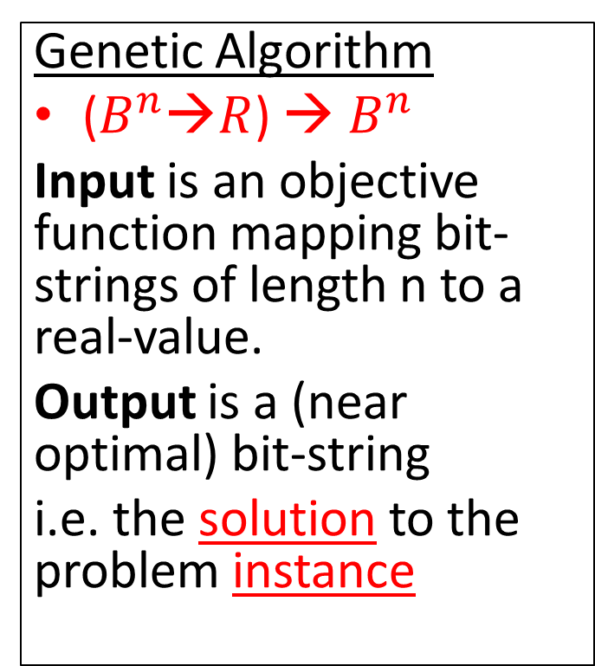
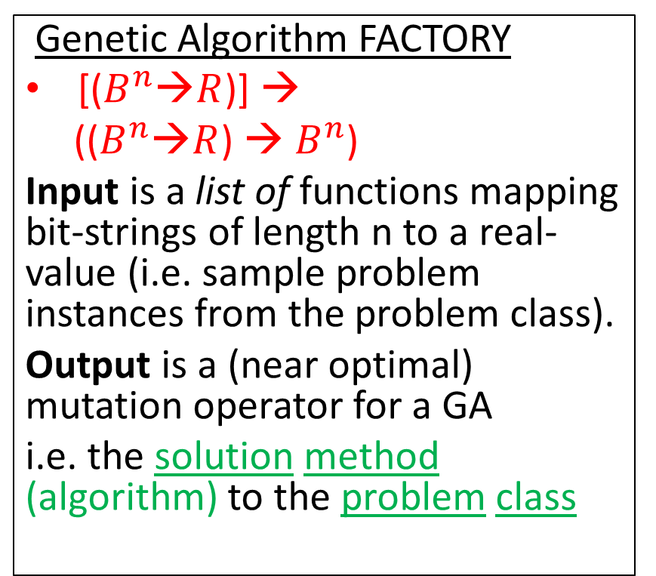
Compare Signatures (Input-Output)
Genetic Algorithm
($B^{n}$→$R$) → $B^{n}$
Input is an objective function mapping bit-strings of length n to a real-value.
Output is a (near optimal) bit-string
i.e. the solution to the problem instance
Genetic Algorithm FACTORY
[($B^{n}$→$R$)] →
(($B^{n}$→$R$) → $B^{n}$)
Input is a list of functions mapping bit-strings of length n to a real-value (i.e. sample problem instances from the problem class).
Output is a (near optimal) mutation operator for a GA
i.e. the solution method (algorithm) to the problem class
We are raising the level of generality at which we operate.
This is one of the aims of hyper-heuristic research
Notes:
Fish the north sea dry…

Slide 25
Two Examples of Mutation Operators
One point mutation flips ONE single bit in the genome (bit-string).
(1 point to n point mutation)
Uniform mutation flips ALL bits with probability p (=1/n).
No matter how we vary p, it will never be one point mutation.
Lets invent some more!!!
☹ NO, lets build a general method (for problem class)
BEFORE – one point mutation
0 | 1 | 1 | 0 | 0 | 0
AFTER
0 | 1 | 1 | 0 | 1 | 0
BEFORE – uniform mutation
0 | 1 | 1 | 0 | 0 | 0
AFTER
0 | 0 | 1 | 0 | 0 | 1
What probability distribution of problem instances are these intended for ?

Slide 26
Off-the-Shelf metaheuristic to Tailor-Make mutation operators for Problem Class
novel
mutation
heuristics
Space
of mutation
operators
Meta-level
Genetic Programming
Iterative Hill Climbing
(mutation operators)
x
x
x
x
Fitness
value
Mutation
operator
One
Point
mutation
Uniform
mutation
Genetic Algorithm
Base-level
Two search spaces
Commonly used
Mutation operators

Slide 27
Building a Space of Mutation Operators
Inc | 0
Dec | 1
Add | 1,2,3
If | 4,5,6
Inc | -1
Dec | -2
Program counter pc | 2
WORKING REGISTERS
110 | -1 | +1 | 43 | …
INPUT-OUTPUT REGISTERS
-20 | -1 | +1 | 20 | …
A program is a list of instructions and arguments.
A register is set of addressable memory (R0,..,R4).
Negative register addresses means indirection.
A program can only affect IO registers indirectly.
positive (TRUE) negative (FALSE) on output register.
Insert bit-string on IO register, extract from IO register

Slide 28
Arithmetic Instructions
These instructions perform arithmetic operations on the registers.
Add Ri ← Rj + Rk
Inc Ri ← Ri + 1
Dec Ri ← Ri − 1
Ivt Ri ← −1 ∗ Ri
Clr Ri ← 0
Rnd Ri ← Random([−1, +1]) //mutation rate
Set Ri ← value
Nop //no operation or identity

Slide 29
Control-Flow Instructions
These instructions control flow (NOT ARITHMETIC).
They include branching and iterative imperatives.
Note that this set is not Turing Complete!
If if(Ri > Rj) pc = pc + |Rk| why modulus?
IfRand if(Ri < 100 * random[0,+1]) pc = pc + Rj//allows us to build mutation probabilities WHY?
Rpt Repeat |Ri| times next |Rj| instruction
Stp terminate

Slide 30
Expressing Mutation Operators
Line UNIFORM ONE POINT MUTATION
0 Rpt, 33, 18 Rpt, 33, 18
1 Nop Nop
2 Nop Nop
3 Nop Nop
4 Inc, 3 Inc, 3
5 Nop Nop
6 Nop Nop
7 Nop Nop
8 IfRand, 3, 6 IfRand, 3, 6
9 Nop Nop
10 Nop Nop
11 Nop Nop
12 Ivt,−3 Ivt,−3
13 Nop Stp
14 Nop Nop
15 Nop Nop
16 Nop Nop
Uniform mutation
Flips all bits with a
fixed probability.
4 instructions
One point mutation
flips a single bit.
5 instructions
Why insert NOP?
We let GP start with these programs and mutate them.

Slide 31
7 Problem Instances
Problem instances are drawn from a problem class.
7 real–valued functions, we will convert to discrete binary optimisations problems for a GA.
number function
1 x
2 sin2(x/4 − 16)
3 (x − 4) ∗ (x − 12)
4 (x ∗ x − 10 ∗ cos(x))
5 sin(pi∗x/64−4) ∗ cos(pi∗x/64−12)
6 sin(pi∗cos(pi∗x/64 − 12)/4)
7 1/(1 + x /64)

Slide 32
Function Optimization Problem Classes
To test the method we use binary function classes
We generate a Normally-distributed value t = −0.7 + 0.5 N (0, 1) in the range [-1, +1].
We linearly interpolate the value t from the range [-1, +1] into an integer in the range [0, 2^num−bits −1], and convert this into a bit-string t′.
To calculate the fitness of an arbitrary bit-string x, the hamming distance between x and the target bit-string t′ is calculated (giving a value in the range [0,numbits]). This value is then fed into one of the 7 functions.

Slide 33
Results – 32 bit problems
Problem classes Means and standard deviations | Uniform Mutation | One-point mutation | generated-mutation
p1 mean | 30.82 | 30.96 | 31.11
p1 std-dev | 0.17 | 0.14 | 0.16
p2 mean | 951 | 959.7 | 984.9
p2 std-dev | 9.3 | 10.7 | 10.8
p3 mean | 506.7 | 512.2 | 528.9
p3 std-dev | 7.5 | 6.2 | 6.4
p4 mean | 945.8 | 954.9 | 978
p4 std-dev | 8.1 | 8.1 | 7.2
p5 mean | 0.262 | 0.26 | 0.298
p5 std-dev | 0.009 | 0.013 | 0.012
p6 mean | 0.432 | 0.434 | 0.462
p6 std-dev | 0.006 | 0.006 | 0.004
p7 mean | 0.889 | 0.89 | 0.901
p7 std-dev | 0.002 | 0.003 | 0.002

Slide 34
Results – 64 bit problems
Problem classes Means and stand dev | Uniform Mutation | One-point mutation | generated-mutation
p1 mean | 55.31 | 56.08 | 56.47
p1 std-dev | 0.33 | 0.29 | 0.33
p2 mean | 3064 | 3141 | 3168
p2 std-dev | 33 | 35 | 33
p3 mean | 2229 | 2294 | 2314
p3 std-dev | 31 | 28 | 27
p4 mean | 3065 | 3130 | 3193
p4 std-dev | 36 | 24 | 28
p5 mean | 0.839 | 0.846 | 0.861
p5 std-dev | 0.012 | 0.01 | 0.012
p6 mean | 0.643 | 0.643 | 0.663
p6 std-dev | 0.004 | 0.004 | 0.003
p7 mean | 0.752 | 0.7529 | 0.7684
p7 std-dev | 0.0028 | 0.004 | 0.0031

Slide 35
p-values T Test for 32 and 64-bit functions on the7 problem classes
 | 32 bit | 32 bit | 64 bit | 64 bit
class | Uniform | One-point | Uniform | One-point
p1 | 1.98E-08 | 0.0005683 | 1.64E-19 | 1.02E-05
p2 | 1.21E-18 | 1.08E-12 | 1.63E-17 | 0.00353
p3 | 1.57E-17 | 1.65E-14 | 3.49E-16 | 0.00722
p4 | 4.74E-23 | 1.22E-16 | 2.35E-21 | 9.01E-13
p5 | 9.62E-17 | 1.67E-15 | 4.80E-09 | 4.23E-06
p6 | 2.54E-27 | 4.14E-24 | 3.31E-24 | 3.64E-28
p7 | 1.34E-24 | 3.00E-18 | 1.45E-28 | 5.14E-23

Slide 36
Rebuttal to Reviews
1. Did we test the new mutation operators against standard operators (one-point and uniform mutation) on different problem classes?
NO – the mutation operator is designed (evolved) specifically for that class of problem.
2. Are we taking the training stage into account?
NO, we are just comparing mutation operators in the testing phase – Anyway how could we meaningfully compare “brain power” (manual design) against “processor power” (evolution).
3. Train for all functions – NO, we are specializing.

Slide 37
Additions to Genetic Programming
1. final program is part human constrained part (for-loop) machine generated (body of for-loop).
2. In GP the initial population is typically randomly created. Here we (can) initialize the population with already known good solutions (which also confirms that we can express the solutions). (improving rather than evolving from scratch) – standing on shoulders of giants. Like genetically modified crops – we start from existing crops.
3. Evolving on problem class (samples of problem instances drawn from a problem class) not instances.

Slide 38
Theoretical Motivation 1 [14]
Metaheuristic a
Search
space
Objective
Function f
P (a, f)
x1
x1
x1
1.
2.
3.
X1.
X2.
X3.
Y1.
Y2.
Y3.
SOLUTION
PROBLEM
A search space contains the set of all possible solutions.
An objective function determines the quality of solution.
A (Mathematical idealized) metaheuristic determines the sampling order (i.e. enumerates i.e. without replacement). It is a (approximate) permutation. What are we learning?
Performance measure P (a, f) depend only on y1, y2, y3
Aim find a solution with a near-optimal objective value using a Metaheuristic . ANY QUESTIONS BEFORE NEXT SLIDE?
Notes:
Temptation is to just write a search algorithm.

Slide 39

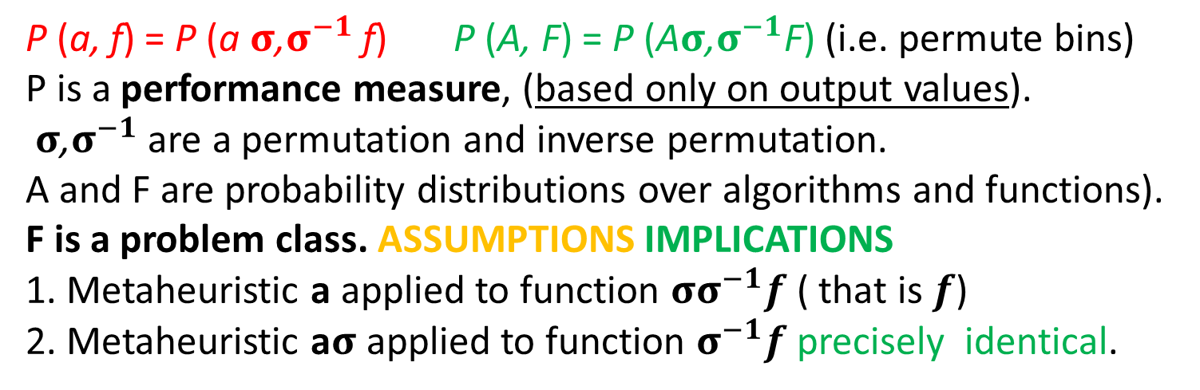
Theoretical Motivation 2
Search
space
permutation
σ
Objective
Function f
Metaheuristic a
$${\text{σ}}^{−1}$$
x1
x1
x1
x1
x1
1.
2.
3.
1.
2.
3.
1.
2.
3.
1.
2.
3.
1.
2.
3.
P (a, f) = P (a$σ$,$σ^{−1}$ f) P (A, F) = P (A$σ$,$σ^{−1}$F) (i.e. permute bins)
P is a performance measure, (based only on output values).
$σ$,$σ^{−1}$ are a permutation and inverse permutation.
A and F are probability distributions over algorithms and functions).
F is a problem class. ASSUMPTIONS IMPLICATIONS
1. Metaheuristic a applied to function ${σσ}^{−1}f$ ( that is $f$)
2. Metaheuristic a$σ$ applied to function $σ^{−1}f$ precisely identical.
Notes:
Not finite, not computable, not all function, not closed under permutation, focussed sets.
Implications. Do not propose a metaheuristic in isolation .
Assumptions - no revisiting, count number of evaluations (ignore execution time. )

Slide 40
Theoretical Motivation 3 [1,2,5,14]
The base-level learns about the function f.
The meta-level learn about the distribution of functions p(f)
The sets do not need to be finite (with infinite sets, a uniform distribution is not possible)
The functions do not need to be computable.
We can make claims about the Kolmogorov Complexity of the functions and search algorithms.
p(f) (the probability of sampling a function )is all we can learn in a black-box approach.

Slide 41
Questions for a few minutes?
Shall we stop for a few questions?
So far we have looked at how we can generate and test new heuristic/algorithms which outperform their human counter part.
We are using a machine learning approach (with an independent training and test set – from problem class) to build optimization algorithms.
Next we will look at
  Problem classes and cross validation.
  Scalability of evolved algorithms.

Slide 42
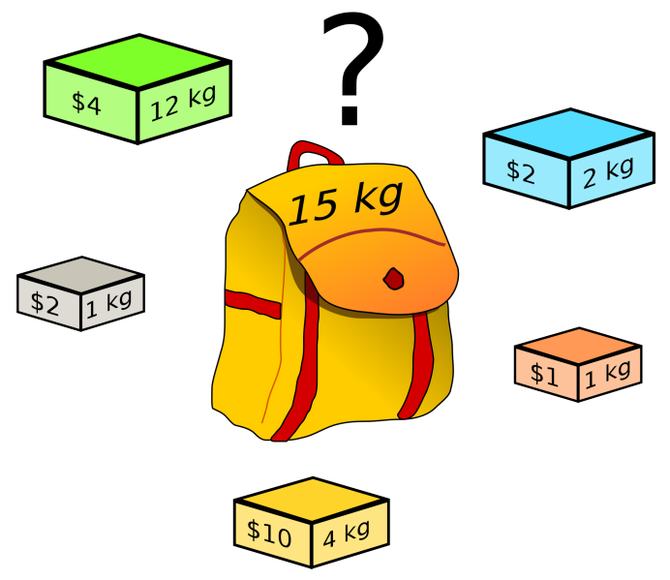
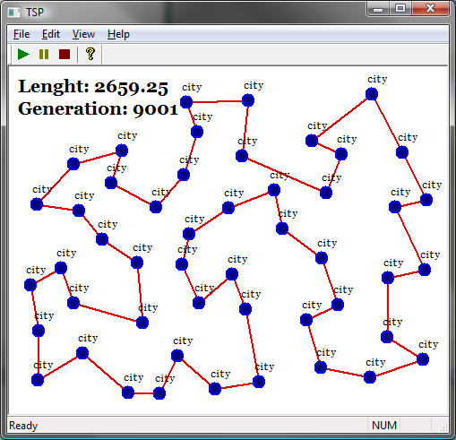
Problem Classes Do Occur
Problem classes are probability distributions over problem instances.
We take some problem instances for training our algorithms
We take some problem instances for testing our algorithms
Travelling Salesman
  Distribution of cities over different counties
  E.g. USA is square, Japan is long and narrow.
Bin Packing & Knapsack Problem
  The items are drawn from some probability distribution.
Problem classes do occur in the real-world
A problem source defined a problem class (i.e. distribution)
Next slides demonstrate problem classes and scalability

Slide 43
On-line Bin Packing Problem [9,11]
A sequence of pieces packed into as few a bins as possible.
Bin size is 150 units, pieces uniformly distributed between 20-100.
Different to the off-line bin packing problem (set of items).
The “best fit” heuristic, places the piece in leaving least slack space.
this heuristic does not open a new bin unless it is forced to.
Array of bins
Range of
Item size
20-100
150 =
Bin
capacity
pieces packed so far
Sequence of pieces to be packed

Slide 44
Genetic Programming applied to on-line bin packing
Not obvious how to link
Genetic Programming to combinatorial problems.
The GP tree is applied to each
bin with the current piece and placed in the bin with
The maximum score
C capacity
E emptiness
Fullness is
irrelevant
The space is
important
Terminals supplied to Genetic Programming
Initial representation {C, F, S}
Replaced with {E, S}, E=C-F
F fullness
S size
S size

Slide 45
How the heuristics are applied
%
C
-
C
+
-15
-3.75
3
4.29
1.88
S
F
70
120
85
70
90
60
45
30
30

Slide 46
The Best Fit Heuristic
Best fit = 1/(E-S). Point out features.
Pieces of size S, which fit well into the space remaining E, score well.
Best fit produces a set of points on the surface,
The bin corresponding to the maximum score is picked.
emptiness
Piece size

Slide 47
Our best heuristic.
Similar shape to best fit – but curls up in one corner.
Note that this is rotated, relative to previous slide.

Slide 48
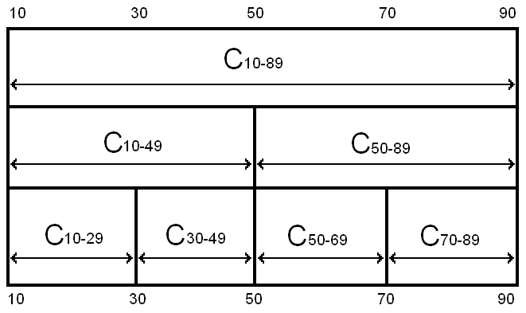
Robustness of Heuristics on different problem classes
= all legal results
= some illegal results
Notes:
Even though the problem is the same, and the hard constraints are the same, the heuristics can fail to stay within the hard constraints if they are asked to pack piece sizes they have not seen before
The safeguards against giving illegal solutions that work in one class will not work in another

Slide 49
Testing Heuristics on problems of much larger size than in training
Table I | H trained100 | H trained 250 | H trained 500
100 | 0.427768358 | 0.298749035 | 0.140986023
1000 | 0.406790534 | 0.010006408 | 0.000350265
10000 | 0.454063071 | 2.58E-07 | 9.65E-12
100000 | 0.271828318 | 1.38E-25 | 2.78E-32
Table shows p-values using the best fit heuristic, for heuristics trained on
different size problems, when applied to different sized problems
1. As number of items trained on increases, the p value decreases
2. As the number of items packed increases, the p value decreases

Slide 50
Compared with Best Fit
Amount
evolved
heuristics
beat
best fit by.
Number of pieces
packed so far.
Averaged over 30 heuristics over 20 problem instances
Performance does not deteriorate
The larger the training problem size, the better the bins are packed.

Slide 51
Compared with Best Fit
Zoom in
of previous
slide
Amount
evolved
heuristics
beat
best fit by.
The heuristic seems to learn the number of pieces in the problem
Analogy with sprinters running a race – accelerate towards end of race.
The “break even point” (matching the performance of best fit) is approximately half of the size of the training problem size
If there is a gap of size 30 and a piece of size 20, it would be better to wait for a better piece to come along later – about 10 items (similar effect at upper bound?).

Slide 52
New Topic
We now move from generating bin packing heuristics to
Generating probability distributions for Evolutionary Programming

Slide 53
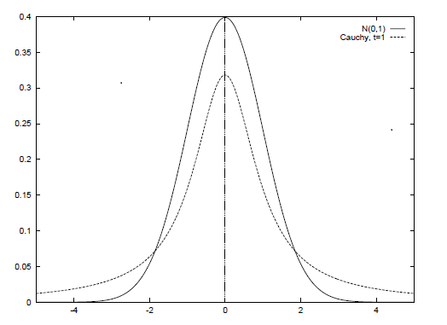
Designing Mutation Operators for Evolutionary Programming [18]
Evolutionary programing optimizes functions by evolving a population of real-valued vectors (genotype).
Variation has been provided by probability distributions (Gaussian, Cauchy, Levy).
We are automatically generating probability distributions (using genetic programming).
Not from scratch, but from already well-known distributions (Gaussian, Cauchy, Levy). We are “genetically improving probability distributions”.
We are evolving mutation operators for a problem class (a probability distributions over functions).
NO CROSSOVER
Genotype is
(1.3,...,4.5,…,8.7)
Before mutation
Genotype is
(1.2,...,4.4,…,8.6)
After mutation

Slide 54
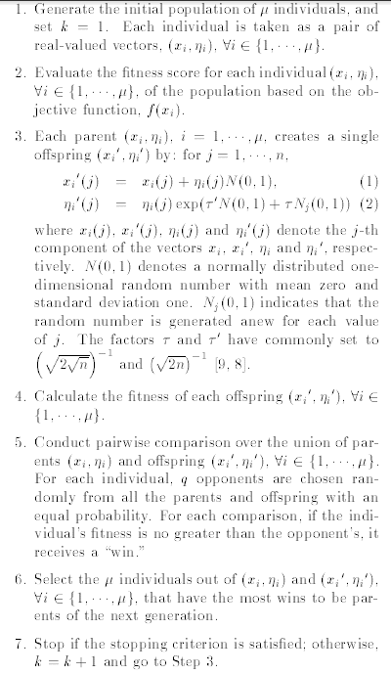
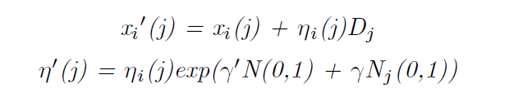
(Fast) Evolutionary Programming
Heart of algorithm is mutation
SO LET’S AUTOMATICALLY DESIGN
Evolutionary Programming mutates with a Gaussian
Fast Evolutionary Programming uses Cauchy
A generalization is mutate with a distribution D (generated with genetic programming)

Slide 55

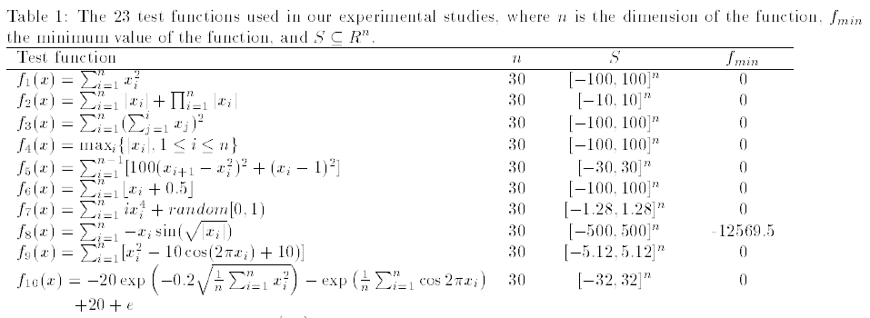
Optimization & Benchmark Functions
A set of 23 benchmark functions is typically used in the literature. Minimization
We use them as problem classes.

Slide 56
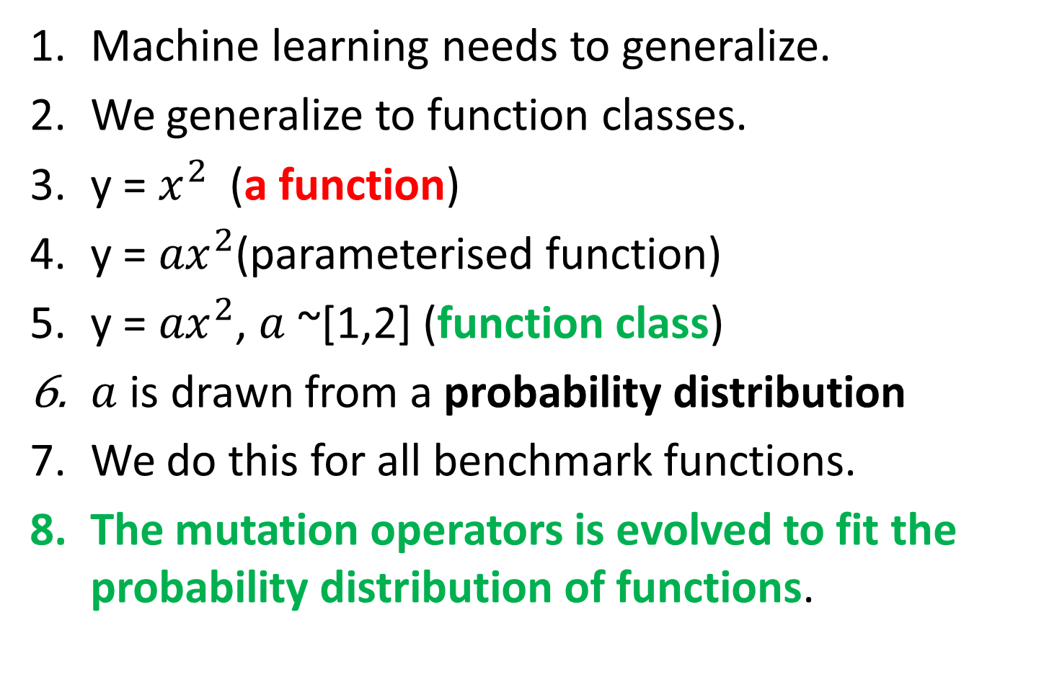
Function Class 1
Machine learning needs to generalize.
We generalize to function classes.
y = $x^{2}$(a function)
y = ${ax}^{2}$(parameterised function)
y = ${ax}^{2}$, $a$ ~[1,2] (function class)
$a$ is drawn from a probability distribution
We do this for all benchmark functions.
The mutation operators is evolved to fit the probability distribution of functions.

Slide 57
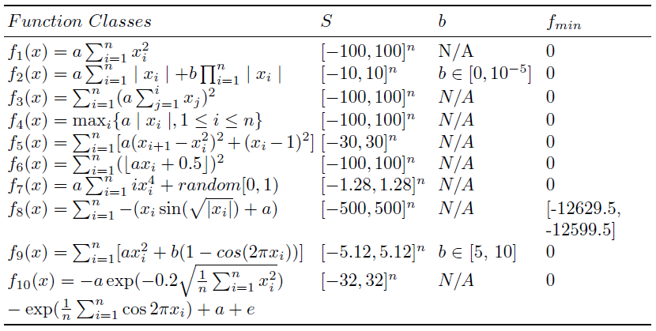
Function Classes 2

Slide 58
Meta and Base Learning
At the base level we are learning about a specific function.
At the meta level we are learning about the problem class.
We are just doing “generate and test” at a higher level
What is being passed with each blue arrow?
Conventional EP
Meta level
Function class
Probability
Distribution
Generator
f(x)
Function to optimize
EP
x
base level

Slide 59
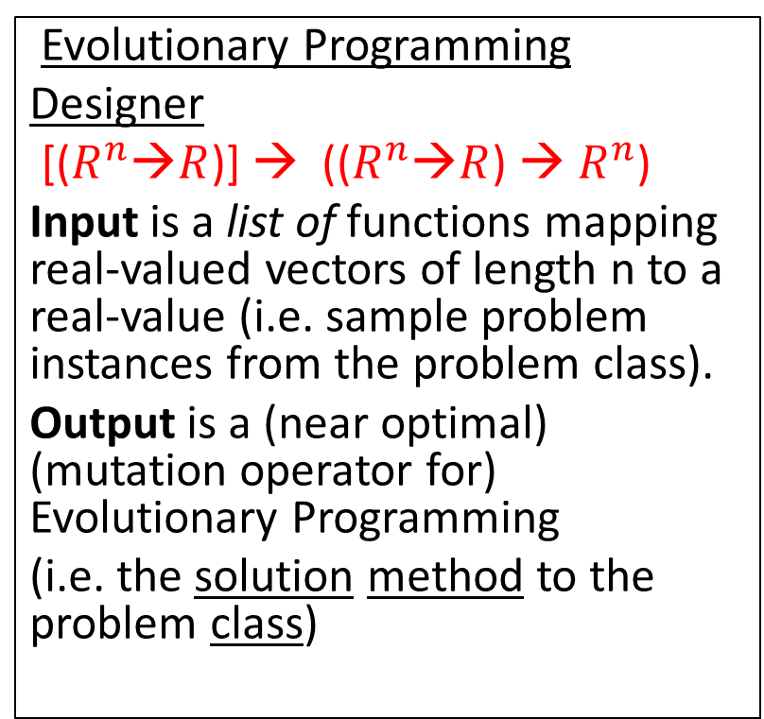
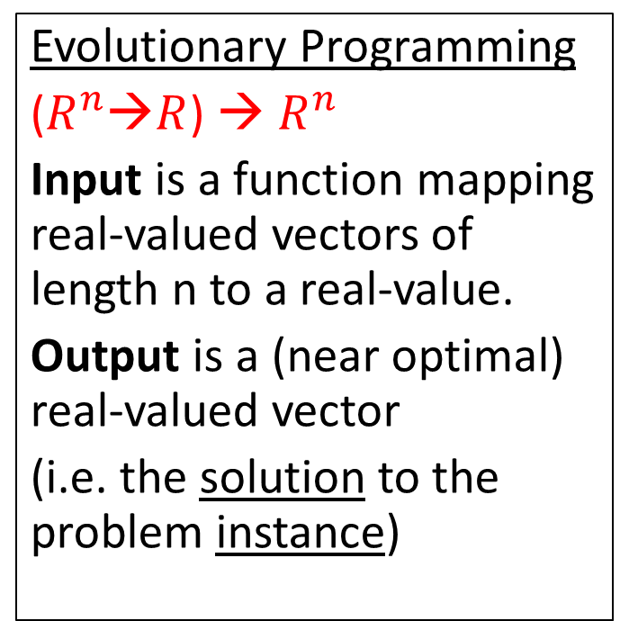
Compare Signatures (Input-Output)
Evolutionary Programming
($R^{n}$→$R$) → $R^{n}$
Input is a function mapping real-valued vectors of length n to a real-value.
Output is a (near optimal) real-valued vector
(i.e. the solution to the problem instance)
Evolutionary Programming
Designer
[($R^{n}$→$R$)] → (($R^{n}$→$R$) → $R^{n}$)
Input is a list of functions mapping real-valued vectors of length n to a real-value (i.e. sample problem instances from the problem class).
Output is a (near optimal) (mutation operator for) Evolutionary Programming
(i.e. the solution method to the problem class)
We are raising the level of generality at which we operate.

Slide 60
Genetic Programming to Generate Probability Distributions
SPACE OF
PROBABILITY
DISTRIBUTIONS
GP Function Set {+, -, *, %}
GP Terminal Set {N(0, random)}
N(0,1) is a normal distribution.
For example a Cauchy distribution is generated by N(0,1)%N(0,1).
Hence the search space of probability distributions contains the two existing probability distributions used in EP but also novel probability distributions.
GAUSSIAN
CAUCHY
NOVEL
PROBABILITY
DISTRIBUTIONS

Slide 61
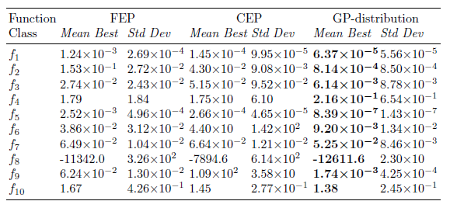
Means and Standard Deviations
These results are good for two reasons.
starting with a manually designed distributions (Gaussian).
evolving distributions for each function class.

Slide 62
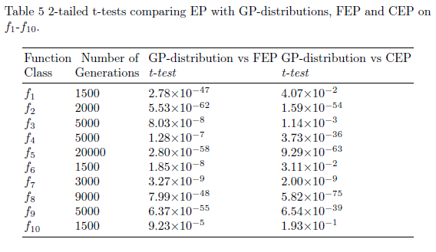
T-tests

Slide 63
Cross testing
Each mutation operator is designed for a specific function class.
What if we train a mutation operator on one function class, then test on a different class it was not intended.
It should not perform as well.
This is just as we would expect with machine learning.

Slide 64
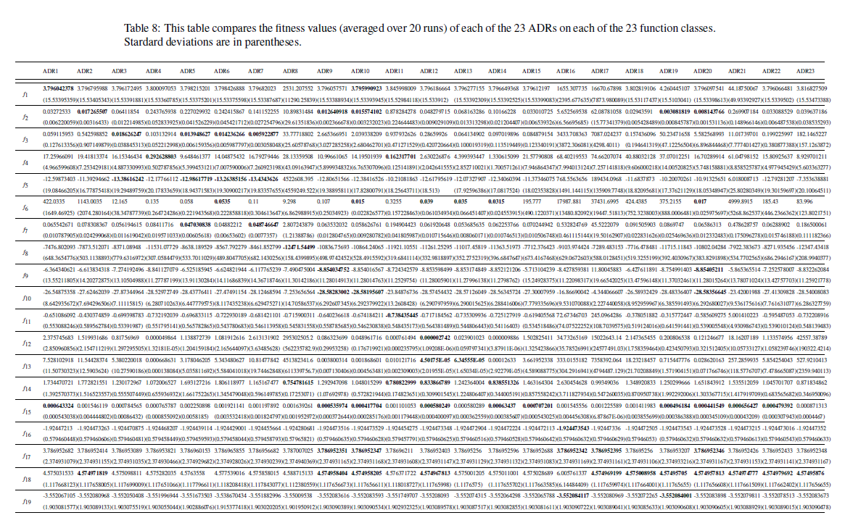
Performance on Other Problem Classes

Slide 65
Step by Step Guide to Automatic Design of Algorithms [8, 12]
Study the literature for existing heuristics for your chosen domain (manually designed heuristics).
Build an algorithmic framework or template which expresses the known heuristics
Let Genetic Programming supply variations on the theme.
Train and test on problem instances drawn from the same probability distribution (like machine learning). Constructing an optimizer is machine learning (this approach prevents “cheating”).

Slide 66
A Brief History (Example Applications) [5]
Image Recognition – Roberts Mark
Travelling Salesman Problem – Keller Robert
Boolean Satisfiability – Fukunaga, Bader-El-Den
Data Mining – Gisele L. Pappa, Alex A. Freitas
Decision Tree - Gisele L. Pappa et. al.
Selection Heuristics – Woodward & Swan
Bin Packing 1,2,3 dimension (on and off line) Edmund Burke et. al. & Riccardo Poli et. al.
Bug Location – Shin Yoo
Job Shop Scheduling - Mengjie Zhang

Slide 67
Comparison of Solution Search Spaces and Heuristic Search Spaces
If we tackle a problem instance directly, e.g. Travelling Salesman Problem, we get a combinatorial explosion. The search space consists of solutions, and therefore explodes as we tackle larger problems.
If we tackle a generalization of the problem, we do not get an explosion. The search space consists of algorithms to produces solutions to a problem instance of any size.
The algorithm to tackle TSP of size 100-cities, is the same size as the algorithm to tackle TSP of size 10,000-cities.
The solution space explodes, the algorithm space does not.

Slide 68
A Paradigm Shift?
One person
proposes one
algorithm
and tests it
in isolation.
One person proposes a
family of algorithms
and tests them
in the context of
a problem class.
Algorithms investigated/unit time
Human cost (INFLATION) machine cost MOORE’S LAW
conventional approach new approach
Previously one person proposes one algorithm
Now one person proposes a set of algorithms
Analogous to “industrial revolution” from hand made to machine made. Automatic Design.
Notes:
What could you do after this talk you could not do before.

Slide 69
Conclusions
Heuristic are trained to fit a problem class, so are designed in context (like evolution). Let’s close the feedback loop! Problem instances exist in problem classes.
Problem instances are not isolated but come from a source of problems (i.e. a distribution)
We can design algorithms on small problem instances and scale them apply them to large problem instances (TSP).
A child learns multiplication on small numbers, and applies the algorithm to larger previously unseen problems.
Notes:
I hope if you are a researcher in the field it has made you think
If you do not know how to write an algorithm, don’t write it, let the computer write it. .

Slide 70
Overview of Applications
 | SELECTION | MUTATION GA | BIN PACKING | MUTATION EP
Scalable performance | ? | ? | Yes - why | No - why
Generation ZERO | Rank, fitness proportional | NO – needed to seed. | Best fit | Gaussian and Cauchy
Problem class |  | Parameterized function | Item size | Parameterized function
Results Human Competitive | Yes | Yes | Yes | Yes
Algorithm iterate over | Population | Bit-string | Bins | Vector
Search Method | Random Search | Iterative Hill-Climber | Genetic Programming | Genetic Programming
Type Signatures | R^2->R | B^n->B^n | R^3->R | ()->R
Reference | [16] | [15] | [6,9,10,11] | [18]

Slide 71
Other related Activity
GECCO 2015 – Sigevo www.sigevo.org/gecco-2015/ (workshop and tutorial)
LION 9 , Lille, FRANCE, Jan. 12-16, 2015.
http://www.lifl.fr/LION9/ (2 tutorials)
The First International Genetic Improvement Workshop (GI-2015) http://geneticimprovement2015.com/

Slide 72
Open Issues
Many of the open issues for Genetic Programming apply to the automatic design of algorithms
  the algorithms sometimes bloat,
  are not readable/ human understandable.
We need a large training set – this can be expensive.

Slide 73
SUMMARY
We can automatically design algorithms that consistently outperform human designed algorithms (on various domains).
Humans should not provide variations– genetic programing can do that.
We are altering the heuristic to suit the set of problem instances presented to it, in the hope that it will generalize to new problem instances (same distribution - central assumption in machine learning).
The “best” heuristics depends on the set of problem instances. (feedback)
Resulting algorithm is part man-made part machine-made (synergy)
not evolving from scratch like Genetic Programming,
improve existing algorithms and adapt them to the new problem instances.
Humans are working at a higher level of abstraction and more creative. Creating search spaces for GP to sample.
Algorithms are reusable, “solutions” aren’t. (e.g. tsp algorithm vs route)
Opens up new problem domains. E.g. bin-packing.

Slide 74
References 1
1. Woodward J. Computable and Incomputable Search Algorithms and Functions. IEEE International Conference on Intelligent Computing and Intelligent Systems (IEEE ICIS 2009) November 20-22,2009 Shanghai, China.
2. John Woodward. The Necessity of Meta Bias in Search Algorithms. International Conference on Computational Intelligence and Software Engineering 2010. CiSE 2010.
3. Woodward, J. & Bai, R. (2009) Why Evolution is not a Good Paradigm for Program Induction; A Critique of Genetic Programming 2009 World Summit on Genetic and Evolutionary Computation (2009 GEC Summit) June 12-14 Shanghai, China
4. J. Swan, J. Woodward, E. Ozcan, G. Kendall, E. Burke. “Searching the Hyper-heuristic Design Space,” Cognitive Computation
5. G.L. Pappa, G. Ochoa, M.R. Hyde, A.A. Freitas, J. Woodward, J. Swan “Contrasting meta-learning and hyper-heuristic research” Genetic Programming and Evolvable Machines.
6. Burke E. K., Hyde M., Kendall G., and Woodward J. 2011. Automating the Packing Heuristic Design Process with Genetic Programming. Evolutionary Computation

Slide 75
References 2
7. Burke, E. K. and Hyde, M. R. and Kendall, G. and Woodward, J., A Genetic Programming Hyper-Heuristic Approach for Evolving Two Dimensional Strip Packing Heuristics, IEEE Transactions on Evolutionary Computation, 2010.
8. E. K. Burke, M. R. Hyde, G. Kendall, G. Ochoa, E. Ozcan and J. R. Woodward (2009) Exploring Hyper-heuristic Methodologies with Genetic Programming, Computational Intelligence: Collaboration, Fusion and Emergence, In C. Mumford and L. Jain (eds.), Intelligent Systems Reference Library, Springer, pp. 177-201
9. Burke E. K., Hyde M., Kendall G., and Woodward J. R. Scalability of Evolved On Line Bin Packing Heuristics Proceedings of Congress on Evolutionary Computation 2007 September 2007
10. Poli R., Woodward J. R., and Burke E. K. A Histogram-matching Approach to the Evolution of Bin-packing Strategies Proceedings of Congress on Evolutionary Computation 2007 September 2007.
11. Burke E. K., Hyde M., Kendall G., and Woodward J. Automatic Heuristic Generation with Genetic Programming: Evolving a Jack-of-all-Trades or a Master of One Proceedings of Genetic and Evolutionary Computation Conference 2007 London UK.
12. John Woodward and Jerry Swan, Template Method Hyper-heuristics Metaheuristic Design Patterns (MetaDeeP) GECCO 2014, Vancouver.

Slide 76
References 3
13. Saemundur O. Haraldsson and John R. Woodward, Automated Design of Algorithms and Genetic Improvement: Contrast and Commonalities, 4th Workshop on Automatic Design of Algorithms GECCO 2014, Vancouver.
14. John R. Woodward, Simon P. Martin and Jerry Swan, Benchmarks That Matter For Genetic Programming, 4th Workshop on Automatic Design of Algorithms GECCO 2014, Vancouver.
15. J. Woodward and J. Swan, "The Automatic Generation of Mutation Operators for Genetic Algorithms" in 2nd Workshop on Evolutionary Computation for designing Generic Algorithms, GECCO 2012, Philadelphia. DOI: http://dx.doi.org/10.1145/2330784.2330796.
16. John Robert Woodward and Jerry Swan. Automatically designing selection heuristics. In GECCO 2011 1st workshop on evolutionary computation for designing generic algorithms pages 583-590, Dublin, Ireland, 2011.
17. E. K. Burke, M. Hyde, G. Kendall, G. Ochoa, E. Ozcan, and J. Woodward (2009). A Classification of Hyper-heuristics Approaches, Handbook of Metaheuristics, International Series in Operations Research & Management Science, M. Gendreau and J-Y Potvin (Eds.), Springer.
18. Libin Hong and John Woodward and Jingpeng Li and Ender Ozcan. Automated Design of Probability Distributions as Mutation Operators for Evolutionary Programming Using Genetic Programming. Proceedings of the 16th European Conference on Genetic Programming, EuroGP 2013, volume 7831, pages 85-96,

Slide 77
References 4
19. John Woodward, GA or GP, that is not the question, Congress on Evolutionary Computation, Canberra, Australia, 8th - 12th December 2003
20. John Woodward and Jerry Swan. Why Classifying Search Algorithms is Essential. 2010 International Conference on Progress in Informatics and Computing.
21. John R. Woodward, Complexity and Cartesian Genetic Programming. European Conference on Genetic Programming 2006, 10-12 April 2006, Budapest, Hungary.
22. John R. Woodward, Invariance of Function Complexity under Primitive Recursive Functions. Accepted at European Conference on Genetic Programming 2006, 10-12 April 2006, Budapest, Hungary.
23. John Woodward, Evolving Turing Complete Representations, Congress on Evolutionary Computation, Canberra, Australia, 8th - 12th December 2003
24. John Woodward, GA or GP, that is not the question, Congress on Evolutionary Computation, Canberra, Australia, 8th - 12th December 2003 ps. pdf.
25. John Woodward and James Neil, No Free Lunch, Program Induction and Combinatorial Problems, Genetic Programming 6th European Conference, EuroGP 2003 Essex, UK, April 2003.
26. John R. Woodward, Modularity in Genetic Programming, Genetic Programming 6th European Conference, EuroGP 2003 Essex, UK, April 2003.

Slide 78
End of File ☺
Thank YOU for listening
I am glad to take any
  comments (+,-)
  criticisms
  Please email me any references.
  http://www.cs.stir.ac.uk/~jrw/
If you want to collaborate on any of these projects, please ask.
I am willing to provide help and guidance.

