Slide 1
Why Evolution Is Not a Good Paradigm For Program Induction; A Critique of Genetic Programming
John Woodward and Ruibin Bai

Slide 2
My interest…
We would not attempt to try to write computer programs without the constructs of
Reusable functions (in GP terminology ADFs),
Iteration (loops or repeat)
Memory (e.g. read-write arrays)
So why don’t we allow GP this ability
Where are the papers on evolving Turing Complete Programs? This suggests it is hard!!!

Slide 3
OUTLINE 1
Revisit natural evolution
genetic code – A T C G bases in DNA
Crossover – primary search operator
re-evaluation – aim of evolution?
limits of natural evolution – what evolution cannot do easily.
Why does evolution seem so successful? Because it solved self-imposed problems
Notes:
For paper – look at number of generations used. Is it more like random sereh or hill climbing?

Slide 4
OUTLINE 2
Re-examine genetic programming.
Non-biological description (mathematical)
Crossover – unsuitable?
number of loops in evolved programs (very few!)
manipulating syntax (what about semantics)
stochastic search for deterministic problems
Notes:
For paper – look at number of generations used. Is it more like random sereh or hill climbing?

Slide 5
GENETIC CODE 1
4 bases (A T C G) along DNA
In groups of 3 (called codons)
code for 21 amino acids (+ STOP).
This is the minimum number.
If only 2 bases per codon = 4*4=16
3 bases (64) and 4 bases (256)

Slide 6
GENETIC CODE 2
The codons do not randomly map to the amino acids!
They are clustered together, often the last base of the 3 in a codon is redundant.
This reduces the chances of a copying error.
In fact we have a perfect code.
But what if an error were to occur?

Slide 7
GENETIC CODE 3
Amino acids have different properties – acidic, hydrophobic …
However different amino acids are clustered together
So even if a wrong amino acid was coded for – the impact on the property of resulting protein is low.
Genetic code is good at the job it does.

Slide 8
BIOLOGICAL CROSSOVER
In biology, like genes are exchanged for like-genes in the crossover process.
Template Skin-hair-eye color example.
Parent1 brown-black-black
Parent2 white-blonde-blue
Child1 brown-brown-blue (possible)
Child2 blue-white-blonde (highly improbably)
Crossover is good for producing novel combinations of traits in a species.
This sub-space is still large

Slide 9
RE-EVALUATION
Magnets “appear” to repel/attract.
Balls “appear” to roll to bottom of valley
It “appears” the aim of evolution is to produce more “like individuals”.
The more individuals in the current generation, the more likely the species will survive.
If the number hits zero – the species is extinct (and therefore very unlikely to reappear).
If everything become extinct, evolution has failed

Slide 10
LIMITS OF NATURAL EVOLUTION
Some bacteria reproduce faster than it takes to copy their DNA! Nice solution ☺
Wheels are simple from an engineering perspective, but hard for evolution. ☹
Bulldogs are artificially selected to have larger heads, which is not naturally selected, with the result bulldogs are born by cesarean section (humans have a fontella ☺).

Slide 11
WHY EVOLUTION SEEMS SUCCESSFUL
Evolution has undoubtedly produced a vast array of interesting, simple/complex, creative solutions to some demanding problems.
Evolution appears so successful as it is often solving self-imposed problems regarding survival.
Basic problem: resource
Advanced problem: competition
Evolution is providing the solutions to the problems it is posing.
A biological solution to a biological problem.
Notes:
Evoluitn may eventualoly come up with a creattuer which can run faster than a bullet
Hunted to extinction.
Arms race with primitive weapons (bow/arrow and spears)
Becomes an arms race with
“conventional wepons”
Hand guns, cannons, tanks,
Then nuclear,
Then robotic.
E.g. earth based evolution vs alien evolution.
African company vs. two caompanies. (cannot compete)
Both teams have the same equimpmetn avaliable to them

Slide 12
End of part 1
Natural evolution
Start of part 2
Genetic programming.

Slide 13
NON-BIOLOGICAL DESCRIPTION
Most crossover operators conserve the amount of genetic material, remaining faithful to biology.
XO: P X P -> P X P and is just a binary operatory.
Labeling thing influences the way we think about things (mathematical terminology is largely unbiased).
Calling it “crossover” makes us think we should conserve the size of the programs.
Could even be n-ary operator!
“Thinking biologically” constrains us!!!
I have even seen post-doc using ATCG for a problem where are binary representation was perfectly okay.

Slide 14
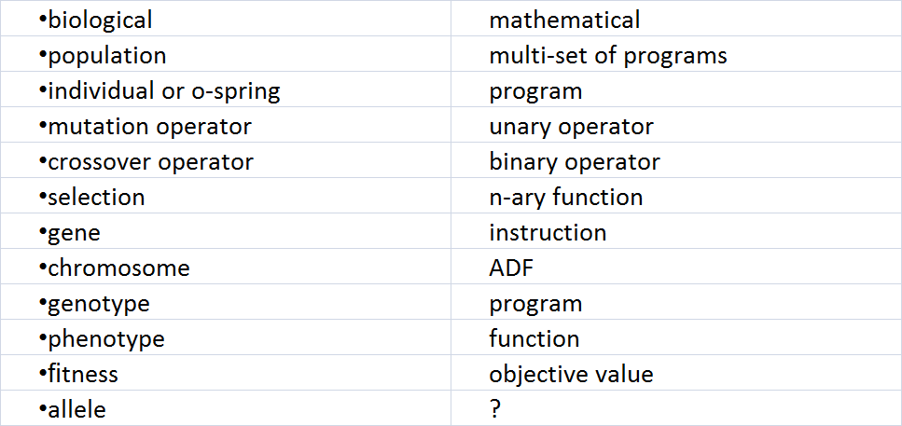
NON-BIOLOGICAL DESCRIPTION

Slide 15
NON-BIOLOGICAL DESCRIPTION

Slide 16
GP - CROSSOVER
Example Evolving a Word processor (wp)
Template Font-hotkeys-input method
WP1 arial-windows-dasher
WP2 courier-unix-voice
Child1 courier-windows-voice (viable variation)
Child2 voice-arial-unix (unviable variation)
The “purpose” of crossover is to “safely” search the sub-space of viable combinations -off-spring.
It is not the position of the code, but the context!
Notes:
Can we write a grant proposal on context GP – like poli one point crossover?
We can call this functional alignment.
It ls like the credit assigmnmet problem.

Slide 17
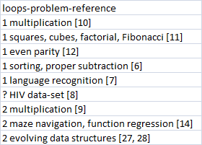
NUMBER OF LOOPS - EVOLVED PROGRAMS

Slide 18
NUMBER OF LOOPS - EVOLVED PROGRAMS
Notes:
I need to defend ymy self if we only need one loop
If I turn this into a jouranl article – I could impement this myslef.
Can I do the multiplcaiotn problem with my look up table methods.

Slide 19
MANIPULATING SYNTAX
How can “random” changes in syntax bring about meaningful changes in semantics?
We are ignoring the mapping between programs and functions.
Given two operators and two function sets most GP researchers would not know which combination would be better.
This interplay is what defines the landscape and ultimately the success of GP.
Notes:
Given two function sets {nand, or} and {not, or and, nor} most GP researchers would not know which of a pair of operators would be better. This interplay is what defines the landscape and ultimately the success of GP.
This interplay is what defines the landscape and ultimately the success of GP.
AND WE ARE FRRE TO CHOOSE BOTH

Slide 20
THOUGHT EXPERIMENT
As a programmer – you understand the semantics of the function set e.g. {+, -, *, /}.
Imagine you were “semantically blind” and were only dealing with “arbitrarily labeled functions” {jiggle, wiggle, boggle, diddle}.
In your favorite GP algorithm, the crossover component is replaced by you the “semantically blind programmer”.
Notes:
The tme for a human to write a prog is the depth of the sarch space
The search time is the size!!!! Of th esearh space.
!!!!this is importatn!!!!!

Slide 21
STOCASTIC SEARCH FOR NON-STOCASTIC PROBLEMS
Many of the problems tackled in the literature (for Turing Complete GP) are not stochastic
E.g. sorting, multiplication, even parity.
These are not even noise problems.
Similar to situation with artificial neural networks and support vector machines.
Would you trust a method that gave you a different answer each time?

Slide 22
SUMMARY
Biology
genetic code
Crossover – primary search operator
limits of natural evolution.
evolution is deceptively successful.
Genetic Programming
Non-biological description (mathematical)
Crossover – unsuitable?
number of loops in evolved programs (very few!)

